Slide 1
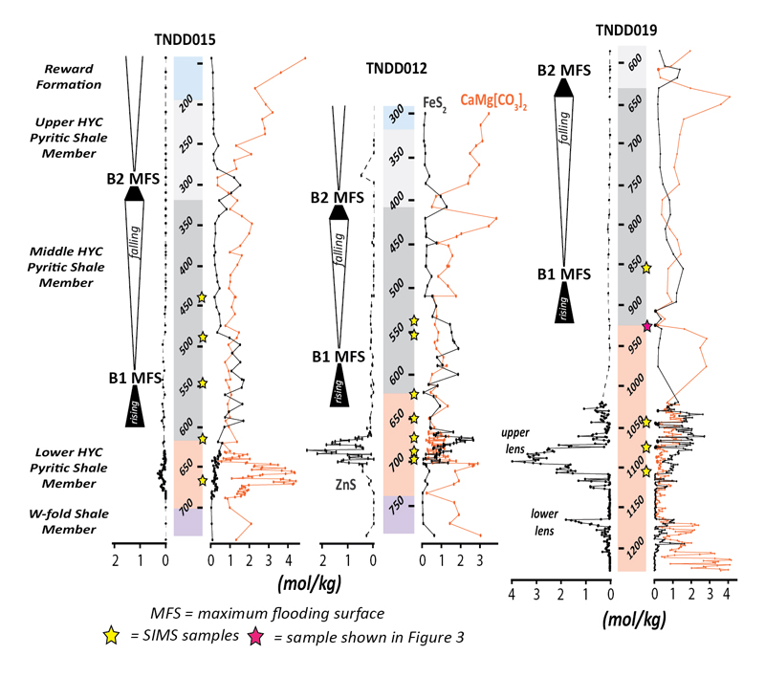
Magnall et al.
Massive sulfide Zn deposits in the Proterozoic did not require euxinia
Figure 1 Chemostratigraphic sections of the Barney Creek Formation from 3 drill holes of the Teena sub-basin. Sequence stratigraphic relationships correspond with the regional framework in Kunzmann et al., (2019). See Supplementary Information for further details.
© 2020 The Authors
Published by the European Association of Geochemistry
under Creative Commons License CC BY-NC-ND.
Magnall et al. (2020) Geochem. Persp. Let. 13, 19-24 | doi: 10.7185/geochemlet.2008
Notes:
Figure 1 Chemostratigraphic sections of the Barney Creek Formation from 3 drill holes of the Teena sub-basin. Sequence stratigraphic relationships correspond with the regional framework in Kunzmann et al., (2019). See Supplementary Information for further details.

