Slide 1
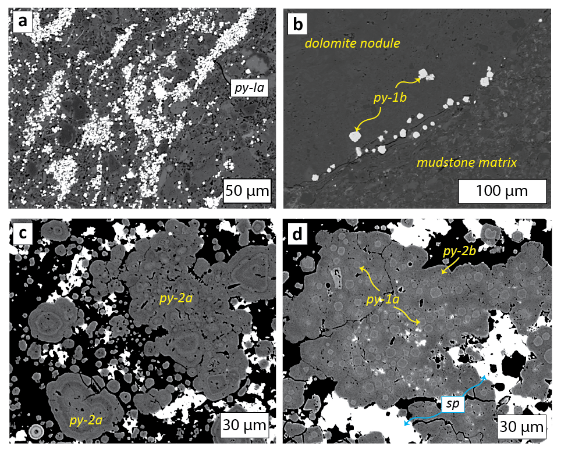
Magnall et al.
Massive sulfide Zn deposits in the Proterozoic did not require euxinia
Figure 2 (a) Aggregates of py-1a within organic rich mudstone matrix. (b) Euhedral py-1b crystals within and around carbonate nodule. (c) Zoned aggregates of py-2a. (d) Aggregate of py-1a overgrown by py-2b.
© 2020 The Authors
Published by the European Association of Geochemistry
under Creative Commons License CC BY-NC-ND.
Magnall et al. (2020) Geochem. Persp. Let. 13, 19-24 | doi: 10.7185/geochemlet.2008
Notes:
Figure 2 (a) Aggregates of py-1a within organic rich mudstone matrix. (b) Euhedral py-1b crystals within and around carbonate nodule. (c) Zoned aggregates of py-2a. (d) Aggregate of py-1a overgrown by py-2b.

