Slide 1
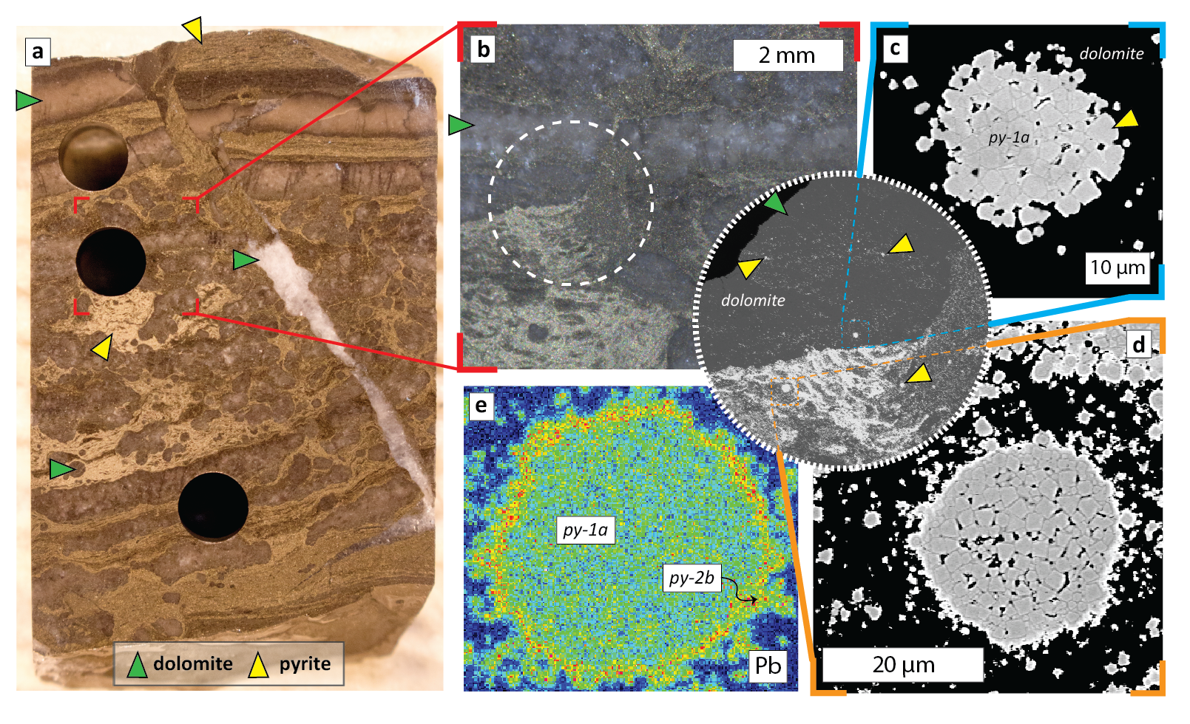
Magnall et al.
Massive sulfide Zn deposits in the Proterozoic did not require euxinia
Figure 3 (a) Thin section block of sample selected for SIMS analysis (mineralised interval @ 925 m in 019; see Fig. 1). (b) Binocular photomicrograph of area selected for micro-drilling and inset showing a backscatter electron (BSE) image of the sample. Notice py-1a contained within dolomite nodule, indicating a pre-nodule origin. (c,d) BSE images of pyrite from the inset in (b). (e) Electron dispersive X-ray (EDX) false colour image, showing Pb enrichment (warm colours) in the fuzzy py-2b overgrowth.
© 2020 The Authors
Published by the European Association of Geochemistry
under Creative Commons License CC BY-NC-ND.
Magnall et al. (2020) Geochem. Persp. Let. 13, 19-24 | doi: 10.7185/geochemlet.2008
Notes:
Figure 3 (a) Thin section block of sample selected for SIMS analysis (mineralised interval @ 925 m in 019; see Fig. 1). (b) Binocular photomicrograph of area selected for micro-drilling and inset showing a backscatter electron (BSE) image of the sample. Notice py-1a contained within dolomite nodule, indicating a pre-nodule origin. (c,d) BSE images of pyrite from the inset in (b). (e) Electron dispersive X-ray (EDX) false colour image, showing Pb enrichment (warm colours) in the fuzzy py-2b overgrowth.

