Slide 1
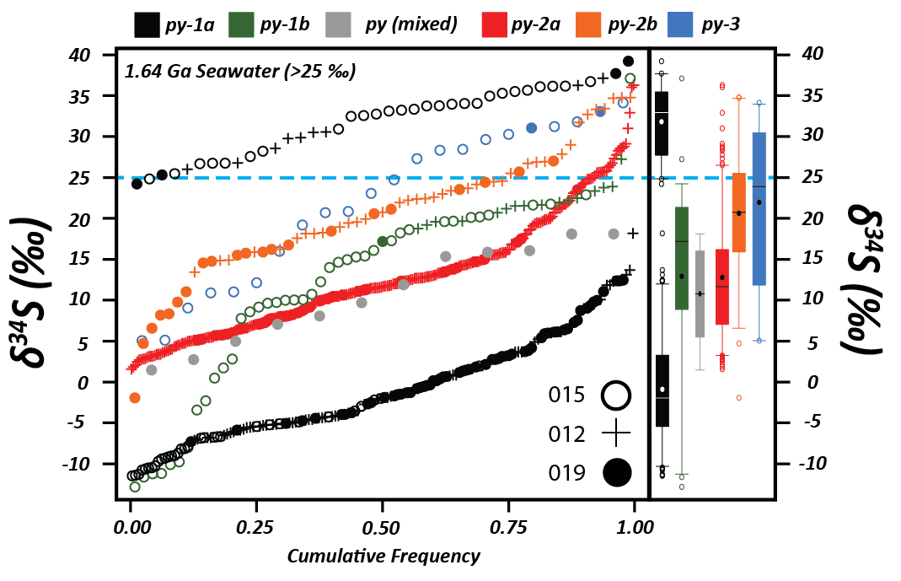
Magnall et al.
Massive sulfide Zn deposits in the Proterozoic did not require euxinia
Figure 4 A cumulative frequency diagram of δ³⁴S values of all stages of the pyrite paragenesis. The sub-group of highly positive δ³⁴S_{py-1a} values is from samples from the high abundance interval. Mixed analyses where the analysis was of adjoining py-1 and 2 grains = py (mixed). The blue dashed line represents a minimum value for 1.64 Ga seawater sulfate (Li et al., 2015).
© 2020 The Authors
Published by the European Association of Geochemistry
under Creative Commons License CC BY-NC-ND.
Magnall et al. (2020) Geochem. Persp. Let. 13, 19-24 | doi: 10.7185/geochemlet.2008
Notes:
Figure 4 A cumulative frequency diagram of δ³⁴S values of all stages of the pyrite paragenesis. The sub-group of highly positive δ³⁴S_{py-1a} values is from samples from the high abundance interval. Mixed analyses where the analysis was of adjoining py-1 and 2 grains = py (mixed). The blue dashed line represents a minimum value for 1.64 Ga seawater sulfate (Li et al., 2015).

