Slide 1
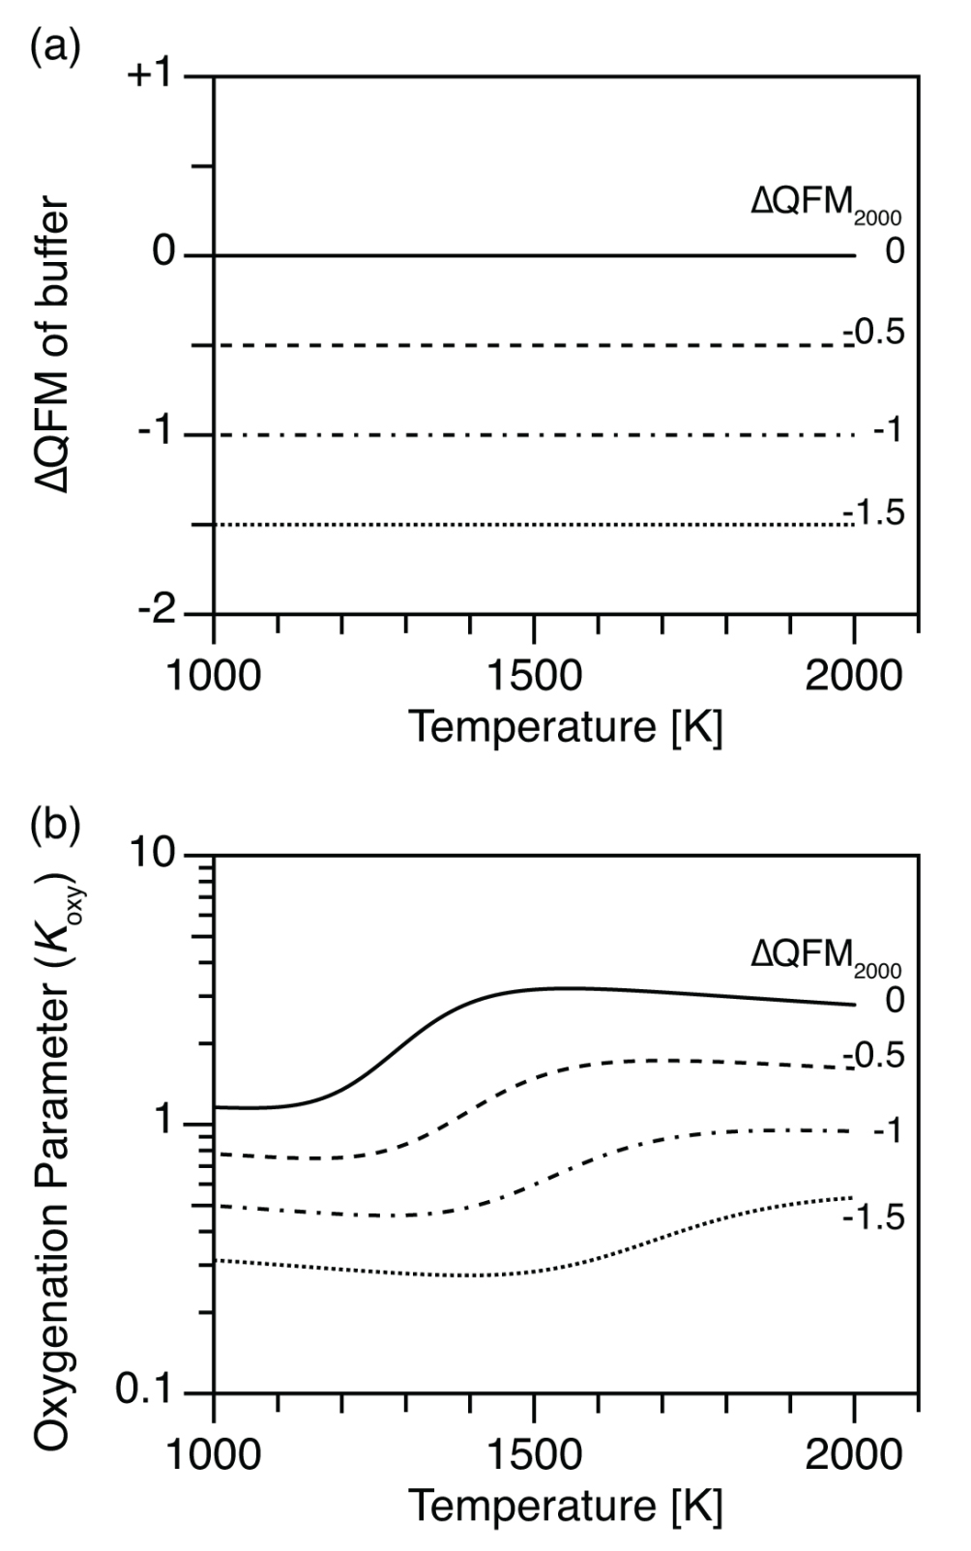
Kadoya et al.
Mantle cooling causes more reducing volcanic gases and gradual reduction of the atmosphere
Figure 1 (a) Oxidation state (ΔQFM) buffering volcanic gas composition, and (b) oxygenation parameter (K_{oxy}), as a function of temperature. Here, we assume a system where gases are redox buffered by the surrounding melt and rocks. ΔQFM₂₀₀₀ represents the oxidation state at 2000 K. By definition, ΔQFM is independent of temperature and equal to ΔQFM₂₀₀₀ in (a) whereas cooling tends to decrease K_{oxy} in (b).
© 2020 The Authors
Published by the European Association of Geochemistry
under Creative Commons License CC BY-NC-ND.
Kadoya et al. (2020) Geochem. Persp. Let. 13, 25-29 | doi: 10.7185/geochemlet.2009
Notes:
Figure 1 (a) Oxidation state (ΔQFM) buffering volcanic gas composition, and (b) oxygenation parameter (K_{oxy}), as a function of temperature. Here, we assume a system where gases are redox buffered by the surrounding melt and rocks. ΔQFM₂₀₀₀ represents the oxidation state at 2000 K. By definition, ΔQFM is independent of temperature and equal to ΔQFM₂₀₀₀ in (a) whereas cooling tends to decrease K_{oxy} in (b).

