Slide 1
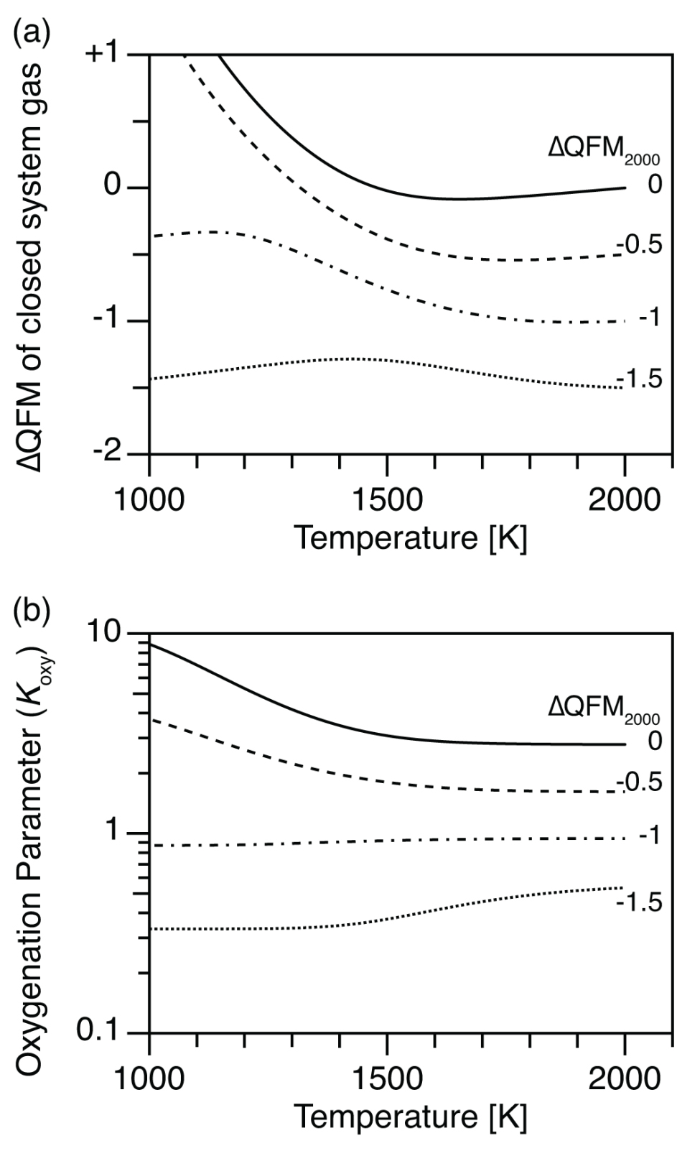
Kadoya et al.
Mantle cooling causes more reducing volcanic gases and gradual reduction of the atmosphere
Figure 2 (a) Oxidation state (ΔQFM), and (b) oxygenation parameter (K_{oxy}), as a function of temperature. Here, we assume a closed system of gases, and the ΔQFM of the gases at 2000 K is denoted as ΔQFM₂₀₀₀. Cooling changes ΔQFM unlike the melt buffered case (Fig. 1a) and changes K_{oxy}. However, an initial K_{oxy} that exceeds unity remains >1 with cooling, and an initial K_{oxy} that is less than unity remains <1.
© 2020 The Authors
Published by the European Association of Geochemistry
under Creative Commons License CC BY-NC-ND.
Kadoya et al. (2020) Geochem. Persp. Let. 13, 25-29 | doi: 10.7185/geochemlet.2009
Notes:
Figure 2 (a) Oxidation state (ΔQFM), and (b) oxygenation parameter (K_{oxy}), as a function of temperature. Here, we assume a closed system of gases, and the ΔQFM of the gases at 2000 K is denoted as ΔQFM₂₀₀₀. Cooling changes ΔQFM unlike the melt buffered case (Fig. 1a) and changes K_{oxy}. However, an initial K_{oxy} that exceeds unity remains >1 with cooling, and an initial K_{oxy} that is less than unity remains <1.

