Slide 1
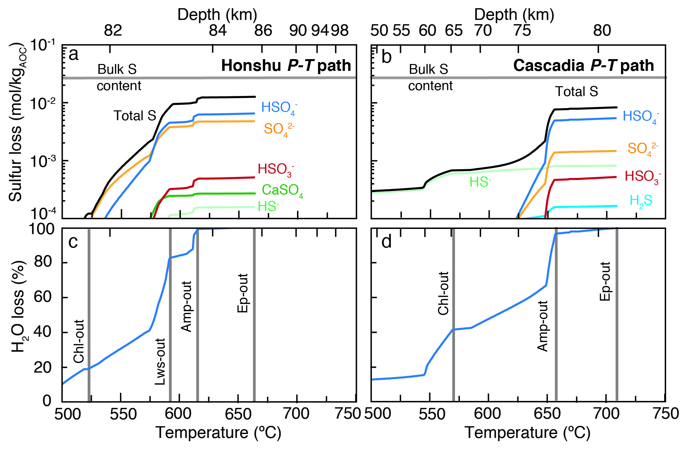
Walters et al.
Sulfur loss from subducted altered oceanic crust and implications for mantle oxidation
Figure 3 Cumulative sulfur (a,b) and fluid (c,d) loss diagrams for fluids fractionated along the Honshu and Cascadia P-T paths. Both temperature and corresponding slab top depth are plotted on the x-axis. Key dehydration reactions are shown for reference.
© 2020 The Authors
Published by the European Association of Geochemistry
under Creative Commons License CC BY-NC-ND.
Walters et al. (2020) Geochem. Persp. Let. 13, 36-41 | doi: 10.7185/geochemlet.2011
Notes:
Figure 3 Cumulative sulfur (a,b) and fluid (c,d) loss diagrams for fluids fractionated along the Honshu and Cascadia P-T paths. Both temperature and corresponding slab top depth are plotted on the x-axis. Key dehydration reactions are shown for reference.

