Slide 1
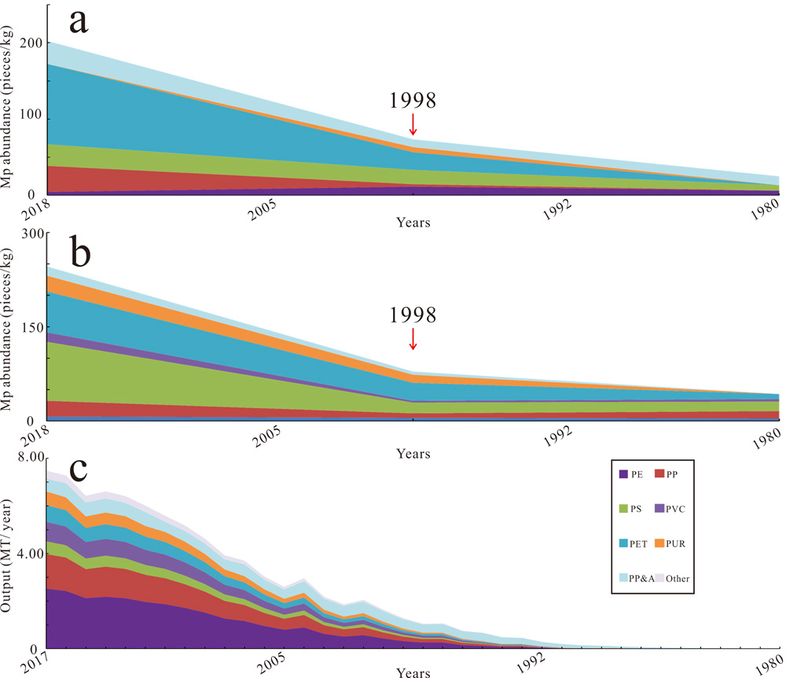
Chen et al.
Forty-year pollution history of microplastics in the largest marginal sea of the western Pacific
Figure 2 Microplastic abundance and composition in the northern SCS and the primary plastic output of Guangdong plastic industries. (a) Microplastic abundance and composition in Xisha Trough during 1980-2018. (b) Microplastic abundance and composition in the continental shelf during 1980-2018. (c) Output and composition of primary plastic during 1980-2017. The output data origin from the National Bureau of Statics of China, Annual Data of Guangdong Province (http://data.stats.gov.cn/easyquery.htm?cn=C01). The composition of primary plastic was calculated according to Geyer et al. (2017). PE-polyethylene, PP-polypropylene, PS-polystyrene, PVC-polyvinyl chloride, PET-polyethylene terephthalate, PUR-polyurethane, PP&A includes polyester, polyamide, rayon and acrylic.
© 2020 The Authors
Published by the European Association of Geochemistry
under Creative Commons License CC BY-NC-ND.
Chen et al. (2020) Geochem. Persp. Let. 13, 42-47 | doi: 10.7185/geochemlet.2012
Notes:
Figure 2 Microplastic abundance and composition in the northern SCS and the primary plastic output of Guangdong plastic industries. (a) Microplastic abundance and composition in Xisha Trough during 1980-2018. (b) Microplastic abundance and composition in the continental shelf during 1980-2018. (c) Output and composition of primary plastic during 1980-2017. The output data origin from the National Bureau of Statics of China, Annual Data of Guangdong Province (http://data.stats.gov.cn/easyquery.htm?cn=C01). The composition of primary plastic was calculated according to Geyer et al. (2017). PE-polyethylene, PP-polypropylene, PS-polystyrene, PVC-polyvinyl chloride, PET-polyethylene terephthalate, PUR-polyurethane, PP&A includes polyester, polyamide, rayon and acrylic.

