Slide 1
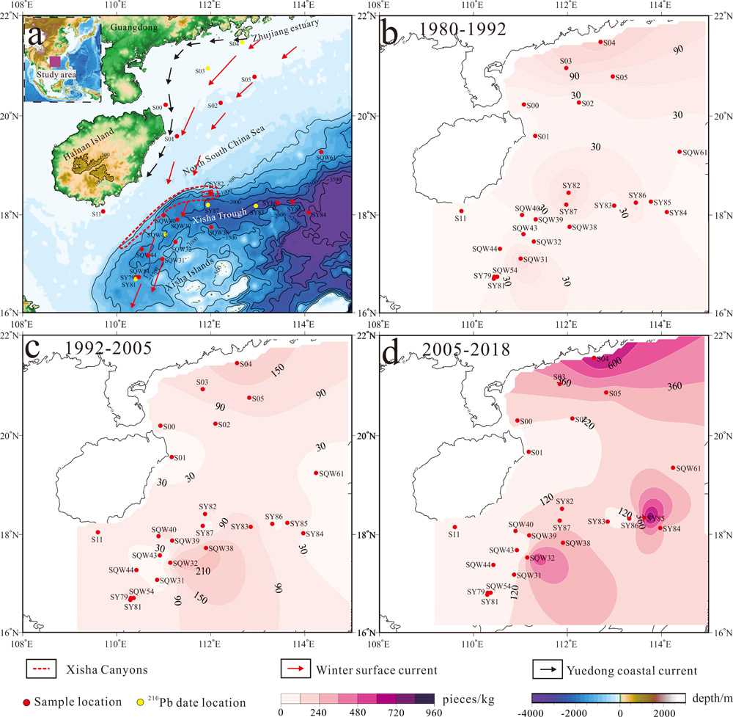
Chen et al.
Forty-year pollution history of microplastics in the largest marginal sea of the western Pacific
Figure 3 Contour maps of microplastic abundance (pieces/kg) in the sediments of the northern SCS. (a) The sample location of the study area (details in Table S-1). (b) Microplastic abundance in 1980-1992. (c) Microplastic abundance in 1992-2005. (d) Microplastic abundance in 2005-2018. The red rectangle in (a) shows the position of a large dump of plastics found by Peng et al. (2019). The black arrows indicate the Yuedong coastal current, while red arrows are for winter surface circulation pathways of the northern SCS that may potentially influence the transportation of microplastics in the water column of the continental shelf (Fang et al., 1998).
© 2020 The Authors
Published by the European Association of Geochemistry
under Creative Commons License CC BY-NC-ND.
Chen et al. (2020) Geochem. Persp. Let. 13, 42-47 | doi: 10.7185/geochemlet.2012
Notes:
Figure 3 Contour maps of microplastic abundance (pieces/kg) in the sediments of the northern SCS. (a) The sample location of the study area (details in Table S-1). (b) Microplastic abundance in 1980-1992. (c) Microplastic abundance in 1992-2005. (d) Microplastic abundance in 2005-2018. The red rectangle in (a) shows the position of a large dump of plastics found by Peng et al. (2019). The black arrows indicate the Yuedong coastal current, while red arrows are for winter surface circulation pathways of the northern SCS that may potentially influence the transportation of microplastics in the water column of the continental shelf (Fang et al., 1998).

