Slide 1
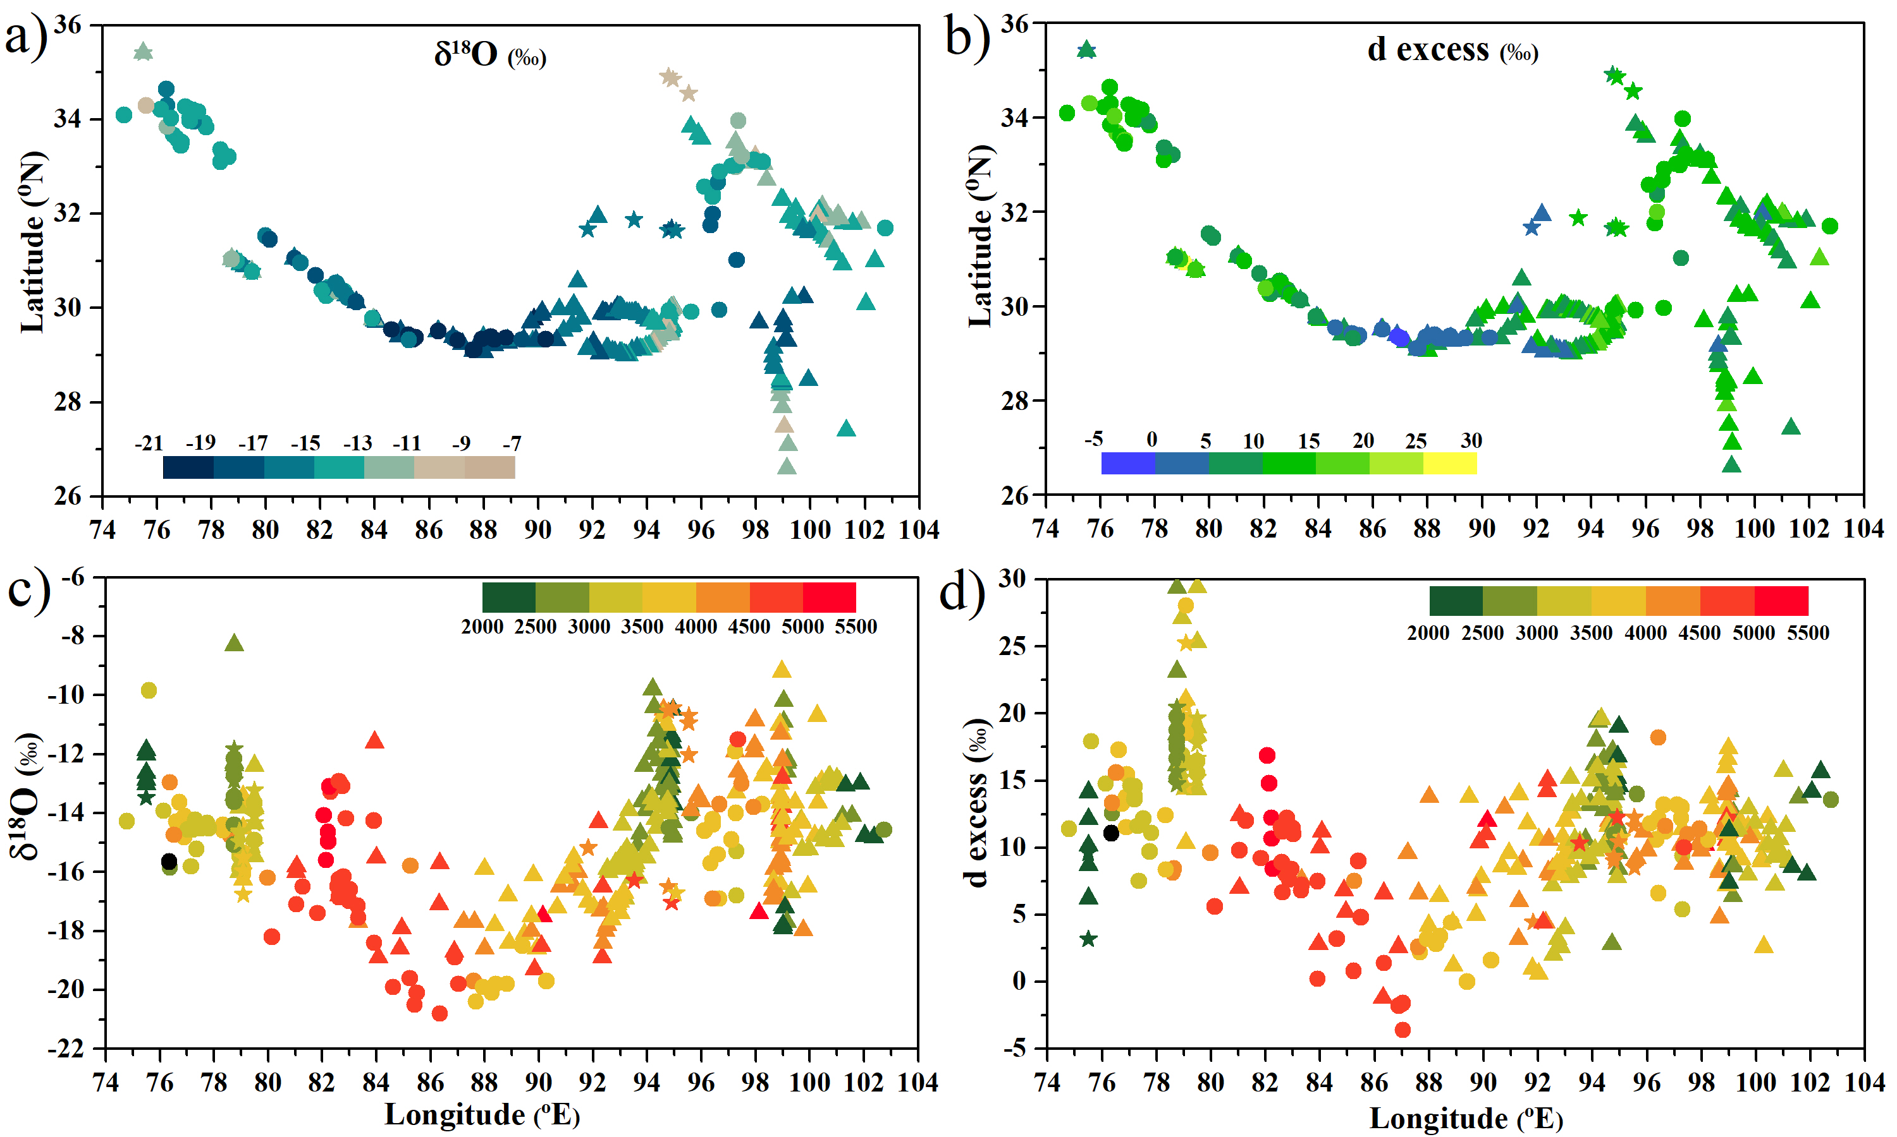
Boral and Sen
Tracing ‘Third Pole’ ice meltwater contribution to the Himalayan rivers using oxygen and hydrogen isotopes
Figure 1 Variability of (a) δ¹⁸O and (b) d excess of riverwater samples across the Himalayan region. Elevation-wise variability of (c) δ¹⁸O and (d) d excess (colour coded, in metres a.m.s.l). Pre-monsoon samples are represented by triangles, monsoon samples by circles and post-monsoon samples by star symbols.
© 2020 The Authors
Published by the European Association of Geochemistry
under Creative Commons License CC BY-NC-ND.
Boral and Sen (2020) Geochem. Persp. Let. 13, 48-53 | doi: 10.7185/geochemlet.2013
Notes:
Figure 1 Variability of (a) δ¹⁸O and (b) d excess of riverwater samples across the Himalayan region. Elevation-wise variability of (c) δ¹⁸O and (d) d excess (colour coded, in metres a.m.s.l). Pre-monsoon samples are represented by triangles, monsoon samples by circles and post-monsoon samples by star symbols.

