Slide 1
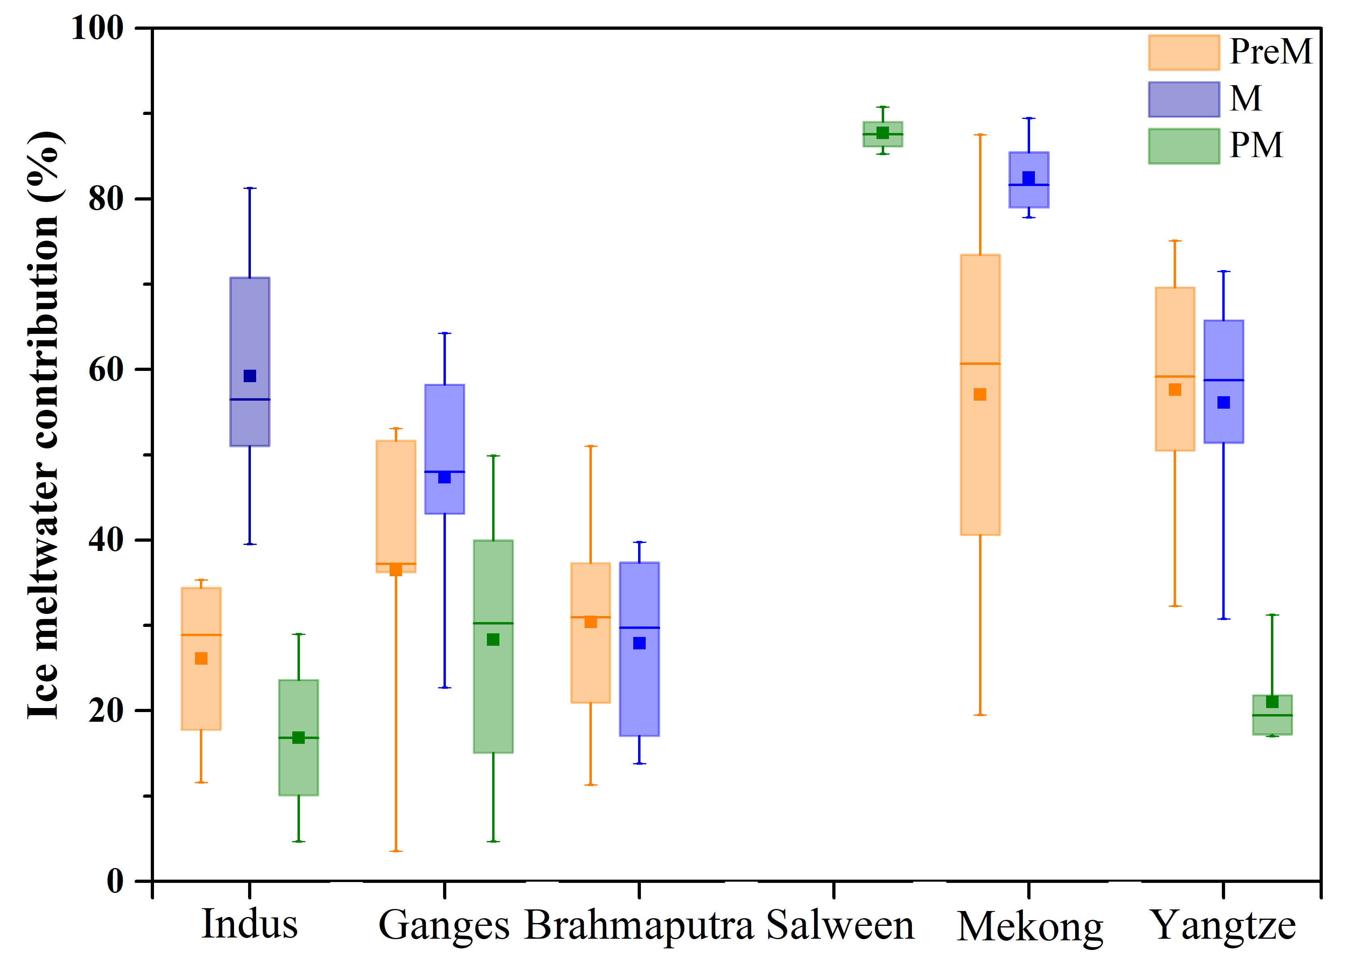
Boral and Sen
Tracing ‘Third Pole’ ice meltwater contribution to the Himalayan rivers using oxygen and hydrogen isotopes
Figure 2 Variability of ice meltwater contribution (in %) to the total river flow of Indus, Ganges, Brahmaputra, Mekong, and Yangtze rivers in pre-monsoon (Pre-M), monsoon (M) and post-monsoon (PM) months. Whisker plots show mean (filled square), median (thick line) interquartile range (shaded) and 5th to 95th percentile (whiskers) as minimum and maximum values.
© 2020 The Authors
Published by the European Association of Geochemistry
under Creative Commons License CC BY-NC-ND.
Boral and Sen (2020) Geochem. Persp. Let. 13, 48-53 | doi: 10.7185/geochemlet.2013
Notes:
Figure 2 Variability of ice meltwater contribution (in %) to the total river flow of Indus, Ganges, Brahmaputra, Mekong, and Yangtze rivers in pre-monsoon (Pre-M), monsoon (M) and post-monsoon (PM) months. Whisker plots show mean (filled square), median (thick line) interquartile range (shaded) and 5th to 95th percentile (whiskers) as minimum and maximum values.

