Slide 1
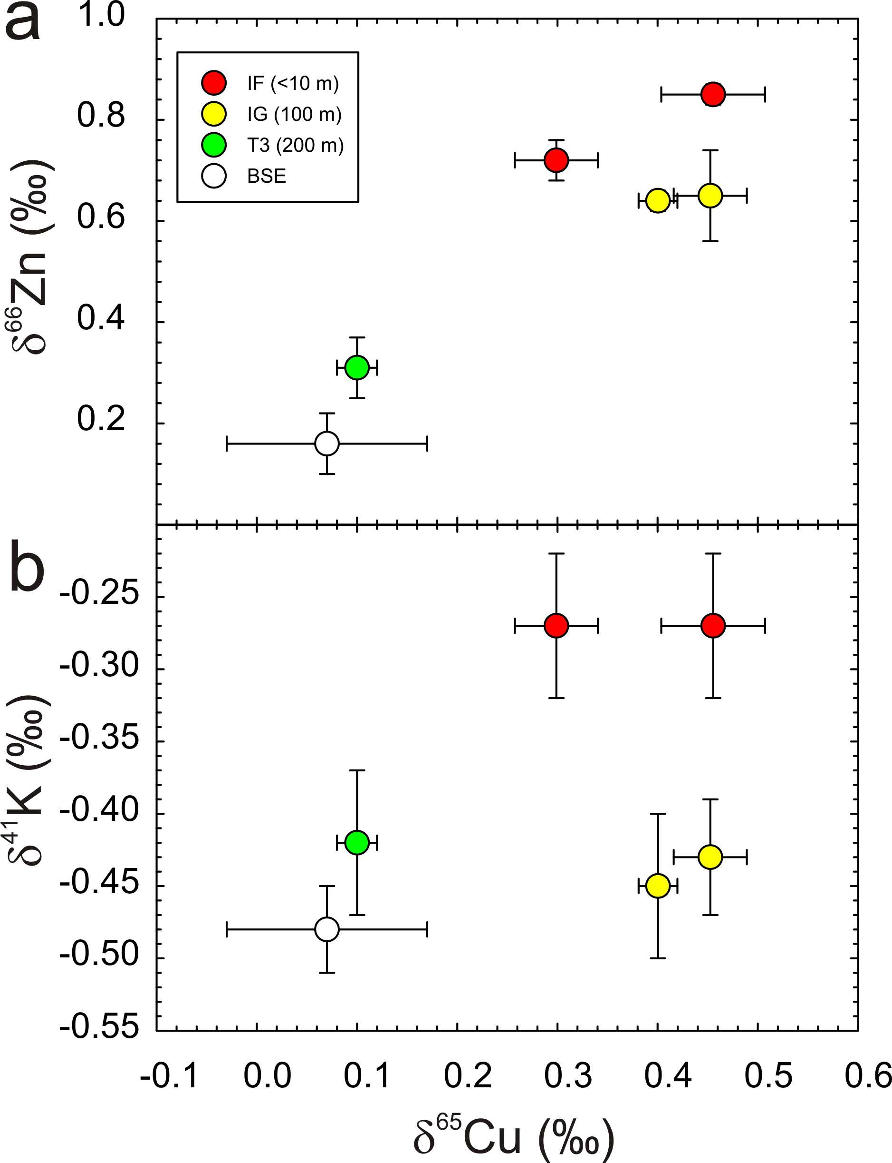
Day et al.
Moderately volatile element behaviour at high temperature determined from nuclear detonation
Figure 3 Copper versus (a) Zn and (b) K isotopes in trinitite. Zinc and K data for trinitites from Day et al. (2017) and Chen et al. (2019). BSE Cu, Zn and K values are from Moynier et al. (2017) and Wang and Jacobsen (2016).
© 2020 The Authors
Published by the European Association of Geochemistry
under Creative Commons License CC BY-NC-ND.
Day et al. (2020) Geochem. Persp. Let. 13, 54-60 | doi: 10.7185/geochemlet.2014
Notes:
Figure 3 Copper versus (a) Zn and (b) K isotopes in trinitite. Zinc and K data for trinitites from Day et al. (2017) and Chen et al. (2019). BSE Cu, Zn and K values are from Moynier et al. (2017) and Wang and Jacobsen (2016).

