Slide 1
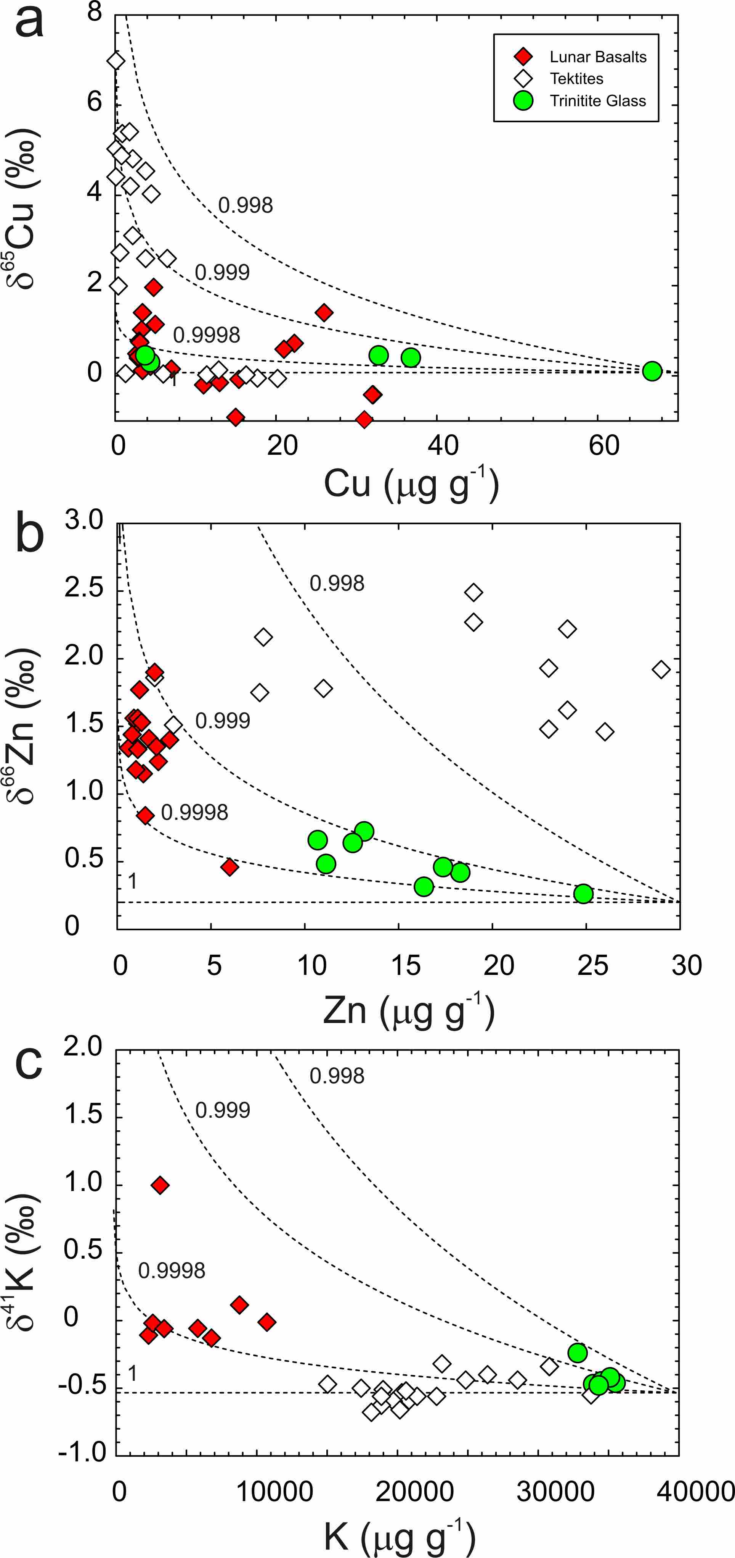
Day et al.
Moderately volatile element behaviour at high temperature determined from nuclear detonation
Figure 4 Rayleigh distillation curves versus (a) Cu, (b) Zn and (c) K contents and isotopic compositions for trinitite glass, tektites and lunar samples. Curves are shown for different alpha fractionation (α) factors (1, 0.9998, 0.999, 0.998) established from trinitite, with 70 µg g⁻¹ Cu, 30 µg g⁻¹ Zn and 40000 µg g⁻¹ K for estimated BSE isotopic compositions. Data are from this study, Day et al. (2017), and Chen et al. (2019) for trinitite. Tektite data are from Moynier et al. (2009, 2010), and Jiang et al. (2019), and lunar basalts data are from Paniello et al. (2012), Kato et al. (2015), and Wang and Jacobsen (2016) and references therein.
© 2020 The Authors
Published by the European Association of Geochemistry
under Creative Commons License CC BY-NC-ND.
Day et al. (2020) Geochem. Persp. Let. 13, 54-60 | doi: 10.7185/geochemlet.2014
Notes:
Figure 4 Rayleigh distillation curves versus (a) Cu, (b) Zn and (c) K contents and isotopic compositions for trinitite glass, tektites and lunar samples. Curves are shown for different alpha fractionation (α) factors (1, 0.9998, 0.999, 0.998) established from trinitite, with 70 µg g⁻¹ Cu, 30 µg g⁻¹ Zn and 40000 µg g⁻¹ K for estimated BSE isotopic compositions. Data are from this study, Day et al. (2017), and Chen et al. (2019) for trinitite. Tektite data are from Moynier et al. (2009, 2010), and Jiang et al. (2019), and lunar basalts data are from Paniello et al. (2012), Kato et al. (2015), and Wang and Jacobsen (2016) and references therein.

