Slide 1
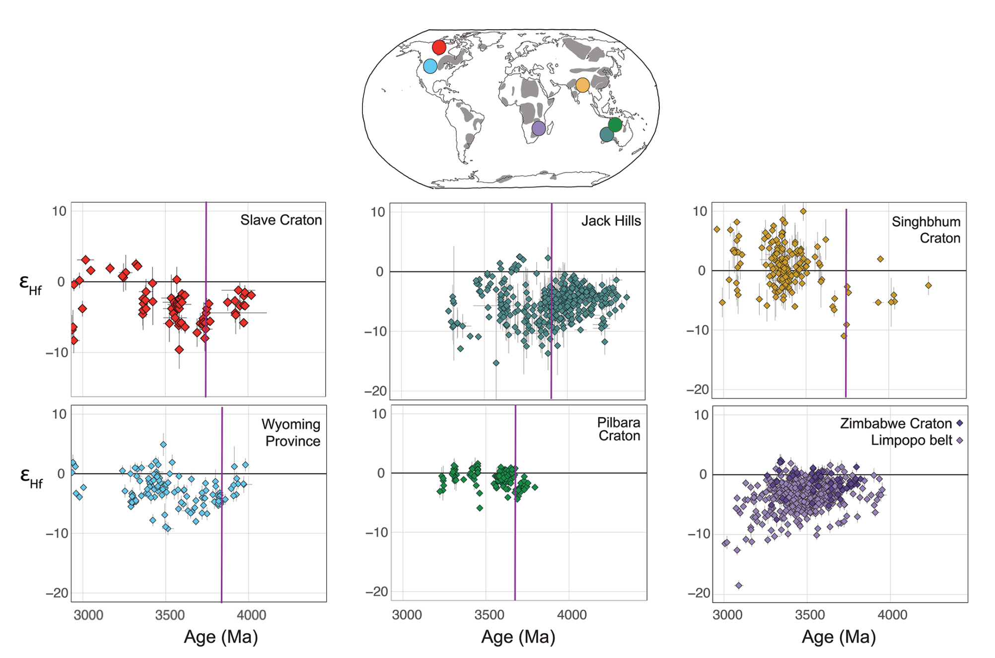
Bauer and Reimink et al.
Hafnium isotopes in zircons document the gradual onset of mobile-lid tectonics
Figure 1 Zircon U-Pb-Hf isotope datasets from globally distributed Archean cratons. The purple lines show the change-point analysis inflection point shifts, which are often older than the first appearance of juvenile ε_{Hf} values and the loss of Hadean protocrustal signals. While the Limpopo belt does not clearly document a similar trend, detrital zircons from the Zimbabwe Craton do (Fig. S-11; Bolhar et al., 2017).
© 2020 The Authors
Published by the European Association of Geochemistry
under Creative Commons License CC BY-NC-ND.
Bauer and Reimink et al. (2020) Geochem. Persp. Let. 14, 1-6 | doi: 10.7185/geochemlet.2015
Notes:
Figure 1 Zircon U-Pb-Hf isotope datasets from globally distributed Archean cratons. The purple lines show the change-point analysis inflection point shifts, which are often older than the first appearance of juvenile ε_{Hf} values and the loss of Hadean protocrustal signals. While the Limpopo belt does not clearly document a similar trend, detrital zircons from the Zimbabwe Craton do (Fig. S-11; Bolhar et al., 2017).

