Slide 1
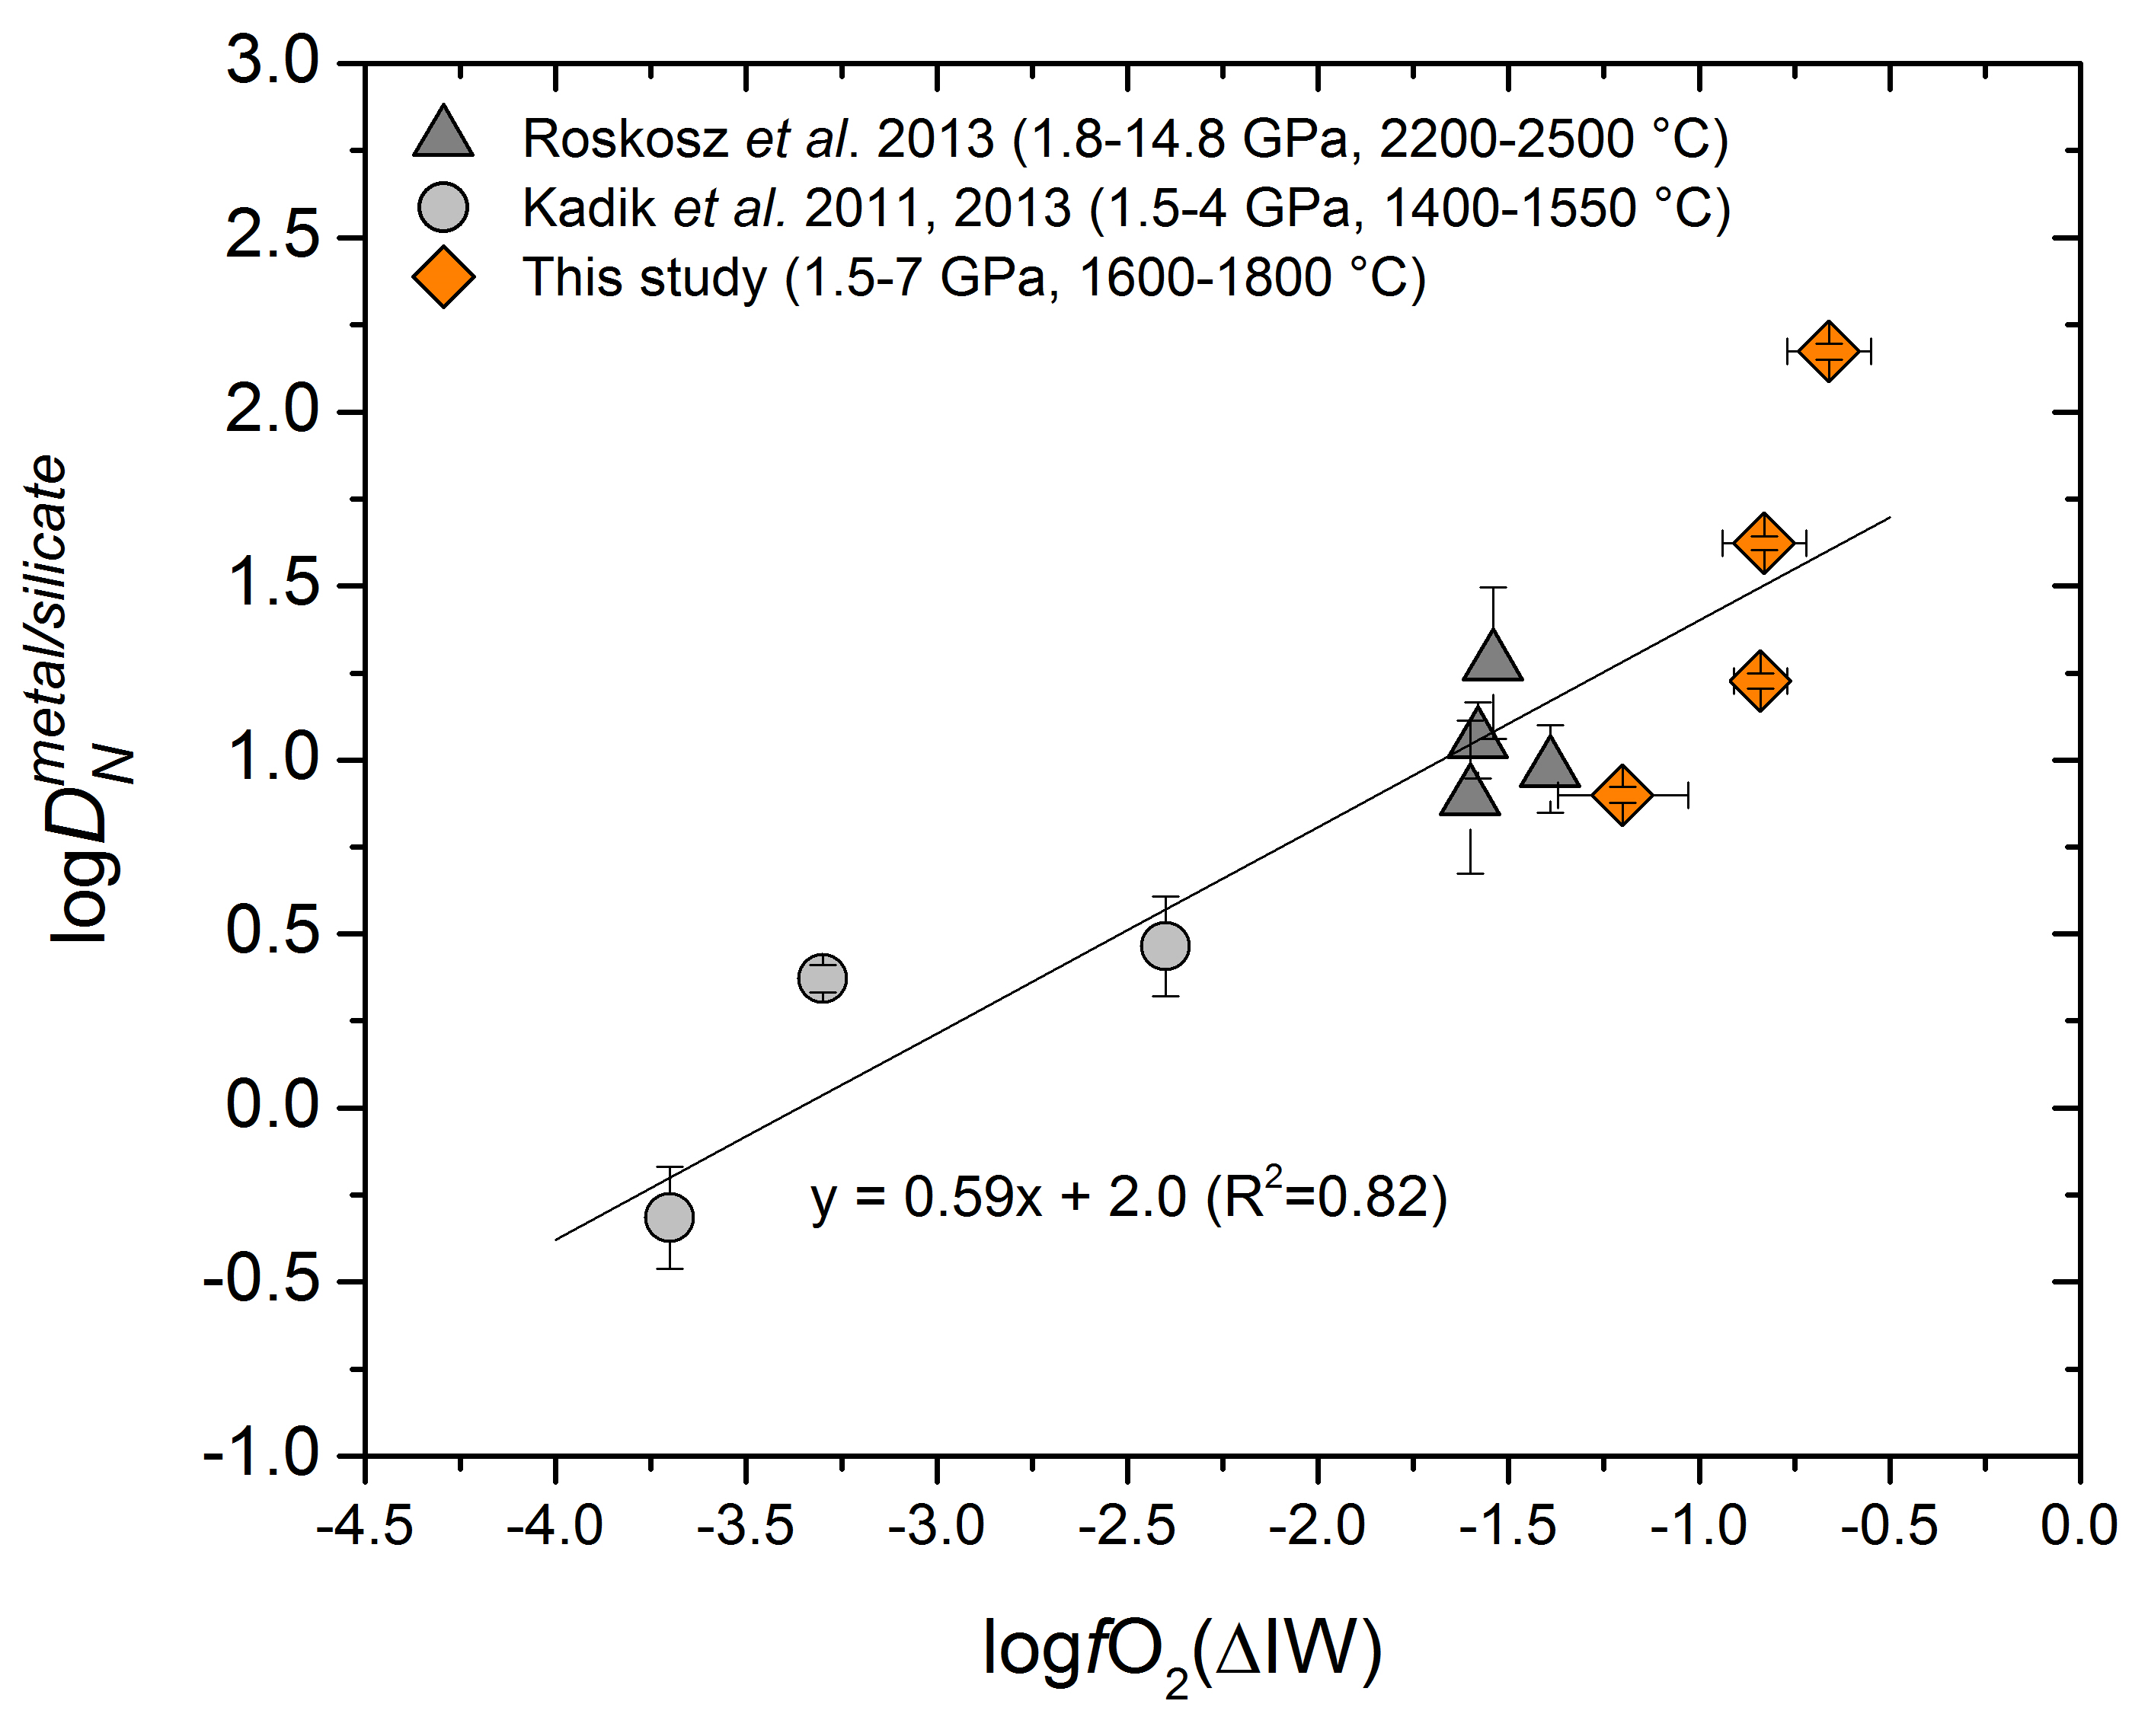
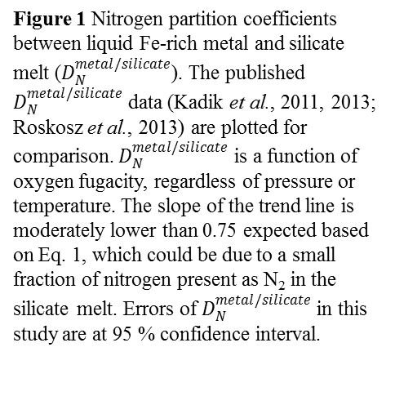
Li et al.
Nitrogen isotope fractionation during terrestrial core-mantle separation
Figure 1 Nitrogen partition coefficients between liquid Fe-rich metal and silicate melt ($D_{N}^{metal/silicate}$). The published $D_{N}^{metal/silicate}$ data (Kadik et al., 2011, 2013; Roskosz et al., 2013) are plotted for comparison. $D_{N}^{metal/silicate}$ is a function of oxygen fugacity, regardless of pressure or temperature. The slope of the trend line is moderately lower than 0.75 expected based on Eq. 1, which could be due to a small fraction of nitrogen present as N₂ in the silicate melt. Errors of $D_{N}^{metal/silicate}$ in this study are at 95 % confidence interval.
Li et al. (2016) Geochem. Persp. Let. 2, 138-147 | doi: 10.7185/geochemlet.1614
© 2016 European Association of Geochemistry
Notes:
Figure 1 Nitrogen partition coefficients between liquid Fe-rich metal and silicate melt ($D_{N}^{metal/silicate}$). The published $D_{N}^{metal/silicate}$ data (Kadik et al., 2011, 2013; Roskosz et al., 2013) are plotted for comparison. $D_{N}^{metal/silicate}$ is a function of oxygen fugacity, regardless of pressure or temperature. The slope of the trend line is moderately lower than 0.75 expected based on Eq. 1, which could be due to a small fraction of nitrogen present as N₂ in the silicate melt. Errors of $D_{N}^{metal/silicate}$ in this study are at 95 % confidence interval.

