Slide 1
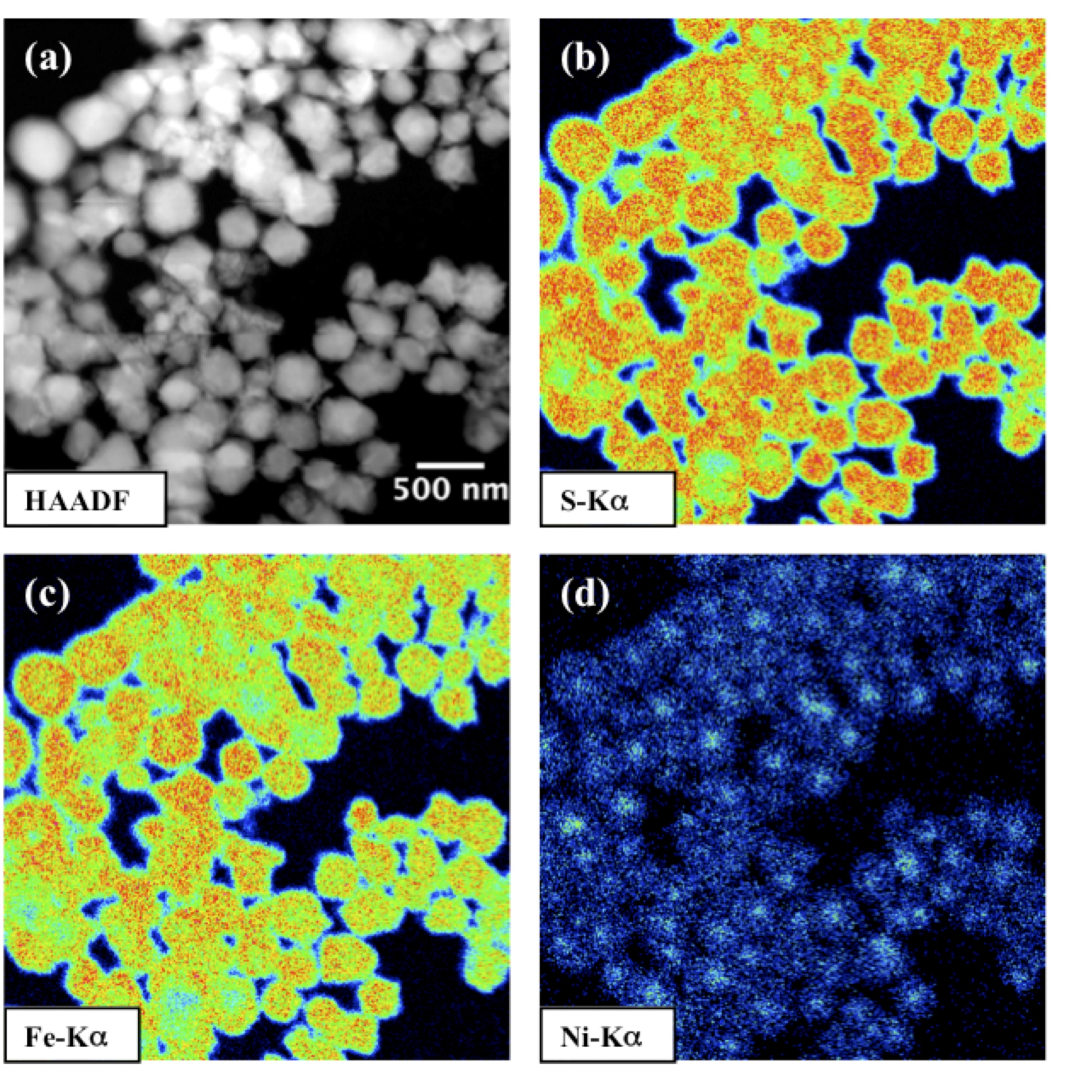
Morin et al.
Nickel accelerates pyrite nucleation at ambient temperature
Figure 3 Compositional zoning of the pyrite nanocrystals. STEM-HAADF images and TEM-EDXS mapping of the pyrite particles collected at 48 hr, from the experiment performed with aqueous Ni. Elemental maps show that Ni is preferentially located into the core of the pyrite crystals. Elemental abundances increase from blue to green and to red colours.
.
Morin et al. (2017) Geochem. Persp. Let. 5, 6-11 | doi: 10.7185/geochemlet.1738
© 2017 European Association of Geochemistry
Notes:
Figure 3 Compositional zoning of the pyrite nanocrystals. STEM-HAADF images and TEM-EDXS mapping of the pyrite particles collected at 48 hr, from the experiment performed with aqueous Ni. Elemental maps show that Ni is preferentially located into the core of the pyrite crystals. Elemental abundances increase from blue to green and to red colours.

