Slide 1
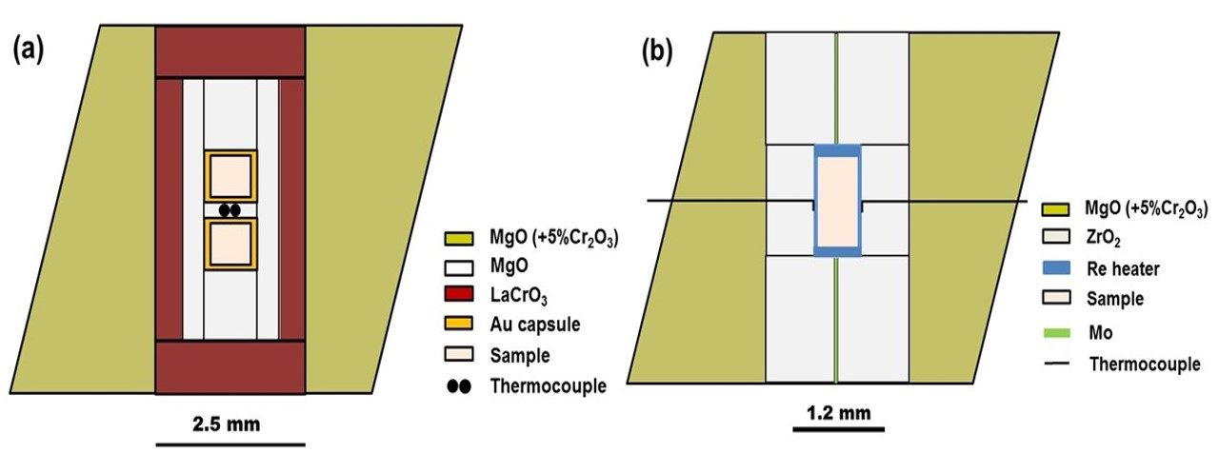
Liu et al.
Rapid decrease of MgAlO_{2.5} component in bridgmanite with pressure
Figure S-1 The schematic illustration of (a) 7/3 and (b) 5.7/1.5 cell assembly for high pressure and high temperature experiments.
Liu et al. (2017) Geochem. Persp. Let. 5, 12-18 | doi: 10.7185/geochemlet.1739
© 2017 European Association of Geochemistry
Notes:
Figure S-1 The schematic illustration of (a) 7/3 and (b) 5.7/1.5 cell assembly for high pressure and high temperature experiments.

