Slide 1
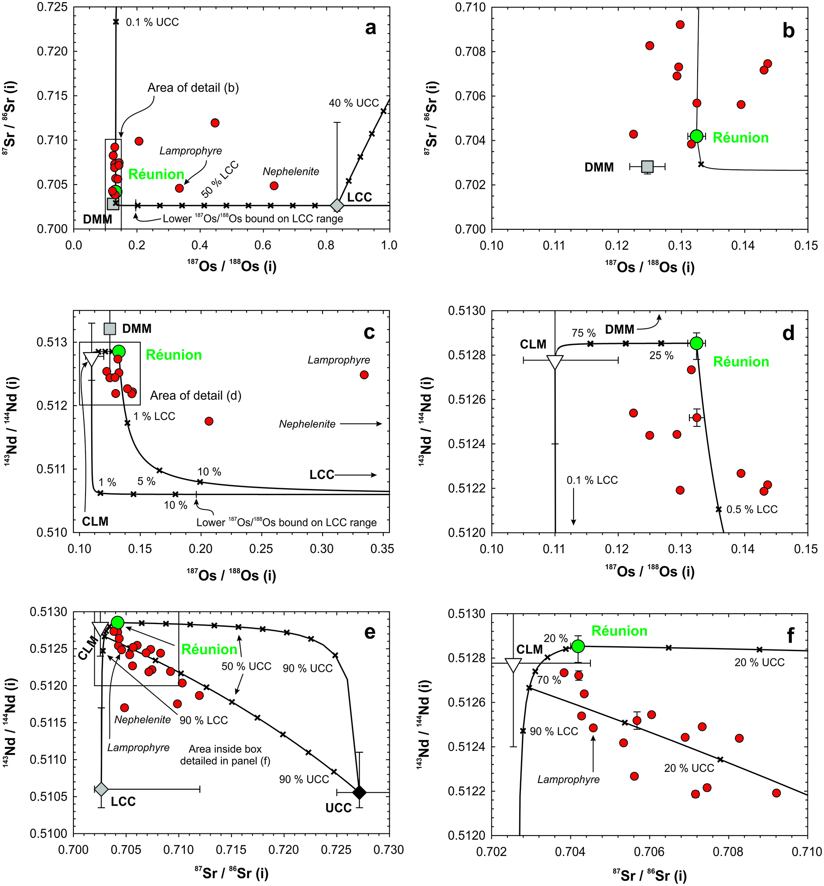
Peters and Day
A geochemical link between plume head and tail volcanism
Figure 3 (a,b) Strontium-osmium, (c,d) Nd-Os and (e,f) Sr-Nd isotopic variations for Deccan basalts plotted with a Réunion end member, crustal (LCC: lower continental crust, UCC: upper continental crust) and lithospheric assimilants as in Figure 2. Small ‘x’ marks denote 10 % mass intervals of mixing unless otherwise marked. In (e,f), a secondary mixing curve between a 20 % Réunion-80 % lower continental crust end member and an upper continental crust end member is shown to illustrate the effects of two stage crustal assimilation. …
Peters and Day (2017) Geochem. Persp. Let. 5, 29-34 | doi: 10.7185/geochemlet.1742
© 2017 European Association of Geochemistry
Notes:
Figure 3 (a,b) Strontium-osmium, (c,d) Nd-Os and (e,f) Sr-Nd isotopic variations for Deccan basalts plotted with a Réunion end member, crustal (LCC: lower continental crust, UCC: upper continental crust) and lithospheric assimilants as in Figure 2. Small ‘x’ marks denote 10 % mass intervals of mixing unless otherwise marked. In (e,f), a secondary mixing curve between a 20 % Réunion-80 % lower continental crust end member and an upper continental crust end member is shown to illustrate the effects of two stage crustal assimilation. For clarity, not all possible mixing arrays or end member compositions are shown in every panel. Model end members are given in Table S-4.

