Slide 1
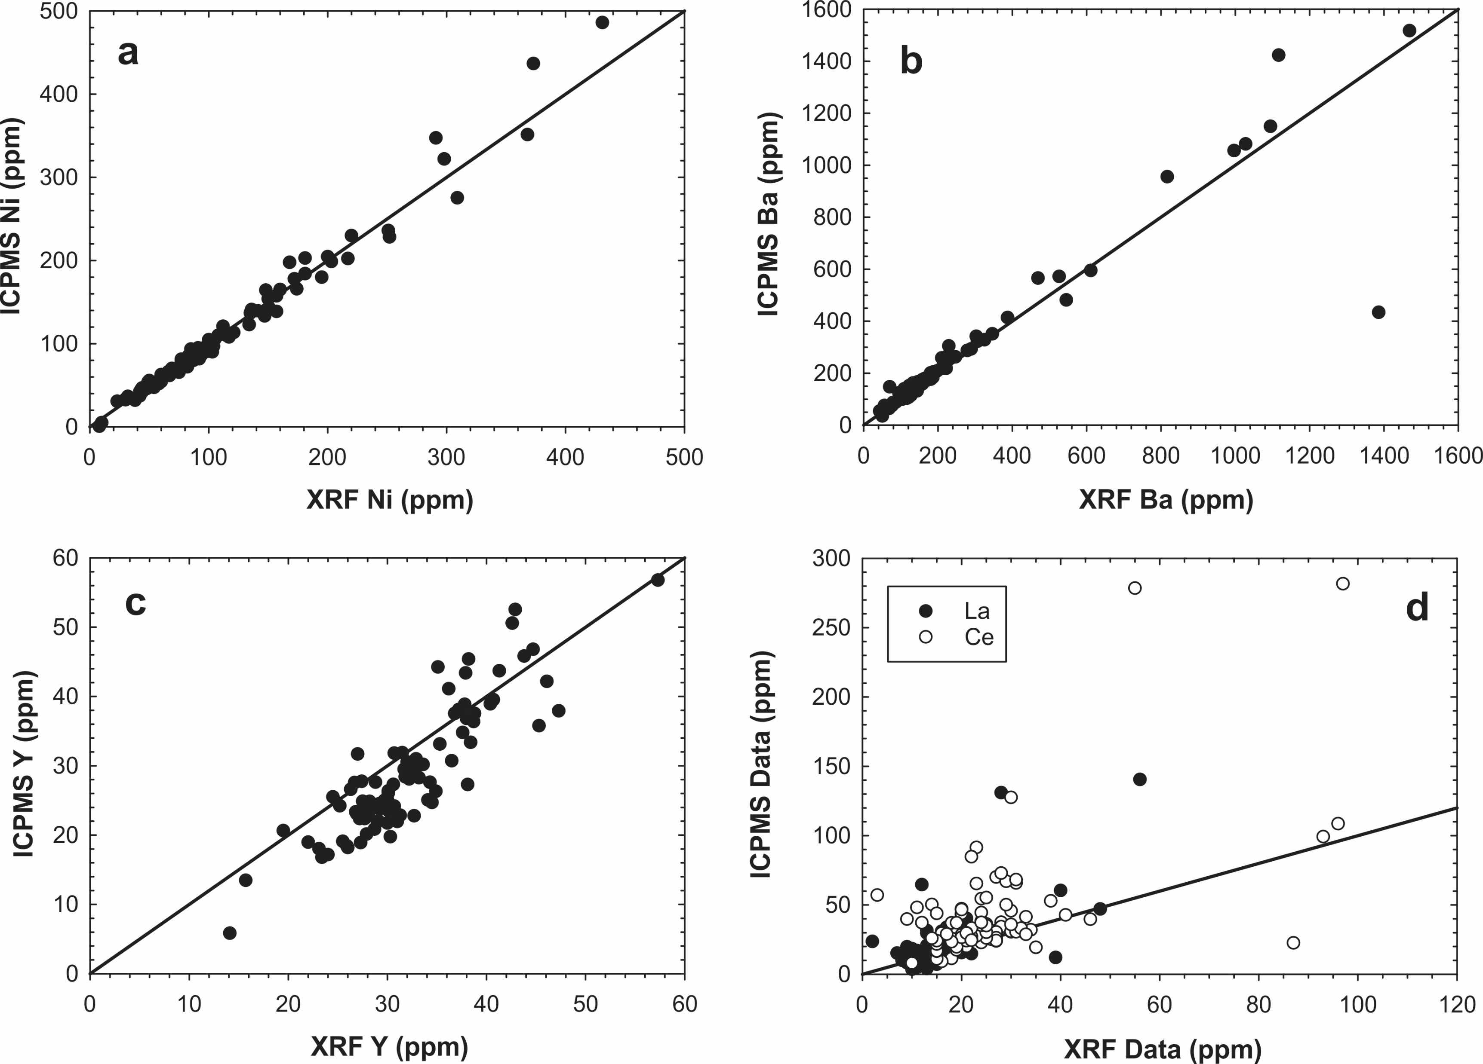
Peters and Day
A geochemical link between plume head and tail volcanism
Figure S-3 Comparison of trace element abundances obtained from XRF (x-axis) and ICPMS (y-axis) plotted with unity lines. Elements are selected to represent several types of relationships: (a) Ni, which shows a robust correlation near unity; (b) Ba, which shows a robust relationship slightly offset from unity; (c) Y, which shows a moderately robust relationship offset from unity; and (d) La and Ce, which show a poor relationship offset from unity. Only rare earth …
Peters and Day (2017) Geochem. Persp. Let. 5, 29-34 | doi: 10.7185/geochemlet.1742
© 2017 European Association of Geochemistry
Notes:
Figure S-3 Comparison of trace element abundances obtained from XRF (x-axis) and ICPMS (y-axis) plotted with unity lines. Elements are selected to represent several types of relationships: (a) Ni, which shows a robust correlation near unity; (b) Ba, which shows a robust relationship slightly offset from unity; (c) Y, which shows a moderately robust relationship offset from unity; and (d) La and Ce, which show a poor relationship offset from unity. Only rare earth elements and U, Th and Pb, the latter three of which are often below detection limits, fall into the last category. We use only the higher precision and accurate ICPMS REE, U, Th and Pb data in our discussion.

