Slide 1
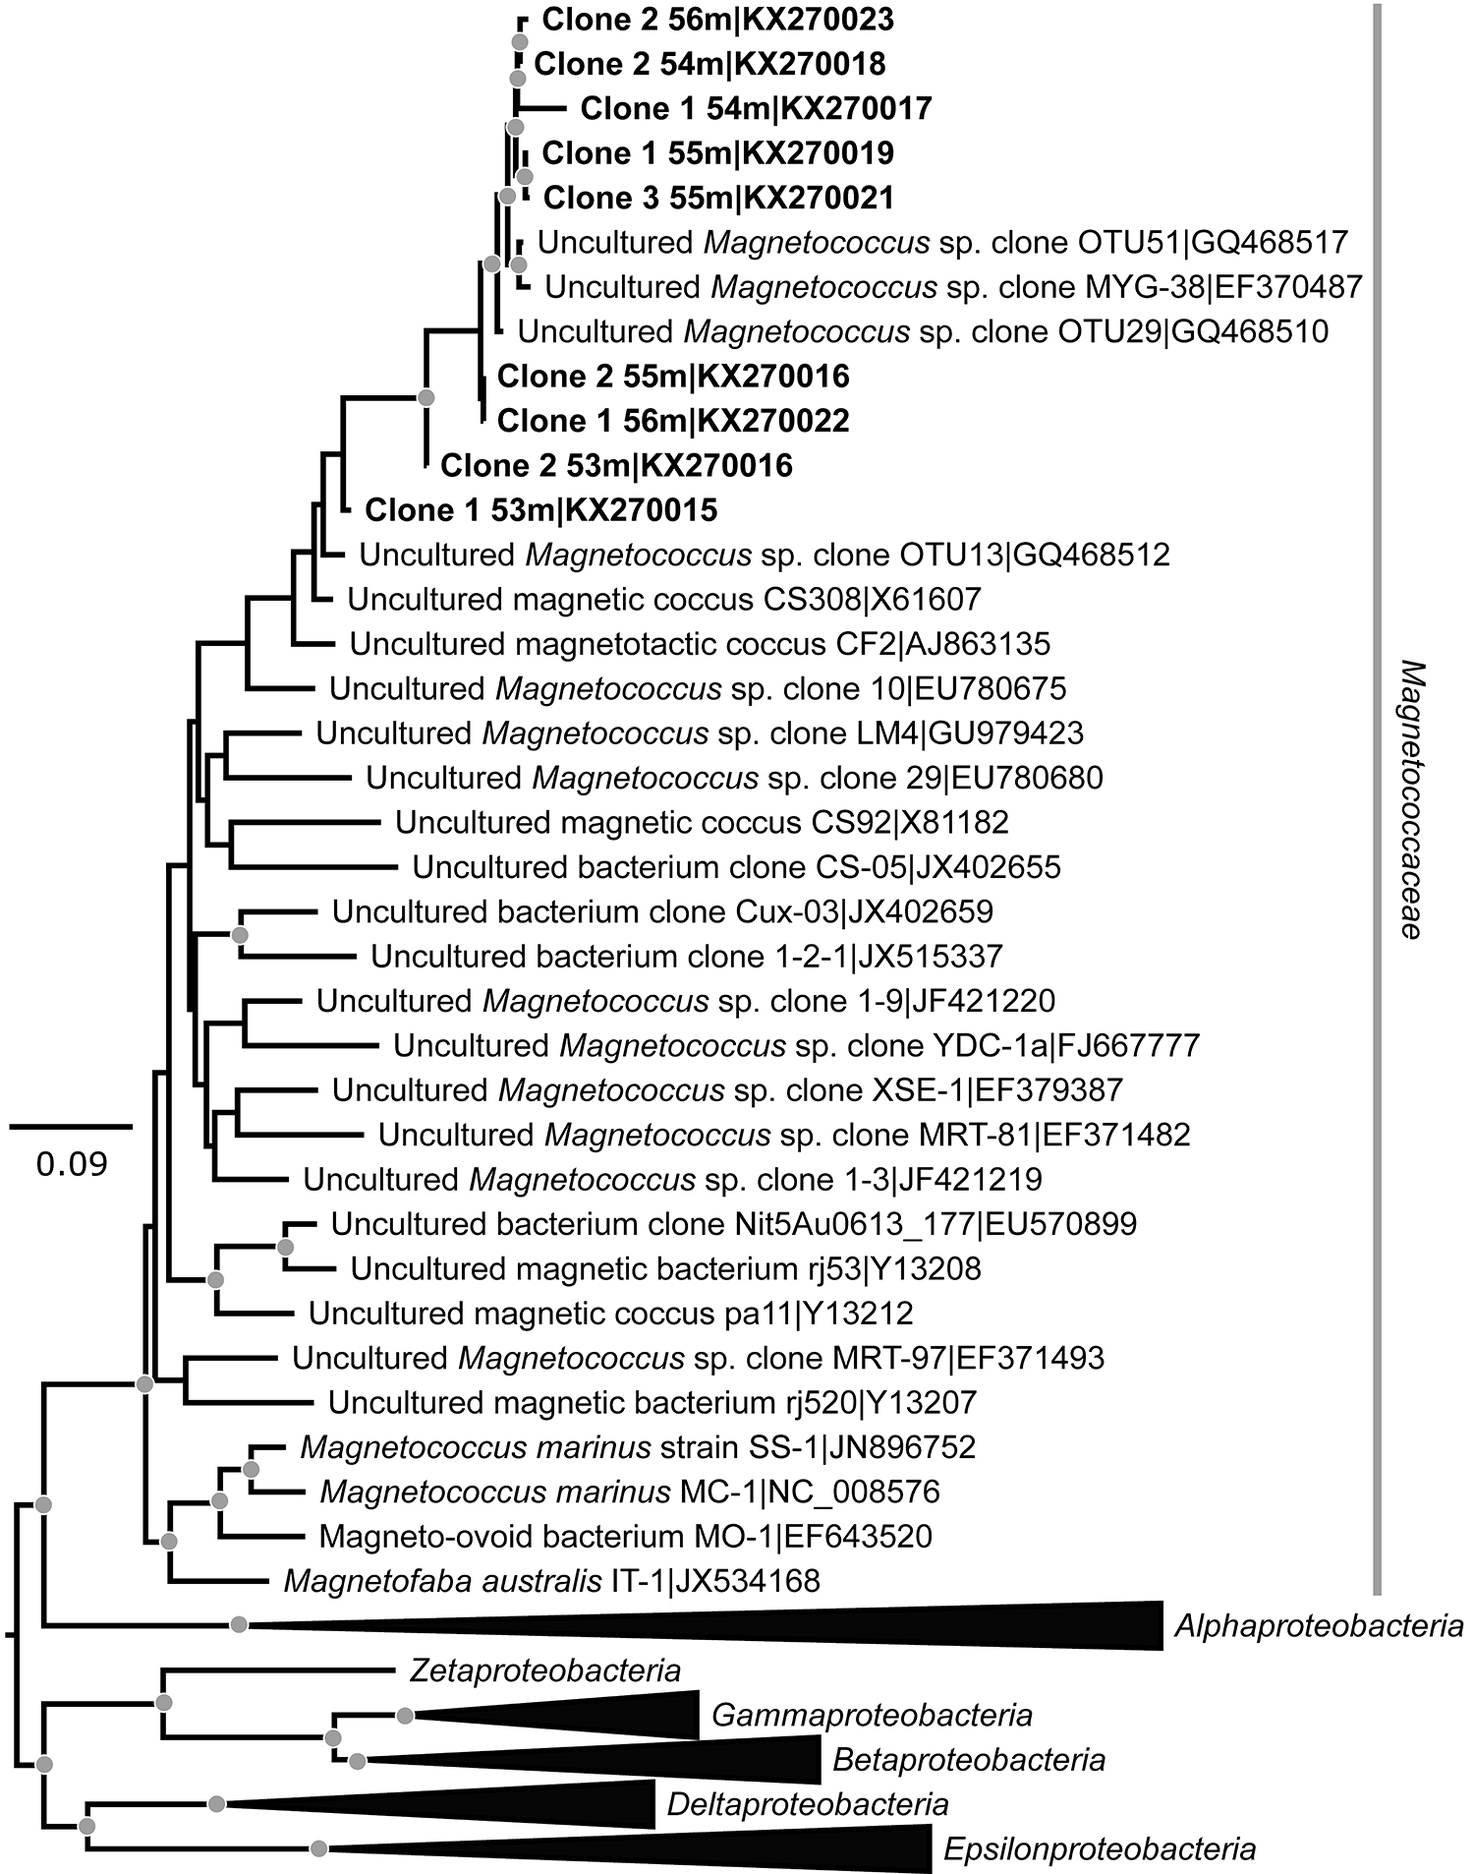
Rivas-Lamelo et al.
Magnetotactic bacteria as a new model for P sequestration in the ferruginous Lake Pavin
Figure 3 Maximum likelihood phylogenetic tree built based on 16S rDNA gene sequences of MTB clones from Lake Pavin (bold). It includes the closest related Magnetococcaceae found elsewhere. GenBank accession numbers are associated with clones/strains names. Nodes supported by a bootstrap value above 70 % are highlighted by a grey circle. Branch length is proportional to the number of base substitutions per site (see scale bar).
Rivas-Lamelo et al. (2017) Geochem. Persp. Let. 5, 35-41 | doi: 10.7185/geochemlet.1743
© 2017 European Association of Geochemistry
Notes:
Figure 3 Maximum likelihood phylogenetic tree built based on 16S rDNA gene sequences of MTB clones from Lake Pavin (bold). It includes the closest related Magnetococcaceae found elsewhere. GenBank accession numbers are associated with clones/strains names. Nodes supported by a bootstrap value above 70 % are highlighted by a grey circle. Branch length is proportional to the number of base substitutions per site (see scale bar).

