Slide 1
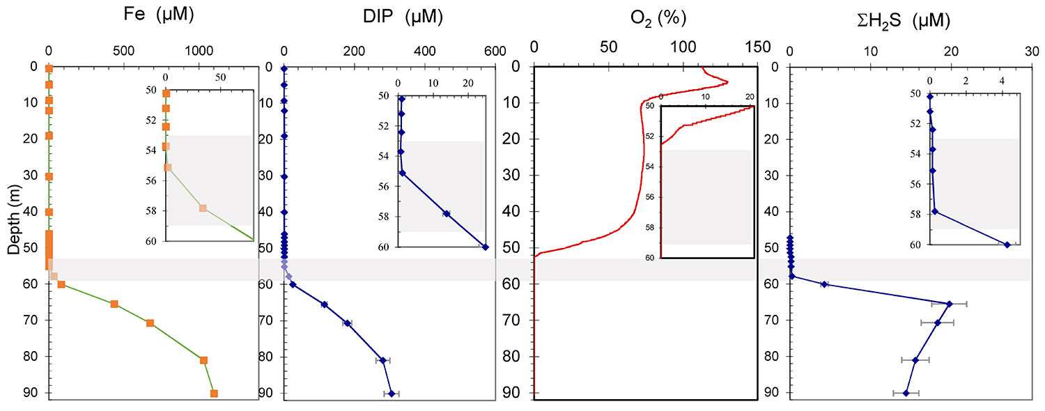
Rivas-Lamelo et al.
Magnetotactic bacteria as a new model for P sequestration in the ferruginous Lake Pavin
Figure S-1 Geochemical depth profiles in the water column of Lake Pavin. The depth profile of O₂ was measured in situ, while depth profiles of dissolved H₂S (ΣH₂S), dissolved PO₄ (DIP) and dissolved Fe²⁺ were measured on water samples collected using a Niskin bottle. The grey rectangle outlines the depth range in which MTB cells were collected.
Rivas-Lamelo et al. (2017) Geochem. Persp. Let. 5, 35-41 | doi: 10.7185/geochemlet.1743
© 2017 European Association of Geochemistry
Notes:
Figure S-1 Geochemical depth profiles in the water column of Lake Pavin. The depth profile of O₂ was measured in situ, while depth profiles of dissolved H₂S (ΣH₂S), dissolved PO₄ (DIP) and dissolved Fe²⁺ were measured on water samples collected using a Niskin bottle. The grey rectangle outlines the depth range in which MTB cells were collected.

