Slide 1
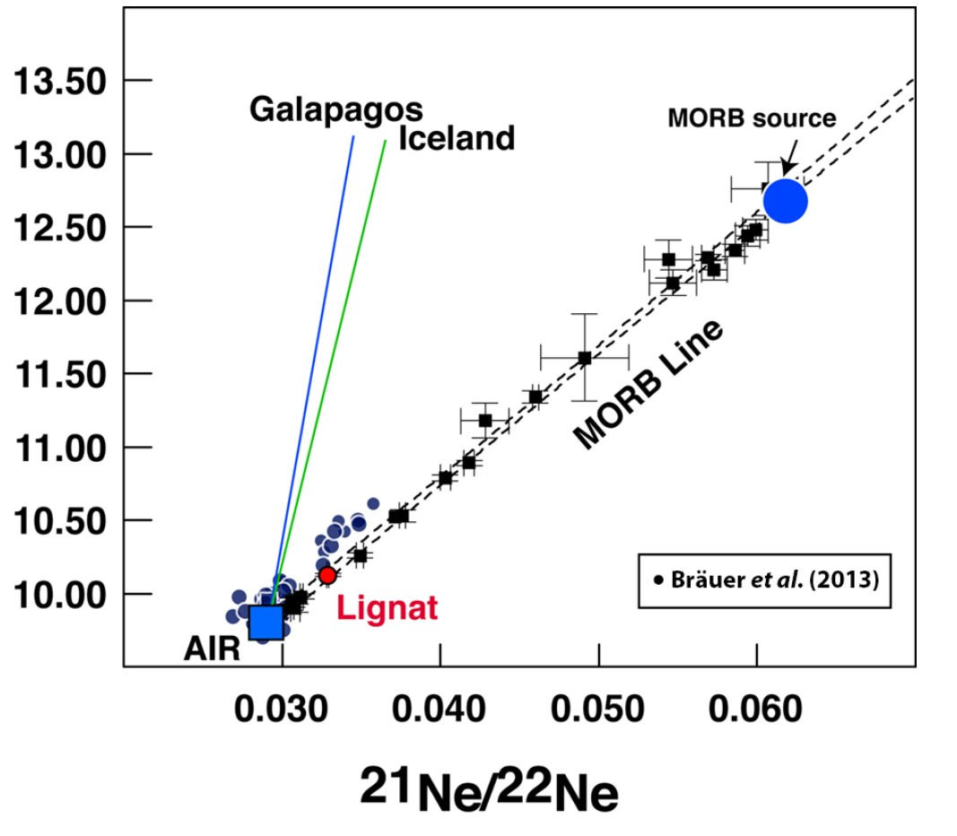
Moreira et al.
The xenon isotopic signature of the mantle beneath Massif Central
Figure 1 Three-neon isotope diagram. MORB data are from Moreira et al. (1998) and define the MORB-AIR mixing line (Sarda et al., 1988), which has a different slope than the OIB mixing lines (Honda et al., 1991; Moreira et al., 2001). The OIB mixing lines are from Mukhopadhyay (2012) and Peron et al. (2016). The MORB source has a ²⁰Ne/²²Ne ~12.5. The neon in Lignat spring comes from the mixture of mantle-derived (~12 %) and atmospheric neon (~88 %). Data from the Eifel area are also reported (Brauer et al., 2013).
© 2018 The Authors
Published by the European Association of Geochemistry
under Creative Commons License CC BY-NC-ND 4.0
Moreira et al. (2018) Geochem. Persp. Let. 6, 28-32 | doi: 10.7185/geochemlet.1805
Notes:
Figure 1 Three-neon isotope diagram. MORB data are from Moreira et al. (1998) and define the MORB-AIR mixing line (Sarda et al., 1988), which has a different slope than the OIB mixing lines (Honda et al., 1991; Moreira et al., 2001). The OIB mixing lines are from Mukhopadhyay (2012) and Peron et al. (2016). The MORB source has a ²⁰Ne/²²Ne ~12.5. The neon in Lignat spring comes from the mixture of mantle-derived (~12 %) and atmospheric neon (~88 %). Data from the Eifel area are also reported (Brauer et al., 2013).

