Slide 1
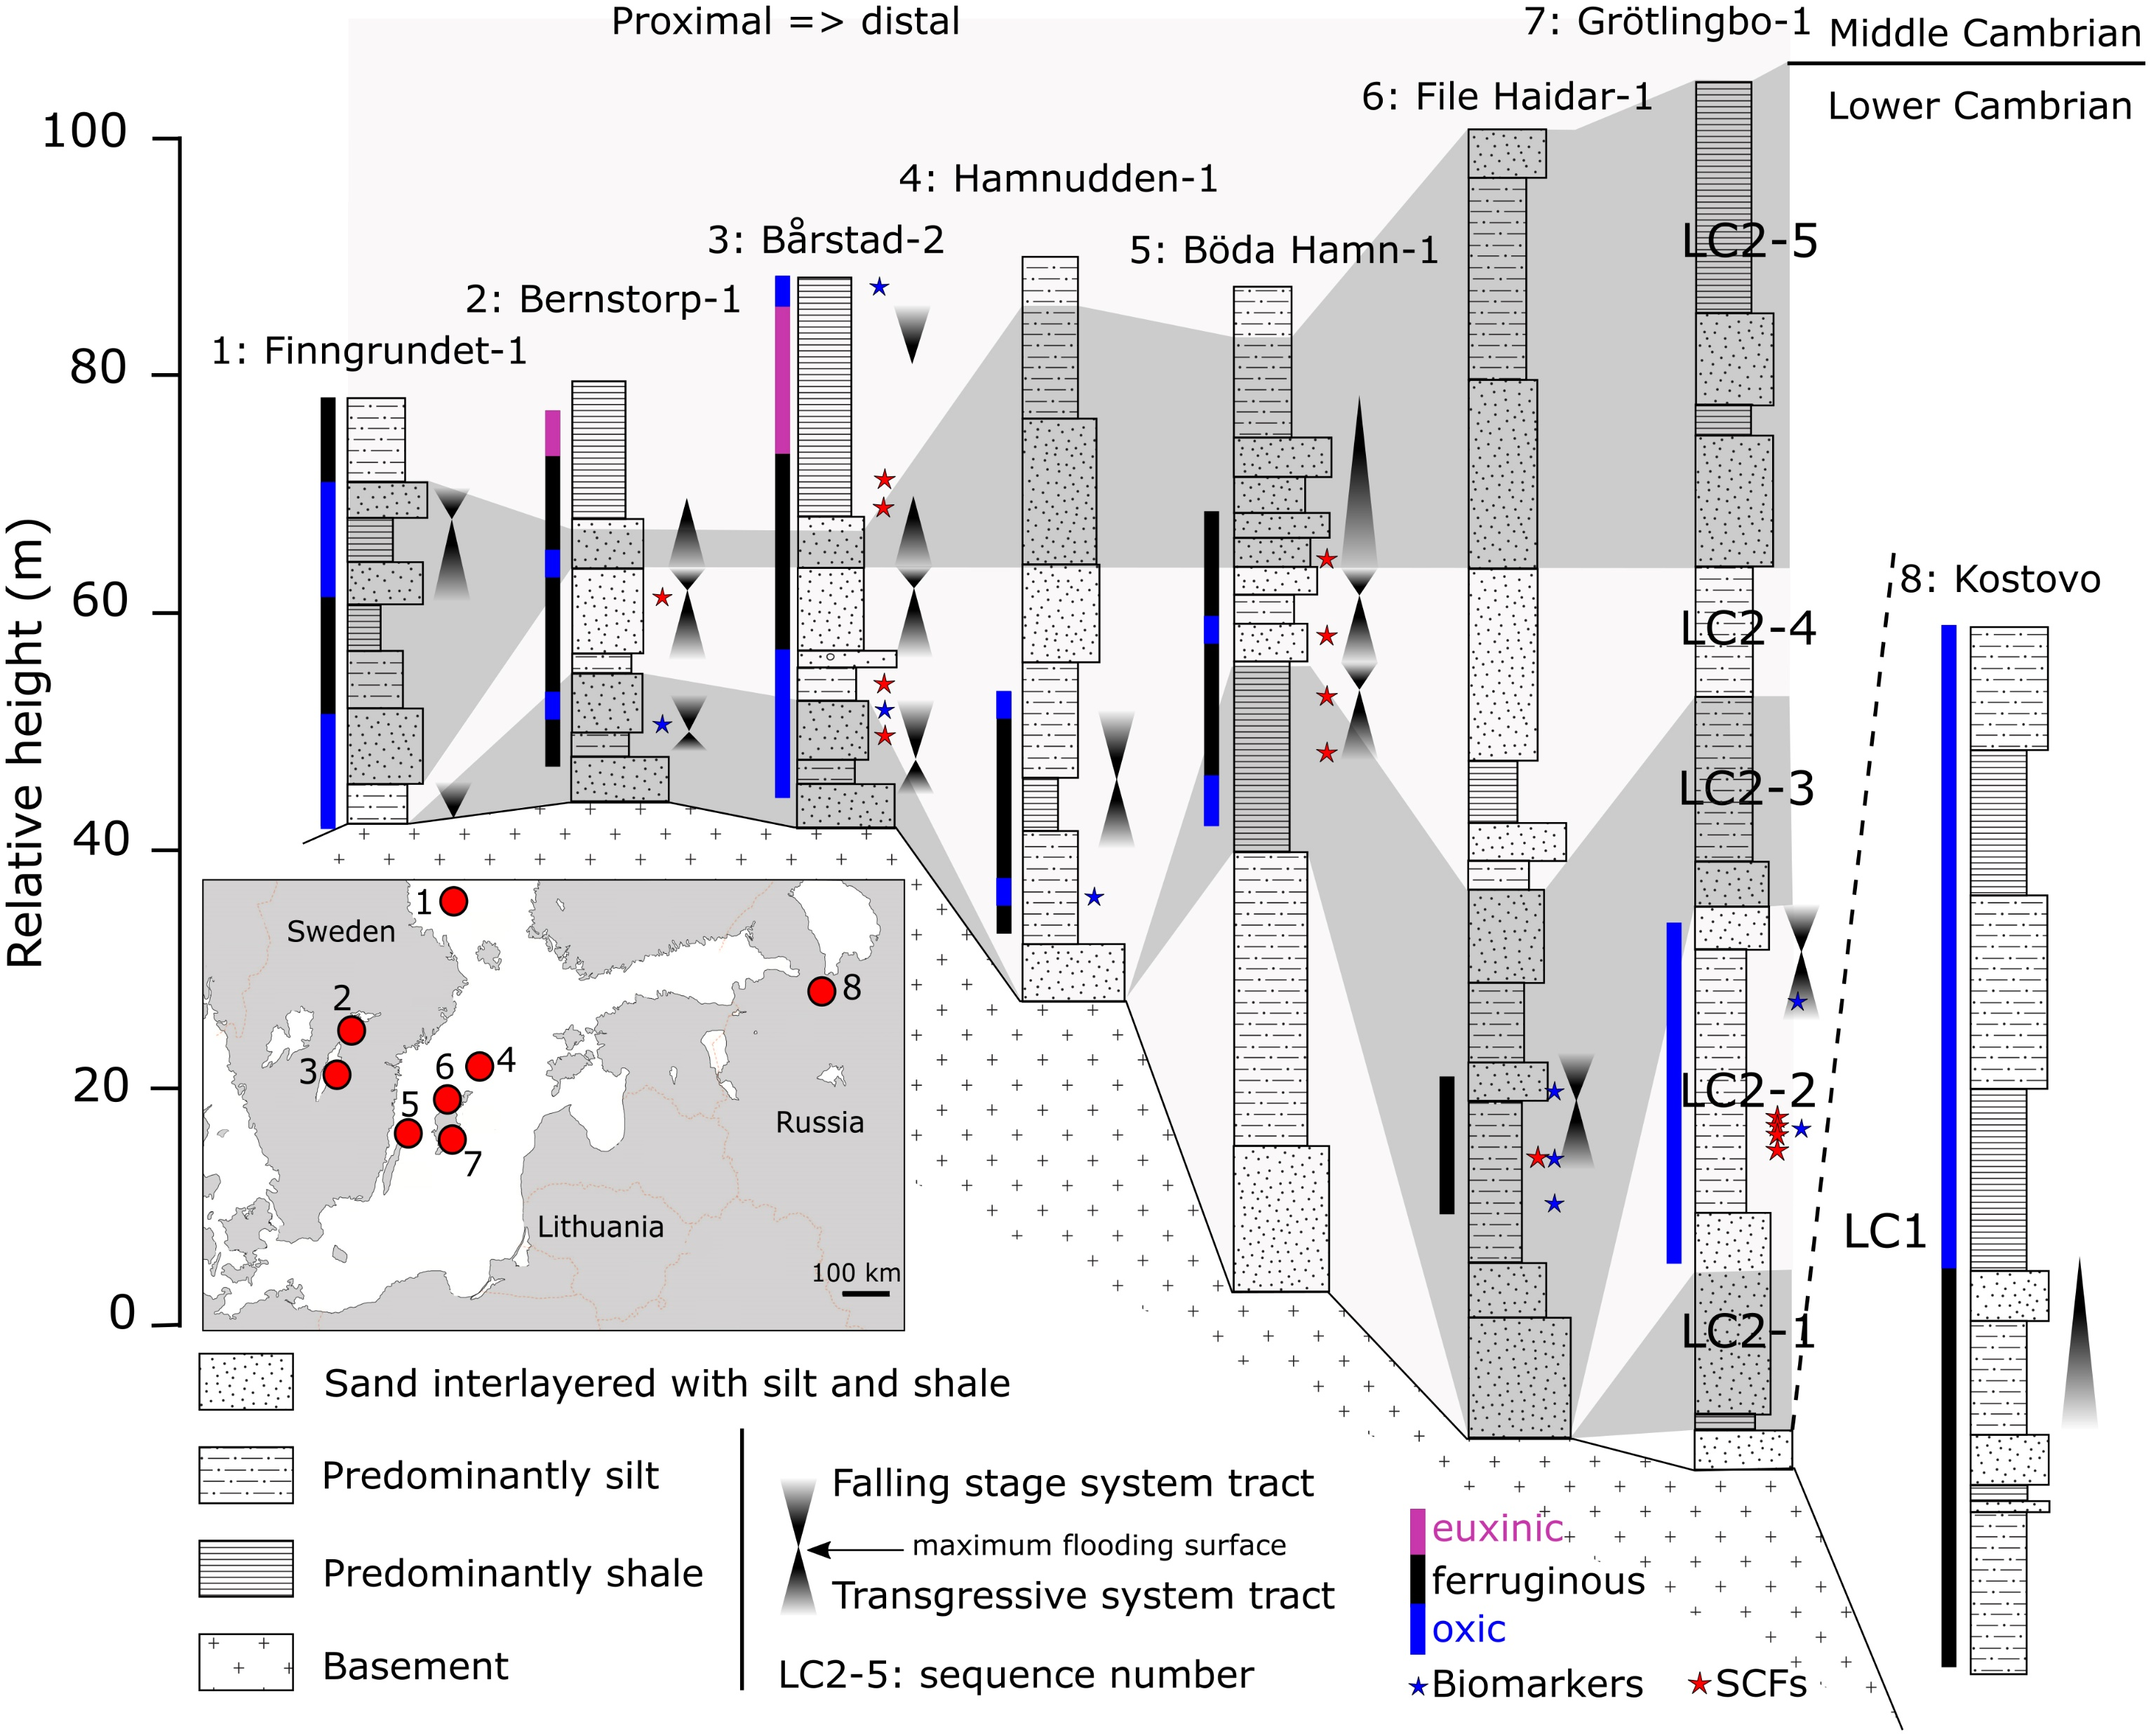
Guilbaud et al.
Oxygen minimum zones in the early Cambrian ocean
Figure 1 Core location (red circles) and stratigraphy, modified after Nielsen and Schovsbo (2011). Grey and white shadings represent the stratigraphic sequences (e.g., LC2-5). The bars illustrate the analysed core sections (on mudstones and siltstones only); euxinic, ferruginous and oxic depositions are in purple, black and blue, respectively.
© 2018 The Authors
Published by the European Association of Geochemistry
under Creative Commons License CC BY 4.0
Guilbaud et al. (2018) Geochem. Persp. Let. 6, 33-38 | doi: 10.7185/geochemlet.1806
Notes:
Figure 1 Core location (red circles) and stratigraphy, modified after Nielsen and Schovsbo (2011). Grey and white shadings represent the stratigraphic sequences (e.g., LC2-5). The bars illustrate the analysed core sections (on mudstones and siltstones only); euxinic, ferruginous and oxic depositions are in purple, black and blue, respectively.

