Slide 1
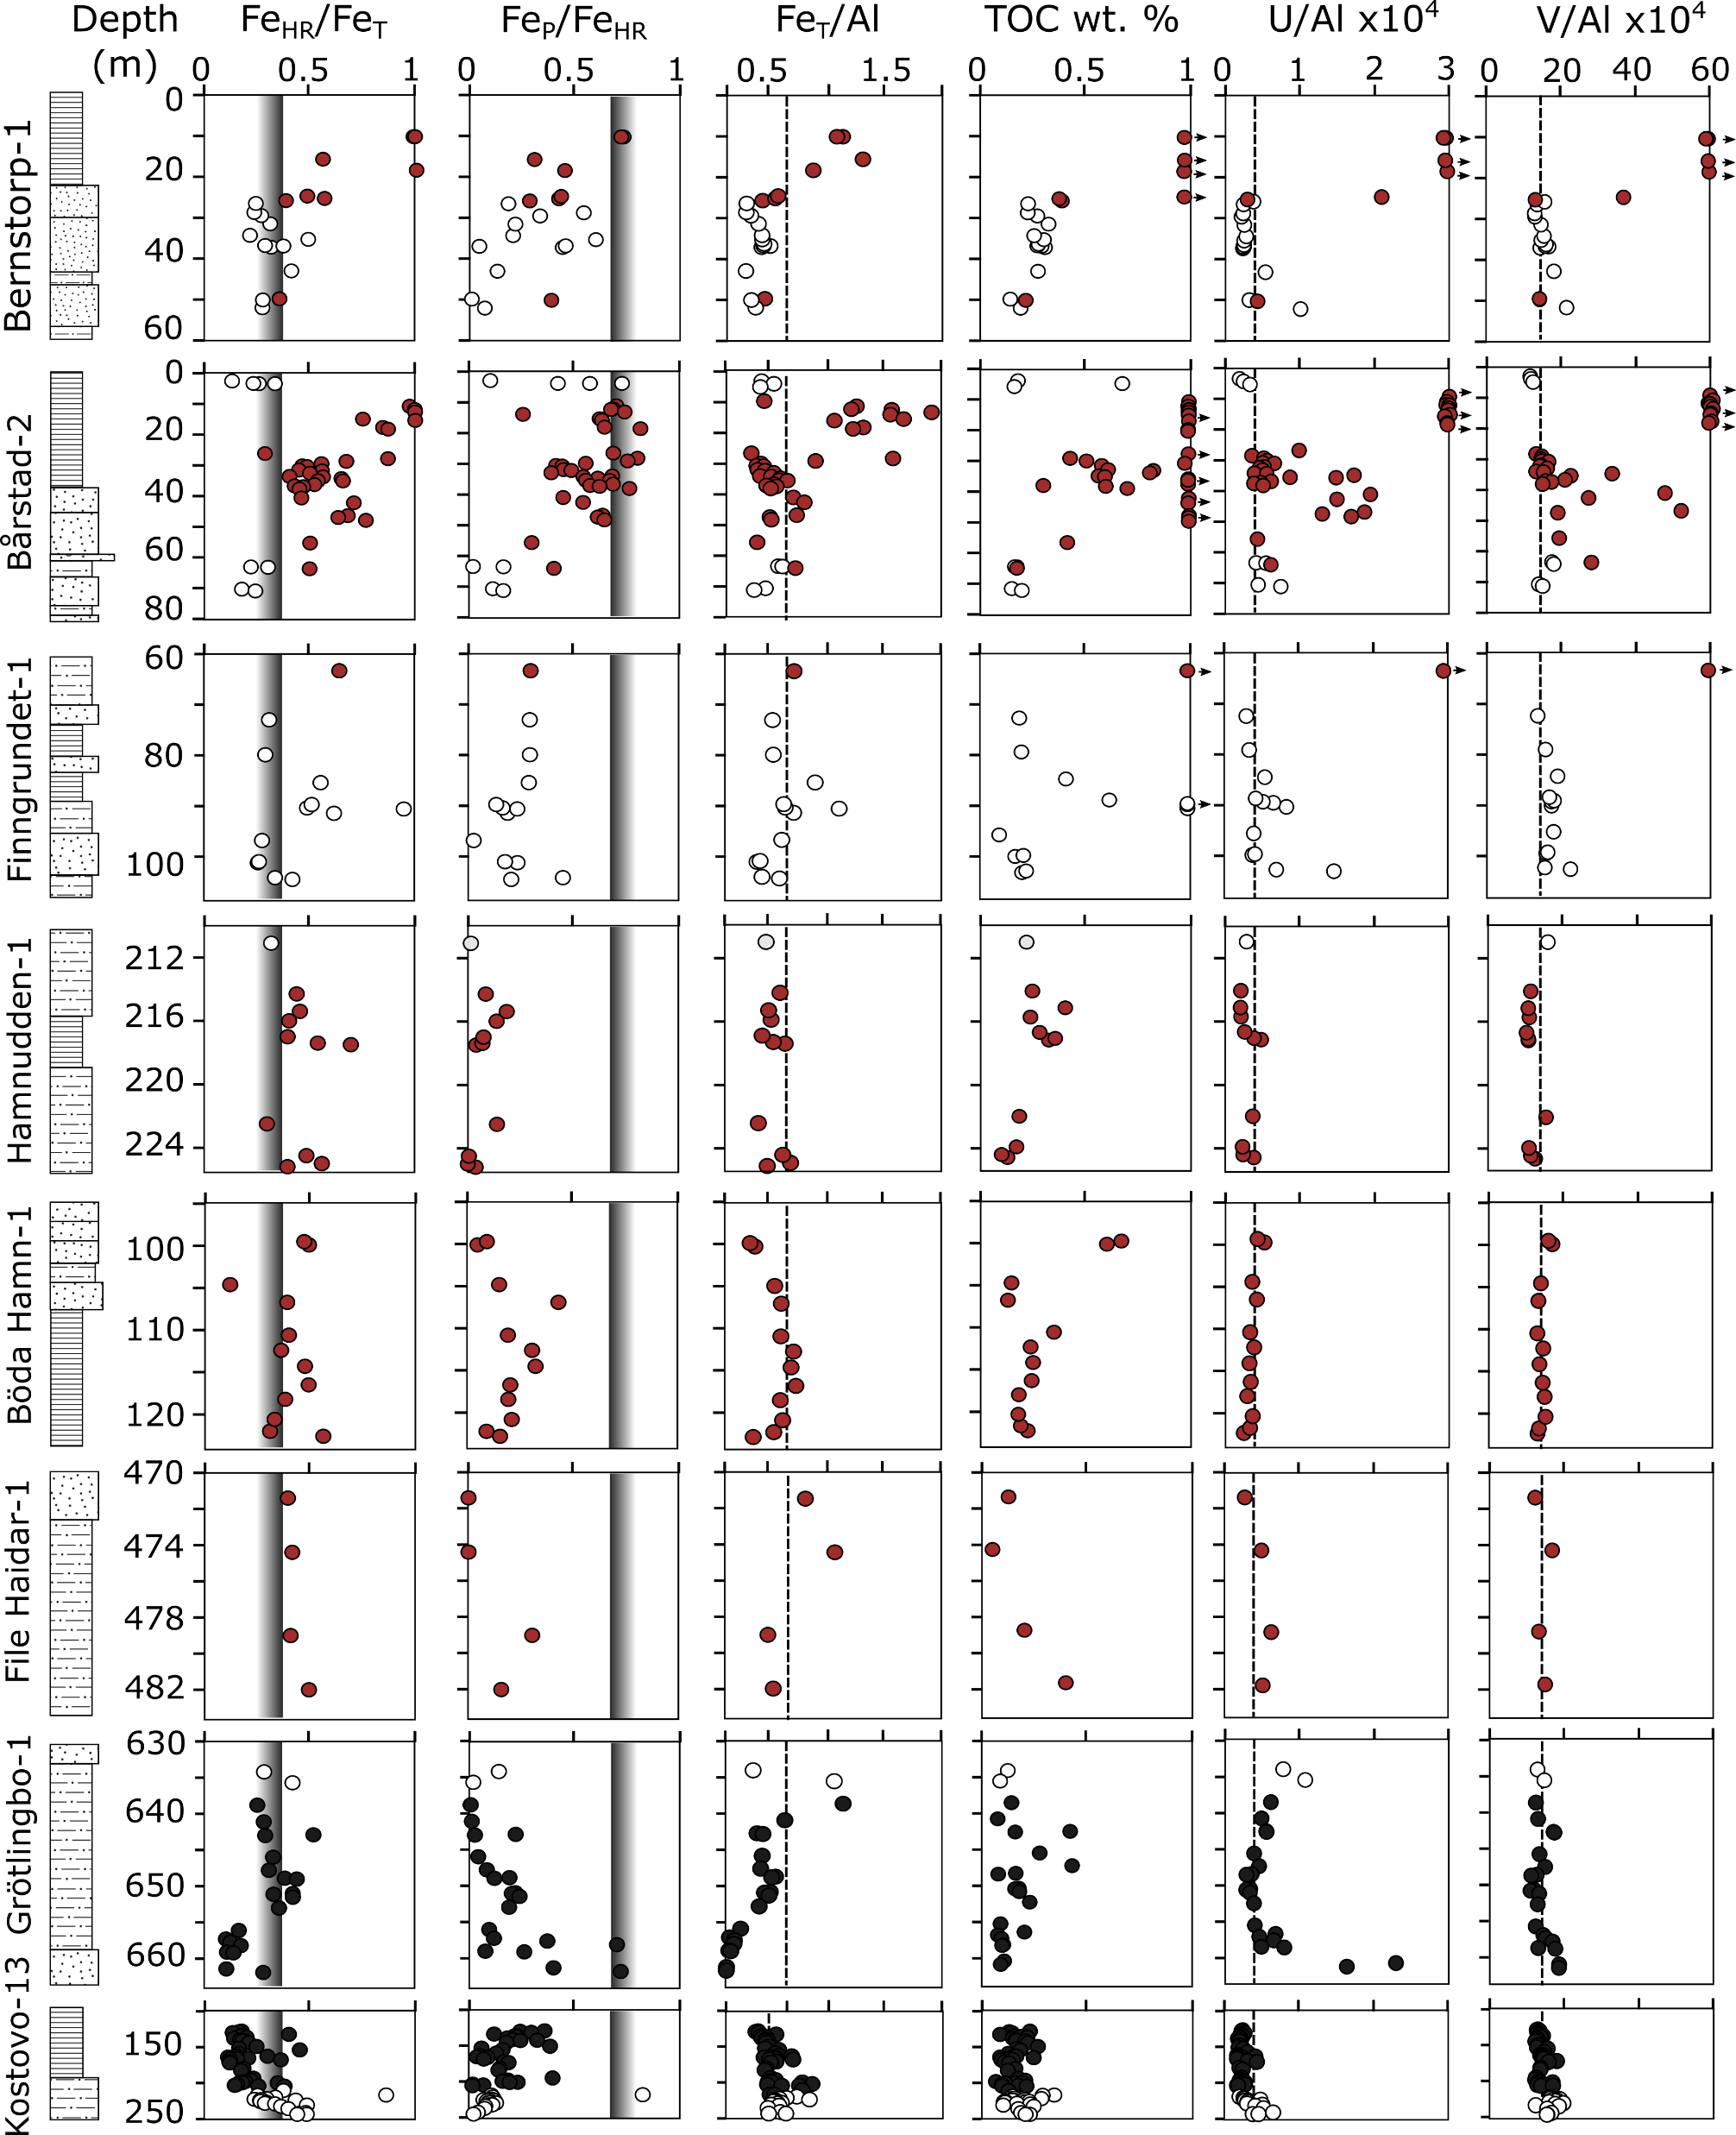
Guilbaud et al.
Oxygen minimum zones in the early Cambrian ocean
Figure 2 Geochemical data. Inner-, mid-, and outer-shelf environments are indicated by open, red and black symbols, respectively. Grey shadows delimit redox domains and dashed lines represent average shale values. Black arrows are for outpassing data points. Maximum values for U/Al and V/Al are 54 and 434 ppm/wt. %, respectively.
© 2018 The Authors
Published by the European Association of Geochemistry
under Creative Commons License CC BY 4.0
Guilbaud et al. (2018) Geochem. Persp. Let. 6, 33-38 | doi: 10.7185/geochemlet.1806
Notes:
Figure 2 Geochemical data. Inner-, mid-, and outer-shelf environments are indicated by open, red and black symbols, respectively. Grey shadows delimit redox domains and dashed lines represent average shale values. Black arrows are for outpassing data points. Maximum values for U/Al and V/Al are 54 and 434 ppm/wt. %, respectively.

