Slide 1
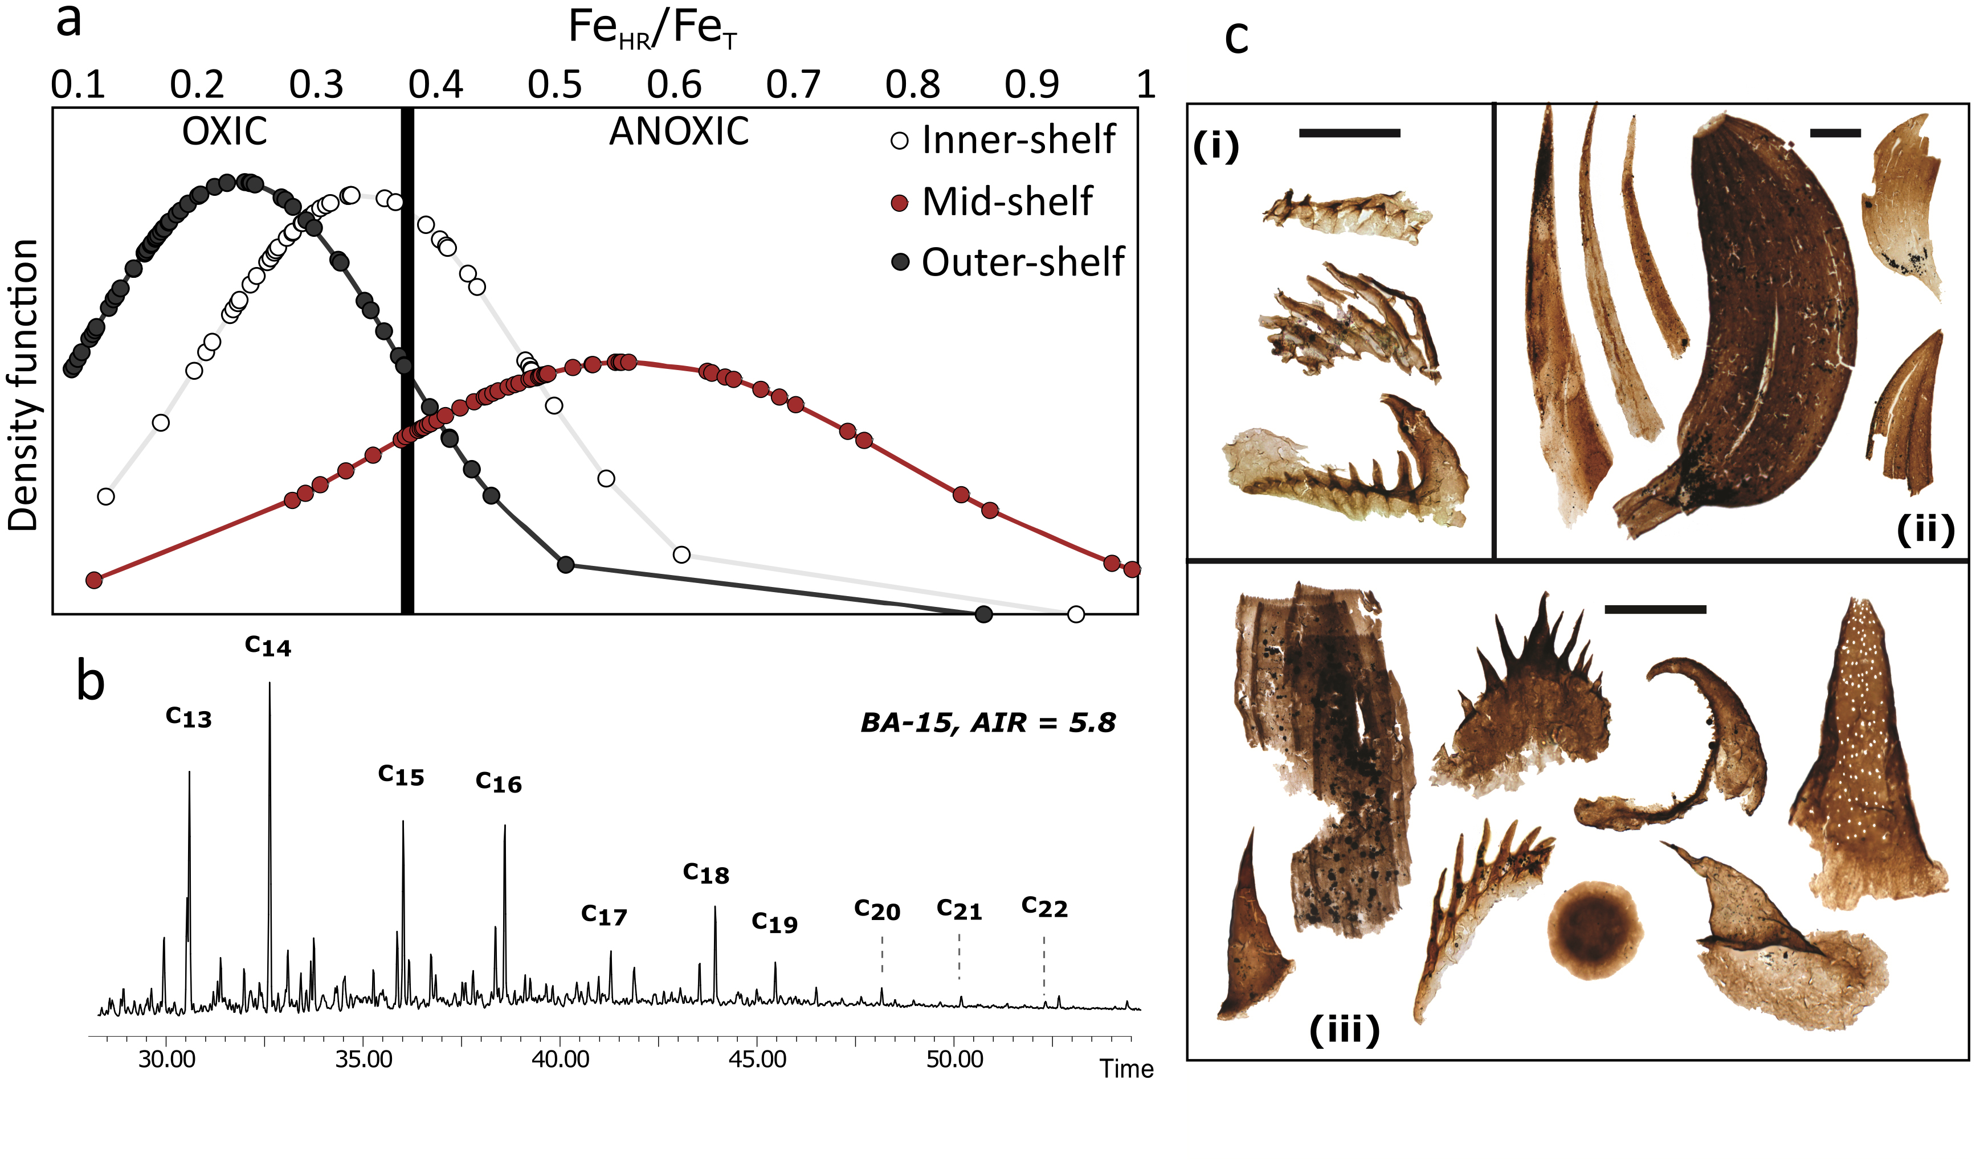
Guilbaud et al.
Oxygen minimum zones in the early Cambrian ocean
Figure 3 (a) Distribution of redox ratios (n = 183), binned as a function of their depositional environment. Inner- and outer-shelf environments show significantly more oxic redox populations than corresponding mid-shelves (t test p << 0.05). (b) Example of m/z = 134 partial ion chromatogram revealing the presence of 2,3,6 trimethyl aryl isoprenoids (AI) in mid-shelf facies. High ratios of…
© 2018 The Authors
Published by the European Association of Geochemistry
under Creative Commons License CC BY 4.0
Guilbaud et al. (2018) Geochem. Persp. Let. 6, 33-38 | doi: 10.7185/geochemlet.1806
Notes:
Figure 3 (a) Distribution of redox ratios (n = 183), binned as a function of their depositional environment. Inner- and outer-shelf environments show significantly more oxic redox populations than corresponding mid-shelves (t test p << 0.05). (b) Example of m/z = 134 partial ion chromatogram revealing the presence of 2,3,6 trimethyl aryl isoprenoids (AI) in mid-shelf facies. High ratios of short- to long-chain AI (AIR) point to strongly varying, intermittent oxygen exposure levels. (c) SCF assemblages from (i) inner-shelf (denticulate metazoan structures), (ii) mid-shelf (protoconodont spines alongside occasional Wiwaxia sclerites) and (iii) outer-shelf environments (priapulid, palaeoscolecid and annelid remains). Scale bars are 100 μm.

