Slide 1
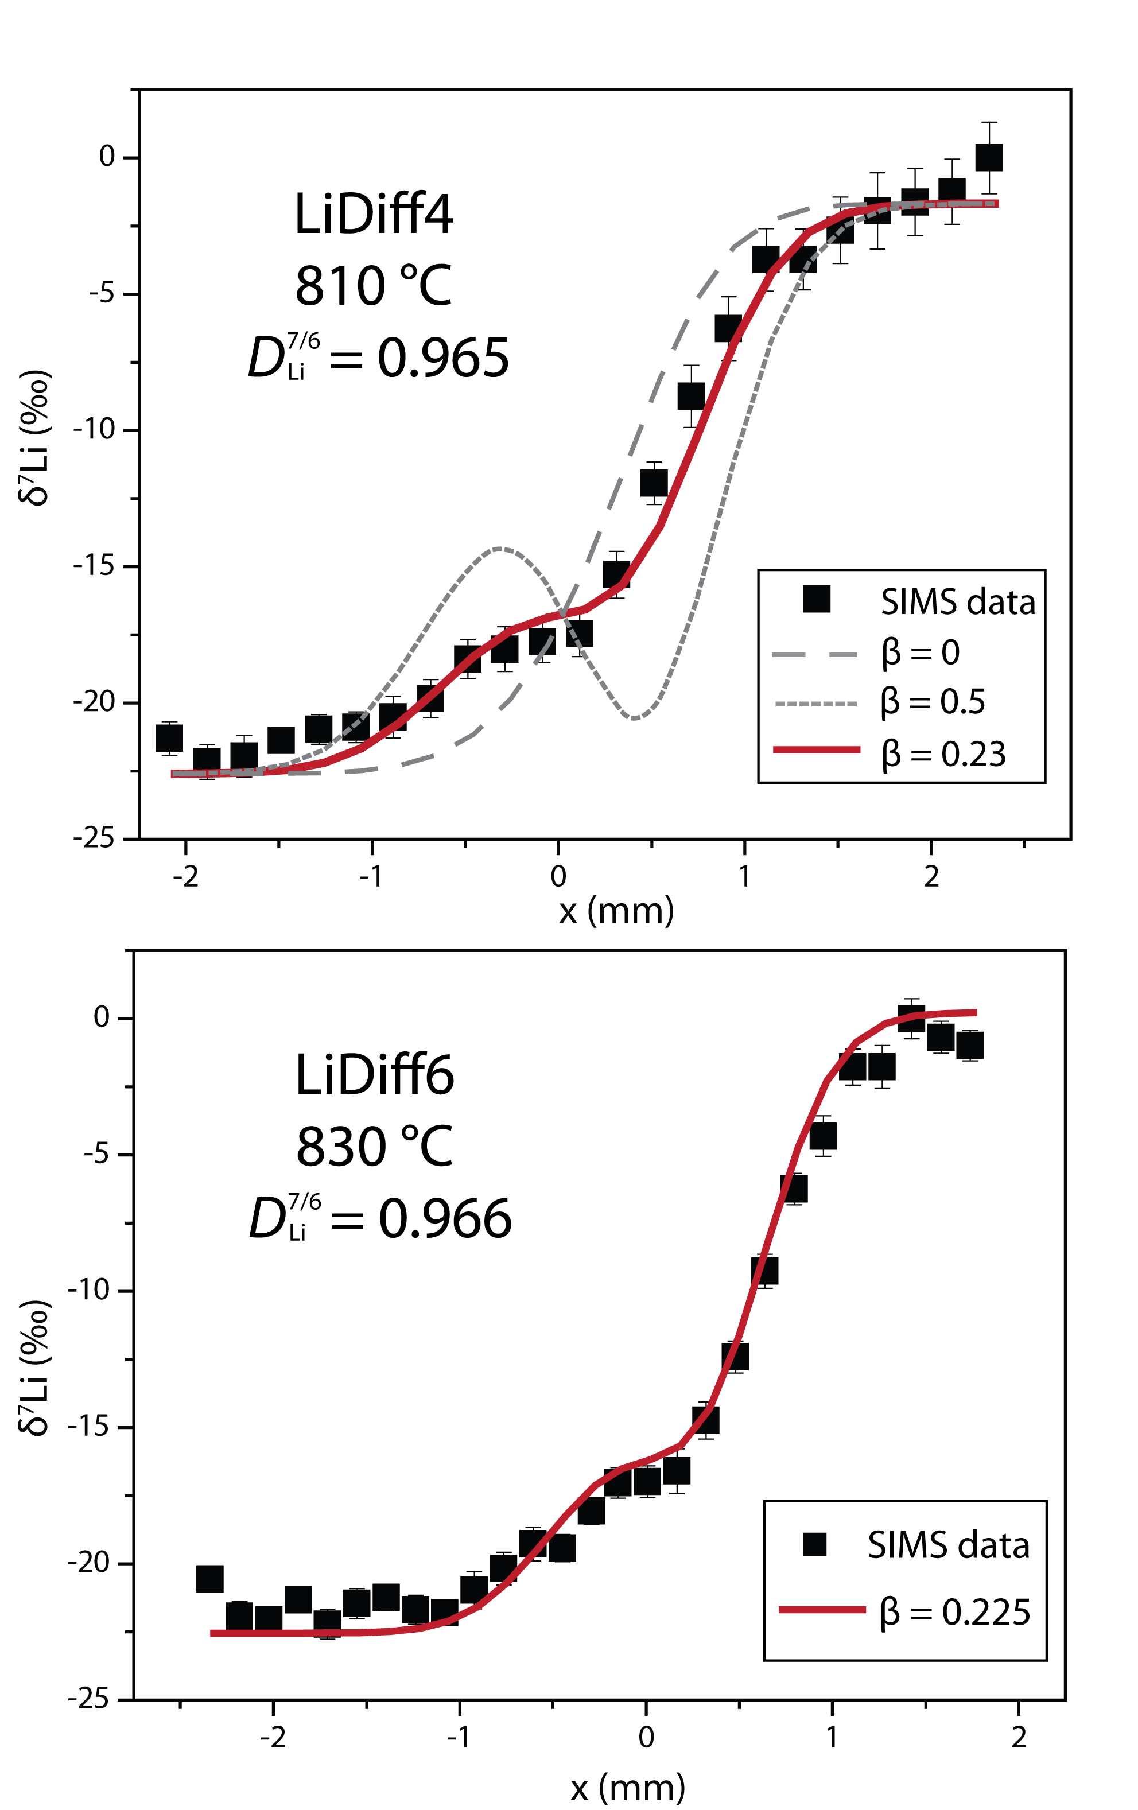
Holycross et al.
Diffusive fractionation of Li isotopes in wet, highly silicic melts
Figure 2 δ⁷Li profiles produced from SIMS analyses. ⁶Li diffuses into the “low” Li glass (x > 0) faster than ⁷Li, fractionating the isotopes in the melt. If the Li isotopes were diffusing at the same speed in rhyolitic melt (β = 0), a smoothly varying isotope gradient would be present near x = 0. When β ≠ 0, calculated profiles…
© 2018 The Authors
Published by the European Association of Geochemistry
under Creative Commons License CC BY 4.0
Holycross et al. (2018) Geochem. Persp. Let. 6, 39-42 | doi: 10.7185/geochemlet.1807
Notes:
Figure 2 δ⁷Li profiles produced from SIMS analyses. ⁶Li diffuses into the “low” Li glass (x > 0) faster than ⁷Li, fractionating the isotopes in the melt. If the Li isotopes were diffusing at the same speed in rhyolitic melt (β = 0), a smoothly varying isotope gradient would be present near x = 0. When β ≠ 0, calculated profiles show a shallow or reversed slope near the diffusion couple interface at x = 0, as is seen in the data in both panels. The kinetic fractionation of Li isotopes in hydrous rhyolitic melt is best fit by an average β = 0.228.

