Slide 1
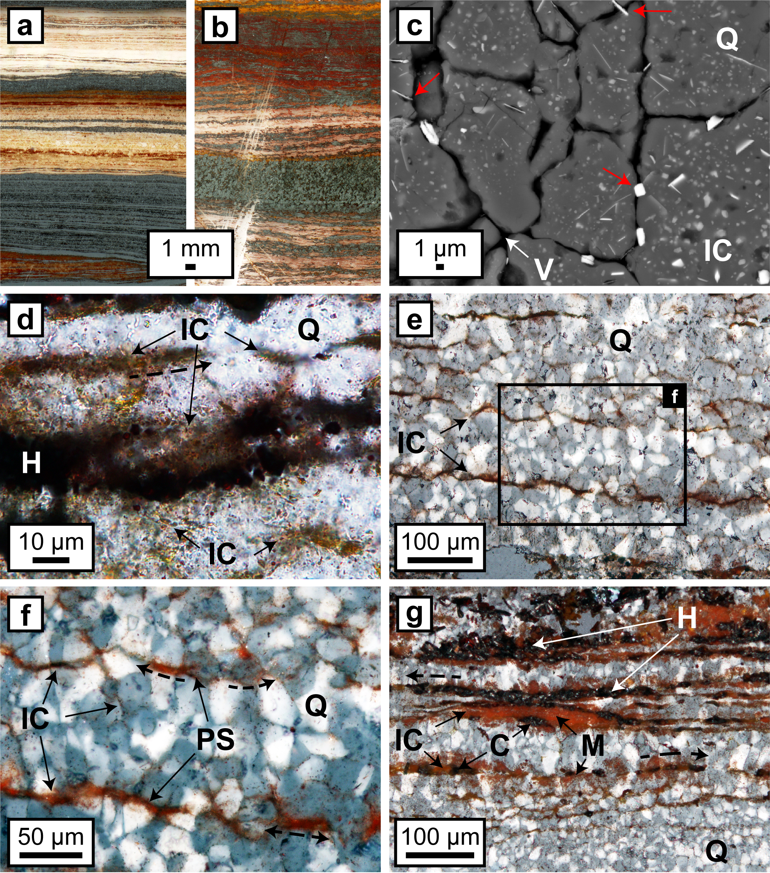
Egglseder et al.
Colloidal origin of microbands in banded iron formations
Figure 1 (a, b) Transmitted light images (TL) of microbands of chert/quartz (white), chert with colloidal hematite (red, brown) and hematite bands (blue grey). (c) BSE image with colloidal hematite ‘floating’ in quartz crystals, partly liberated (red arrows) and free haematite particles at grain boundaries. (d) TL and (e, f) reflected light images (XPL) displaying…
© 2018 The Authors
Published by the European Association of Geochemistry
under Creative Commons License CC BY-NC-ND 4.0
Egglseder et al. (2018) Geochem. Persp. Let. 6, 43-49 | doi: 10.7185/geochemlet.1808
Notes:
Figure 1 (a, b) Transmitted light images (TL) of microbands of chert/quartz (white), chert with colloidal hematite (red, brown) and hematite bands (blue grey). (c) BSE image with colloidal hematite ‘floating’ in quartz crystals, partly liberated (red arrows) and free hematite particles at grain boundaries. (d) TL and (e, f) reflected light images (XPL) displaying irregular layers of hematite particles at truncated quartz crystals (PS) and along quartz grain boundaries with lateral transitions into equigranular quartz aggregates (dashed arrows). (g) XPL image showing hematite particles that surround layered hematite forming core/mantle textures. C: core, H: hematite, M: mantle, IC: iron oxide colloids/particles, PS: pressure solution, Q: quartz, V: void.

