Slide 1
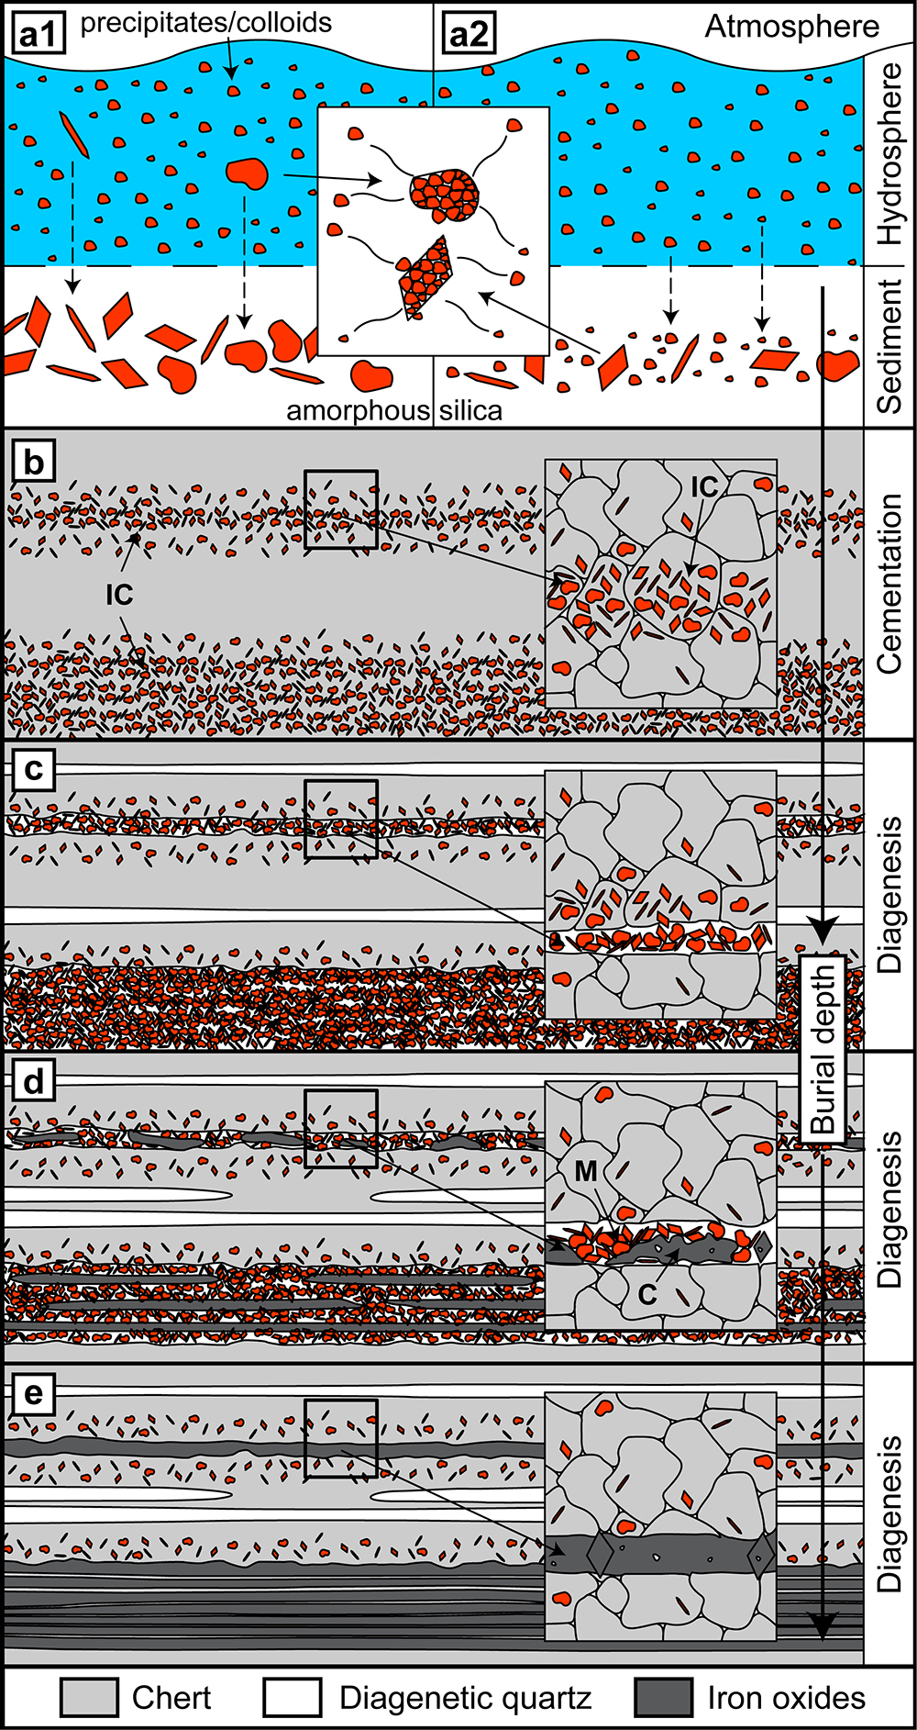
Egglseder et al.
Colloidal origin of microbands in banded iron formations
Figure 4 Conceptual evolution from BIF precursor sediments to BIF microbands. (a1, a2). Schematic Precambrian depositional environment of BIF precursor minerals. The inset shows the aggregation of precipitates/colloidal phases to form larger particles by flocculation in the water column (a1) and/or attachment in the sediment prior to lithification (a2). (b–e) Development of BIF textures after lithification. Insets…
© 2018 The Authors
Published by the European Association of Geochemistry
under Creative Commons License CC BY-NC-ND 4.0
Egglseder et al. (2018) Geochem. Persp. Let. 6, 43-49 | doi: 10.7185/geochemlet.1808
Notes:
Figure 4 Conceptual evolution from BIF precursor sediments to BIF microbands. (a1, a2). Schematic Precambrian depositional environment of BIF precursor minerals. The inset shows the aggregation of precipitates/colloidal phases to form larger particles by flocculation in the water column (a1) and/or attachment in the sediment prior to lithification (a2). (b–e) Development of BIF textures after lithification. Insets show the microscale to nanoscale formation of minerals and textures. (b) Quartz crystallisation (cementation) leads to the entrapment of randomly dispersed colloidal phases. (c) Progressive compression leads to quartz dissolution by DPC, liberation of encapsulated particles and residual layer-parallel accumulation. Dissolved silica forms new particle-free quartz layers (i.e. diagenetic quartz). (d) Simultaneously, accumulated particles transform into more stable iron oxides resulting in the common BIF texture of pristine chert, diagenetic quartz and iron oxide microbands (e).

