Slide 1
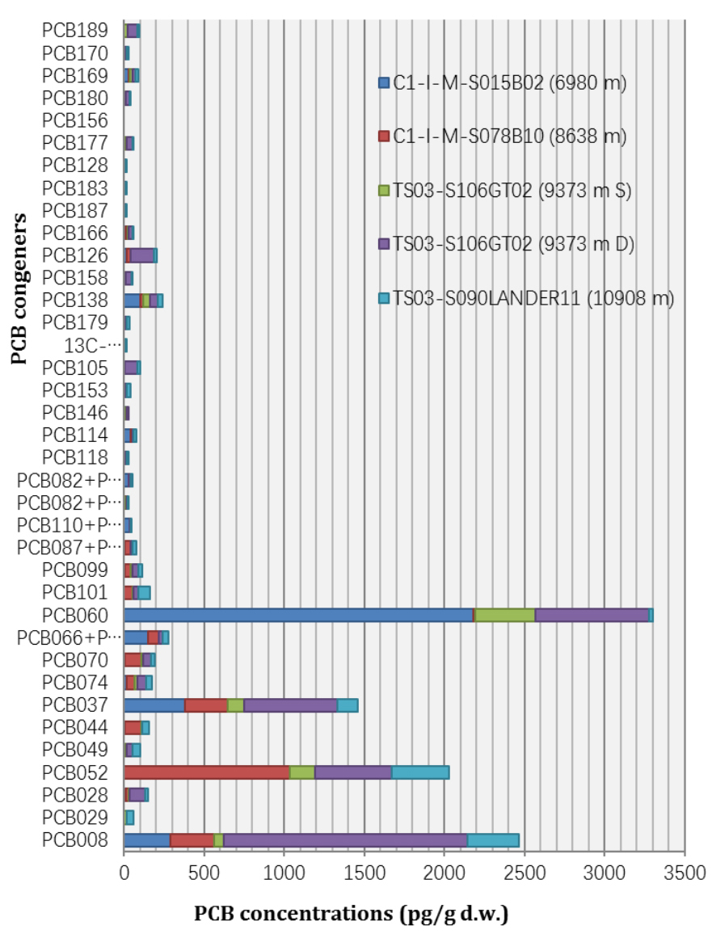
Dasgupta et al.
Toxic anthropogenic pollutants reach the deepest ocean on Earth
Figure 2 Concentrations of PCB congeners (pg/g d.w.) for different sampling locations at various water depths, as represented by coloured stacked bars. Refer to Table S-2 for details.
© 2018 The Authors
Published by the European Association of Geochemistry
under Creative Commons License CC BY-NC-ND 4.0
Dasgupta et al. (2018) Geochem. Persp. Let. 7, 22-26 | doi: 10.7185/geochemlet.1814
Notes:
Figure 2 Concentrations of PCB congeners (pg/g d.w.) for different sampling locations at various water depths, as represented by coloured stacked bars. Refer to Table S-2 for details.

