Slide 1
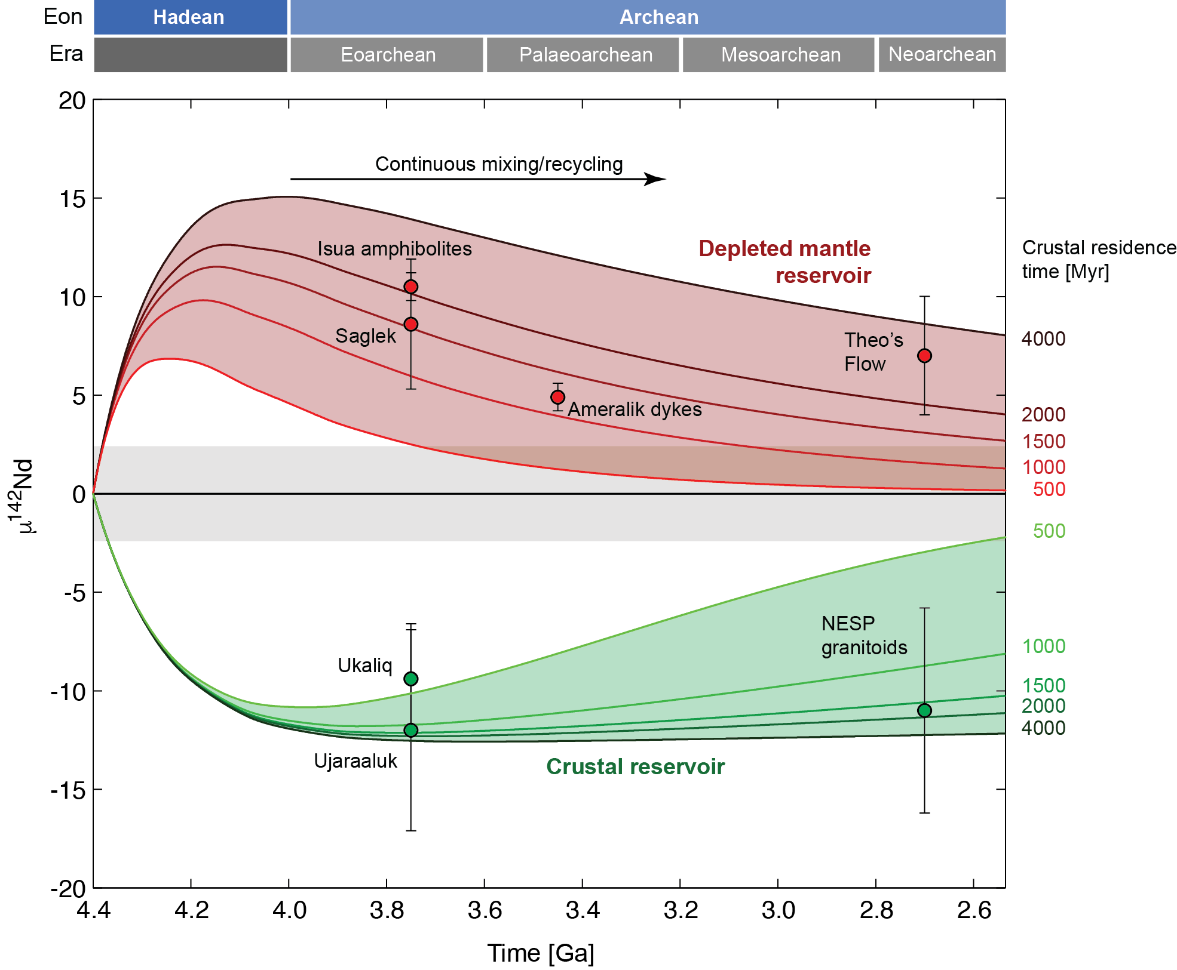
Saji et al.
Hadean geodynamics inferred from time-varying ¹⁴²Nd/¹⁴⁴Nd in the early Earth rock record
Figure 3 µ¹⁴²Nd evolution of the depleted mantle and complementary crust as calculated by a continually interacting crust-mantle box model. The different coloured curves correspond to crustal residence times between 500 to 4000 Myr. The evolution of Isua µ¹⁴²Nd data is best fitted for residence times between 1000-2000 Myr. Sensitivity of the inferred residence…
© 2018 The Authors
Published by the European Association of Geochemistry
under Creative Commons License CC BY-NC-ND 4.0
Saji et al. (2018) Geochem. Persp. Let. 7, 43-48 | doi: 10.7185/geochemlet.1818
Notes:
Figure 3 µ¹⁴²Nd evolution of the depleted mantle and complementary crust as calculated by a continually interacting crust-mantle box model. The different coloured curves correspond to crustal residence times between 500 to 4000 Myr. The evolution of Isua µ¹⁴²Nd data is best fitted for residence times between 1000-2000 Myr. Sensitivity of the inferred residence times to model parameters is detailed in Table S-5. The Hadean crustal component identified in Eoarchean Ujaraaluk and Ukaliq units in Nuvvuagittuq Supracrustal Belt and Neoarchean North Easter Superior Province (NESP) granitoids are also in agreement with crustal residence time of 1000-2000 Myr (O’Neil et al., 2012; Caro et al., 2017; O’Neil and Carlson, 2017). Inferred crustal residence times are also consistent within error with the µ¹⁴²Nd data for Theo’s Flow (Debaille et al., 2013).

