Slide 1

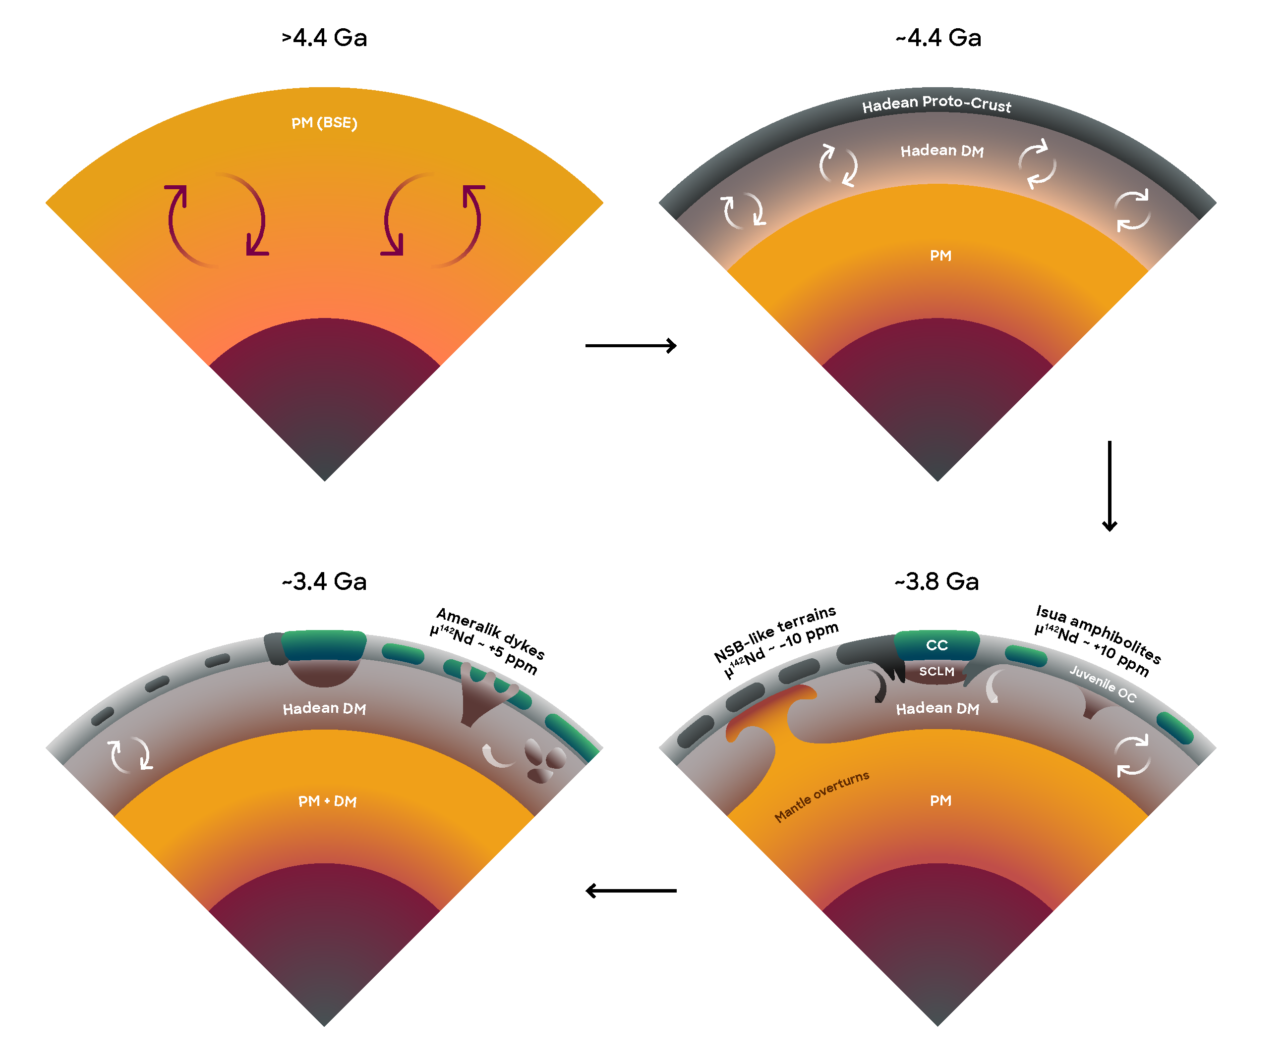
Saji et al.
Hadean geodynamics inferred from time-varying ¹⁴²Nd/¹⁴⁴Nd in the early Earth rock record
Figure 4 A schematic diagram illustrating the evolution of Isua Hadean depleted mantle and proto-crust. The Hadean depleted mantle (DM) and proto-crust formed by primary differentiation at ~4.45-4.36 Ga following the Moon-forming event. The Hadean proto-crust acts as a stagnant-lid due to its buoyancy and is reworked…
© 2018 The Authors
Published by the European Association of Geochemistry
under Creative Commons License CC BY-NC-ND 4.0
Saji et al. (2018) Geochem. Persp. Let. 7, 43-48 | doi: 10.7185/geochemlet.1818
Notes:
Figure 4 A schematic diagram illustrating the evolution of Isua Hadean depleted mantle and proto-crust. The Hadean depleted mantle (DM) and proto-crust formed by primary differentiation at ~4.45-4.36 Ga following the Moon-forming event. The Hadean proto-crust acts as a stagnant-lid due to its buoyancy and is reworked and recycled into the mantle during large-scale deep mantle upwellings in a lid-overturn tectonic regime (Bédard, 2018). Basaltic magmatism thickens the oceanic crust (OC) and results in formation of continental crust (CC) by intra-crustal melting and ensures stabilisation of cratons with a depleted subcontinental lithospheric mantle (SCLM) keel. ISB amphibolites are derived in the Eoarchean from the convecting Hadean DM metasomatised by crust-derived fluids. The NSB rocks possibly formed during reworking of the Hadean proto-crust in mantle overturn episodes recycling portions of the crust into the mantle. Ameralik dykes form in the Palaeoarchean during a delamination episode triggering decompression melting of the Isua Hadean DM.

