Slide 1
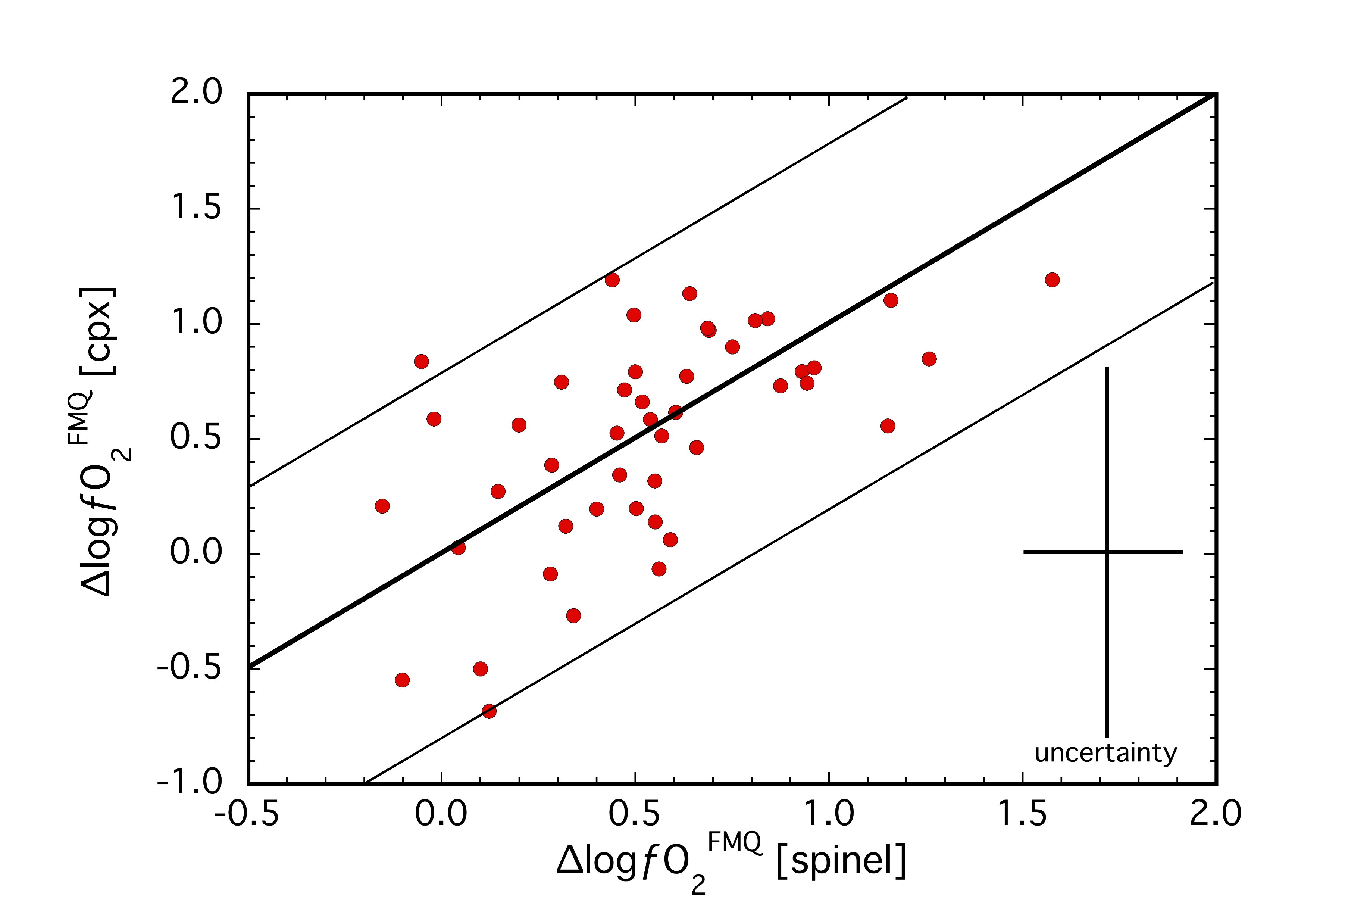
Woodland et al.
Influence of metasomatism on vanadium-based redox proxies for mantle peridotite
Figure 1 Comparison of ∆logƒO₂ determined from spinel-based and clinopyroxene-based Fe³⁺-Fe²⁺ equilibria (see Supplementary Information). The 1:1 correlation line is shown for reference, along with the estimated uncertainty of the clinopyroxene-based oxybarometer of ±0.8 log units (Luth and Canil, 1993).
© 2018 The Authors
Published by the European Association of Geochemistry
under Creative Commons License CC BY 4.0
Woodland et al. (2018) Geochem. Persp. Let. 8, 11-16 | doi: 10.7185/geochemlet.1822
Notes:
Figure 1 Comparison of ∆logƒO₂ determined from spinel-based and clinopyroxene-based Fe³⁺-Fe²⁺ equilibria (see Supplementary Information). The 1:1 correlation line is shown for reference, along with the estimated uncertainty of the clinopyroxene-based oxybarometer of ±0.8 log units (Luth and Canil, 1993).

