Slide 1
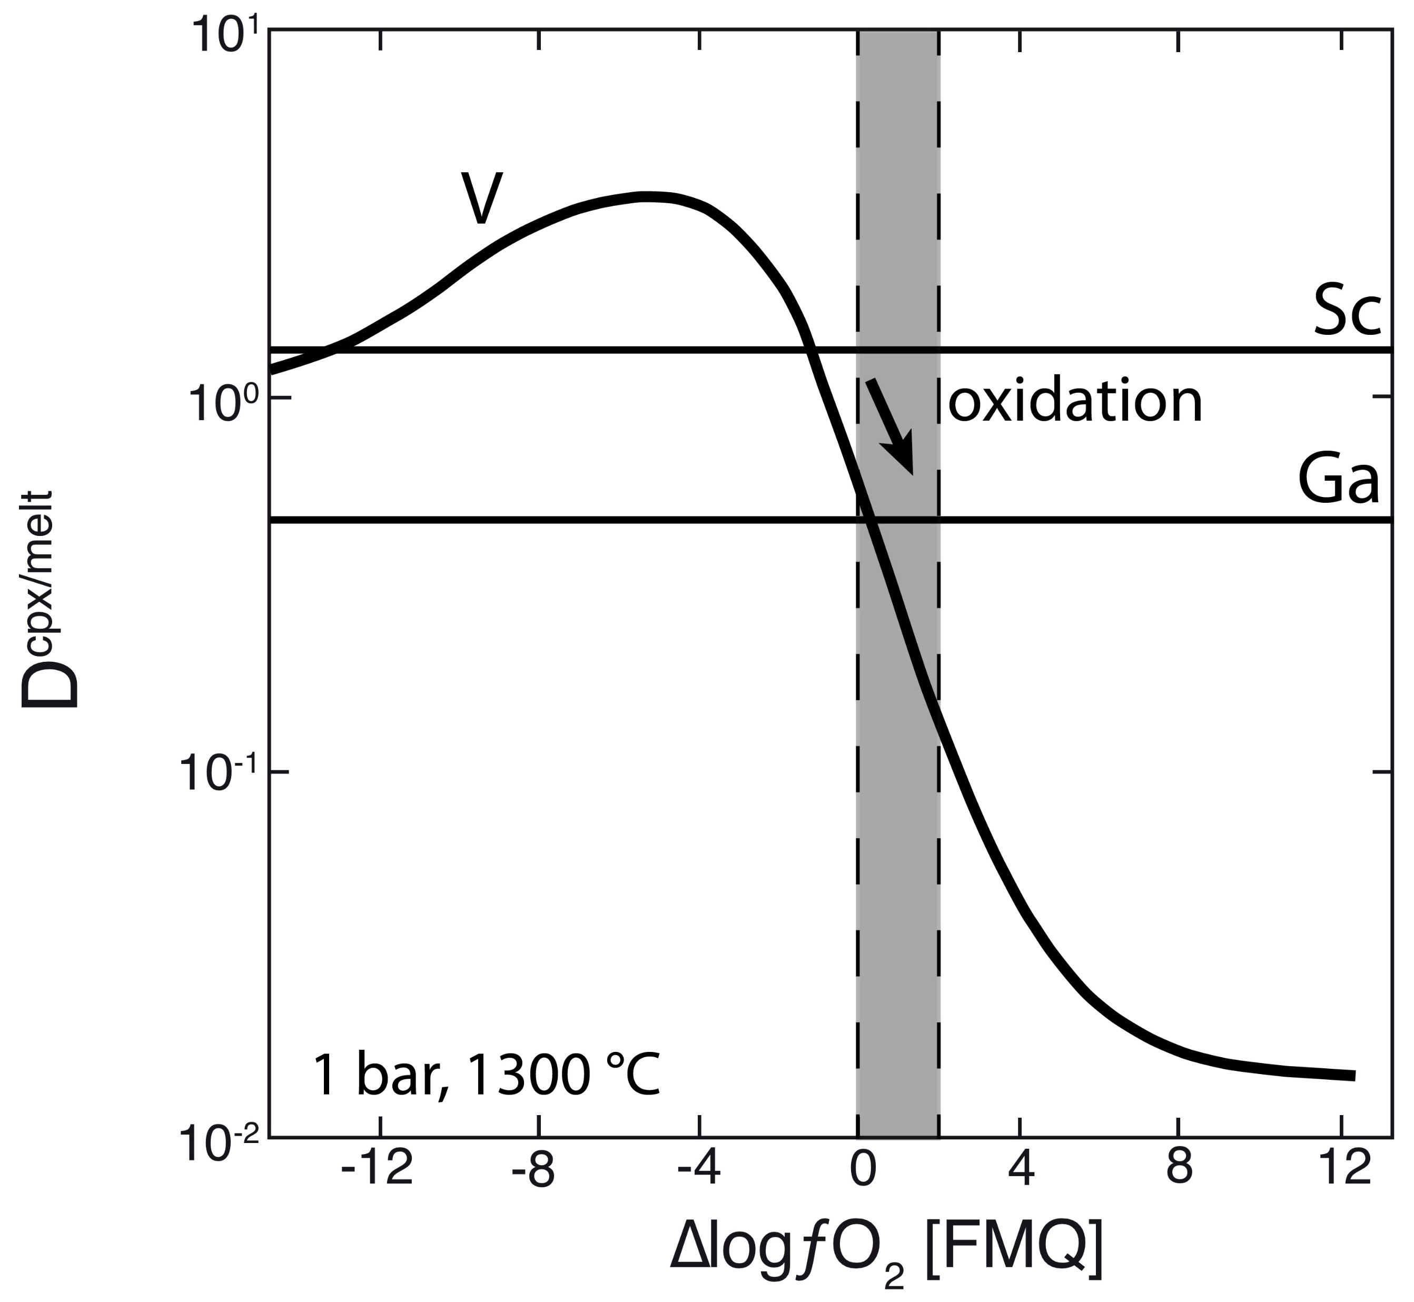
Woodland et al.
Influence of metasomatism on vanadium-based redox proxies for mantle peridotite
Figure 4 Variation in the clinopyroxene/silicate melt partition coefficient with ƒO₂ at 1 bar and 1300 °C, along with Sc and Ga for reference as reported by Mallmann and O’Neill (2009). The arrow emphasises the effect of oxidation on D_{V} in the ƒO₂ range observed in our xenolith suite from the Massif Central (shaded area). See text.
© 2018 The Authors
Published by the European Association of Geochemistry
under Creative Commons License CC BY 4.0
Woodland et al. (2018) Geochem. Persp. Let. 8, 11-16 | doi: 10.7185/geochemlet.1822
Notes:
Figure 4 Variation in the clinopyroxene/silicate melt partition coefficient with ƒO₂ at 1 bar and 1300 °C, along with Sc and Ga for reference as reported by Mallmann and O’Neill (2009). The arrow emphasises the effect of oxidation on D_{V} in the ƒO₂ range observed in our xenolith suite from the Massif Central (shaded area). See text.

