Slide 1
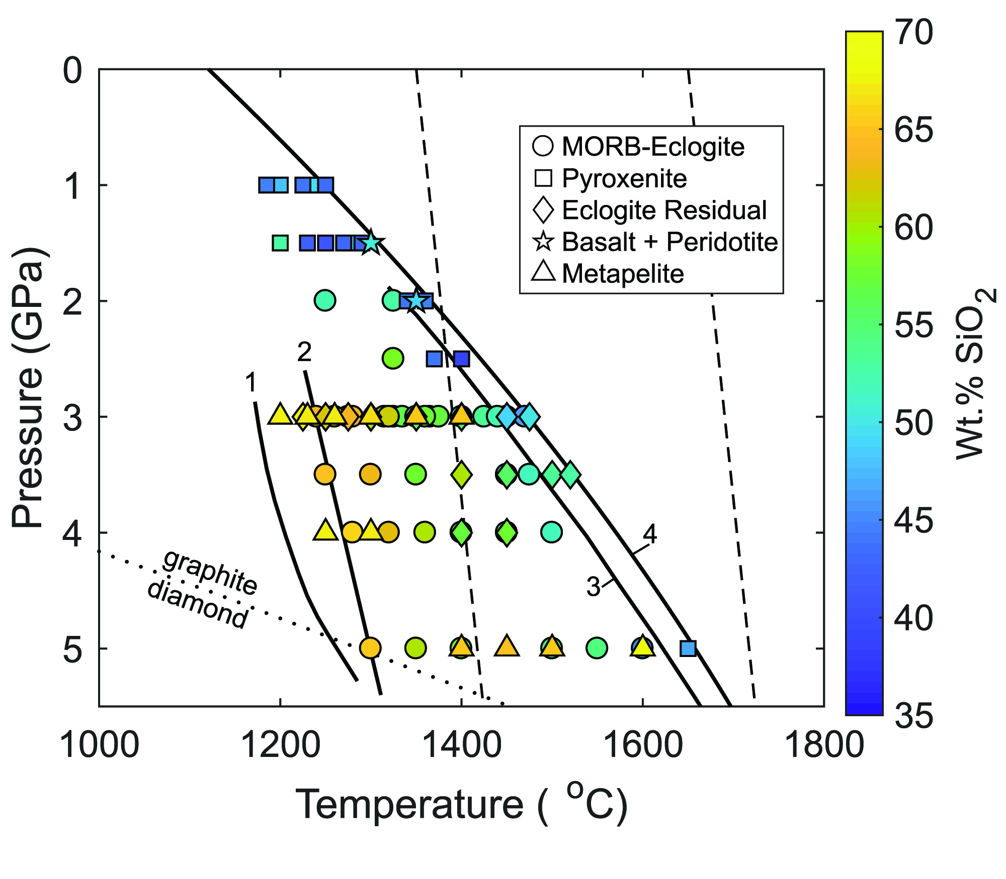
Eguchi and Dasgupta
Redox state of the convective mantle from CO₂-trace element systematics of oceanic basalts
Figure 1 Pressure-temperature conditions for generation of partial melts from crustal/mafic lithologies in the mantle with colour map for wt. % SiO₂ in the melt. Also plotted for reference are mantle adiabats for mantle potential temperatures of 1350 and 1650 °C (dashed lines), solidi of various…
© 2018 The Authors
Published by the European Association of Geochemistry
under Creative Commons License CC BY-NC-ND 4.0
Eguchi and Dasgupta (2018) Geochem. Persp. Let. 8, 17-21 | doi: 10.7185/geochemlet.1823
Notes:
Figure 1 Pressure-temperature conditions for generation of partial melts from crustal/mafic lithologies in the mantle with colour map for wt. % SiO₂ in the melt. Also plotted for reference are mantle adiabats for mantle potential temperatures of 1350 and 1650 °C (dashed lines), solidi of various volatile-free lithologies (1-metapelite, 2-MORB-eclogite, 3-silica-deficient garnet pyroxenite, 4-peridotite, references given in footnote of Table S-3 – the table of compiled experiments), and graphite-diamond transition (dotted line).

