Slide 1
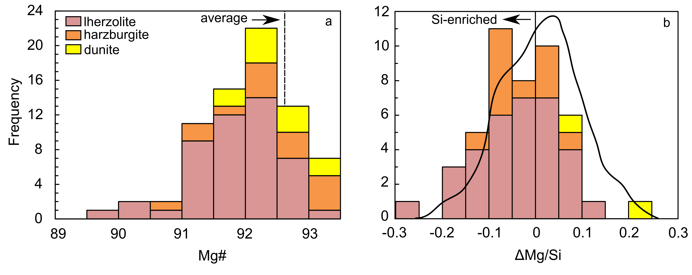
Regier et al.
An oxygen isotope test for the origin of Archean mantle roots
Figure 2 (a) Mg# histogram of olivines in this study. Mg#s are both more and less depleted than the worldwide average for olivine in cratonic peridotite, denoted by the dotted line (Pearson and Wittig, 2008). (b) ΔMg/Si histogram of samples compared to a vertically unscaled probability density function for worldwide cratonic mantle xenoliths from Canil and Lee (2009). Negative ΔMg/Si designates Si-enriched lithologies.
© 2018 The Authors
Published by the European Association of Geochemistry
under Creative Commons License CC BY 4.0
Regier et al. (2018) Geochem. Persp. Let. 9, 6-10 | doi: 10.7185/geochemlet.1830
Notes:
Figure 2 (a) Mg# histogram of olivines in this study. Mg#s are both more and less depleted than the worldwide average for olivine in cratonic peridotite, denoted by the dotted line (Pearson and Wittig, 2008). (b) ΔMg/Si histogram of samples compared to a vertically unscaled probability density function for worldwide cratonic mantle xenoliths from Canil and Lee (2009). Negative ΔMg/Si designates Si-enriched lithologies.

