Slide 1
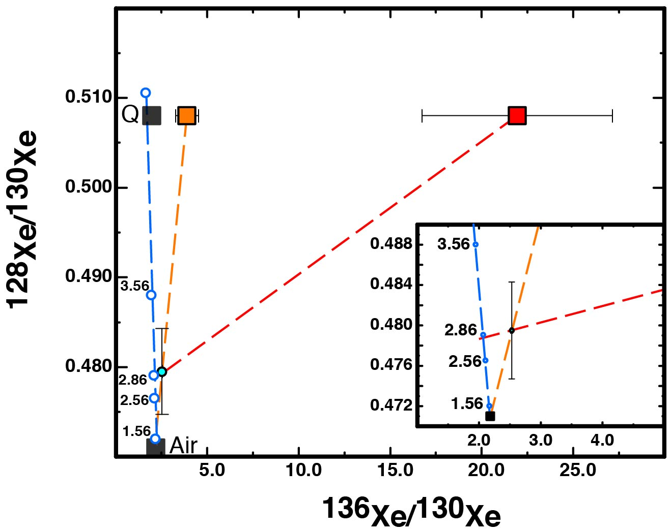
Péron and Moreira
Onset of volatile recycling into the mantle determined by xenon anomalies
Figure 3 Determination of the maximum average age of recycled atmosphere in the mantle. The evolution of the xenon atmospheric composition is represented with the blue dashed line with the numbers indicating the time in Gyr (a power law was considered; Bekaert et al., 2018). The corrected data for shallow atmospheric contamination is shown (light blue dot). The minimum (3.9 ± 0.6 (1σ); orange square) and maximum (21.9 ± 5.2 (1σ); red square) ¹³⁶Xe/¹³⁰Xe ratios in the mantle before recycling of atmospheric xenon are calculated considering mixing with air (orange and red dashed lines) and that the initial ¹²⁸Xe/¹³⁰Xe is chondritic (Phase Q; Busemann et al., 2000). The red line suggests that recycling of atmospheric xenon could have been effective only since 2.8 ± 0.3 (1σ) Gyr ago. Otherwise, unreasonable values of ¹³⁶Xe/¹³⁰Xe ratios are obtained.
© 2018 The Authors
Published by the European Association of Geochemistry
under Creative Commons License CC BY-NC-ND.
Péron and Moreira (2018) Geochem. Persp. Let. 9, 21-25 | doi: 10.7185/geochemlet.1833
Notes:
Figure 3 Determination of the maximum average age of recycled atmosphere in the mantle. The evolution of the xenon atmospheric composition is represented with the blue dashed line with the numbers indicating the time in Gyr (a power law was considered; Bekaert et al., 2018). The corrected data for shallow atmospheric contamination is shown (light blue dot). The minimum (3.9 ± 0.6 (1σ); orange square) and maximum (21.9 ± 5.2 (1σ); red square) ¹³⁶Xe/¹³⁰Xe ratios in the mantle before recycling of atmospheric xenon are calculated considering mixing with air (orange and red dashed lines) and that the initial ¹²⁸Xe/¹³⁰Xe is chondritic (Phase Q; Busemann et al., 2000). The red line suggests that recycling of atmospheric xenon could have been effective only since 2.8 ± 0.3 (1σ) Gyr ago. Otherwise, unreasonable values of ¹³⁶Xe/¹³⁰Xe ratios are obtained.

