Slide 1
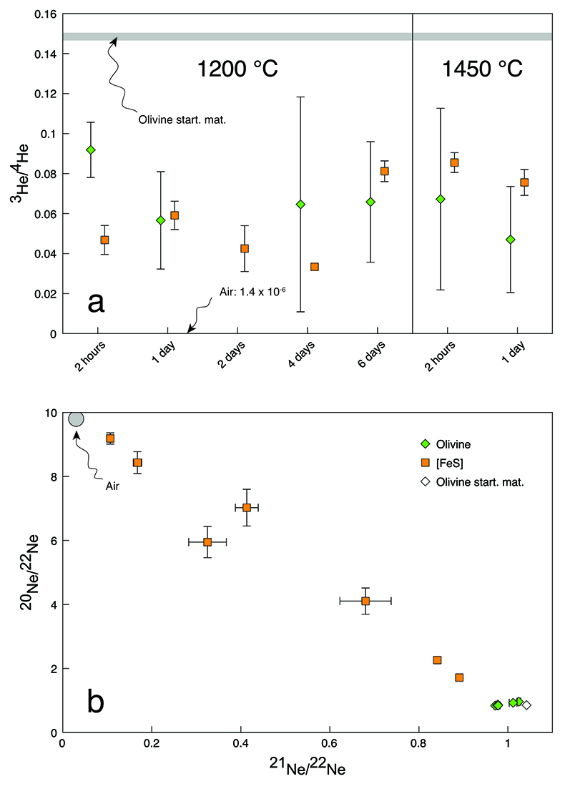
Roth et al.
The primordial He budget of the Earth set by percolative core formation in planetesimals
Figure 1 Helium and Ne isotopic compositions in the run products. Materials contain mixtures of atmospheric and cosmogenic noble gases. (a) Olivine-[FeS] pairs have within analytical uncertainties the same ³He/⁴He ratios except for the experiment conducted at 1200 °C for 2 hours. (b) All olivine-[FeS] pairs have different Ne isotopic compositions. Error bars are 2 sd.
© 2019 The Authors
Published by the European Association of Geochemistry
under Creative Commons License CC BY-NC-ND.
Roth et al. (2019) Geochem. Persp. Let. 9, 26-31 | doi: 10.7185/geochemlet.1901
Notes:
Figure 1 Helium and Ne isotopic compositions in the run products. Materials contain mixtures of atmospheric and cosmogenic noble gases. (a) Olivine-[FeS] pairs have within analytical uncertainties the same ³He/⁴He ratios except for the experiment conducted at 1200 °C for 2 hours. (b) All olivine-[FeS] pairs have different Ne isotopic compositions. Error bars are 2 sd.

