Slide 1
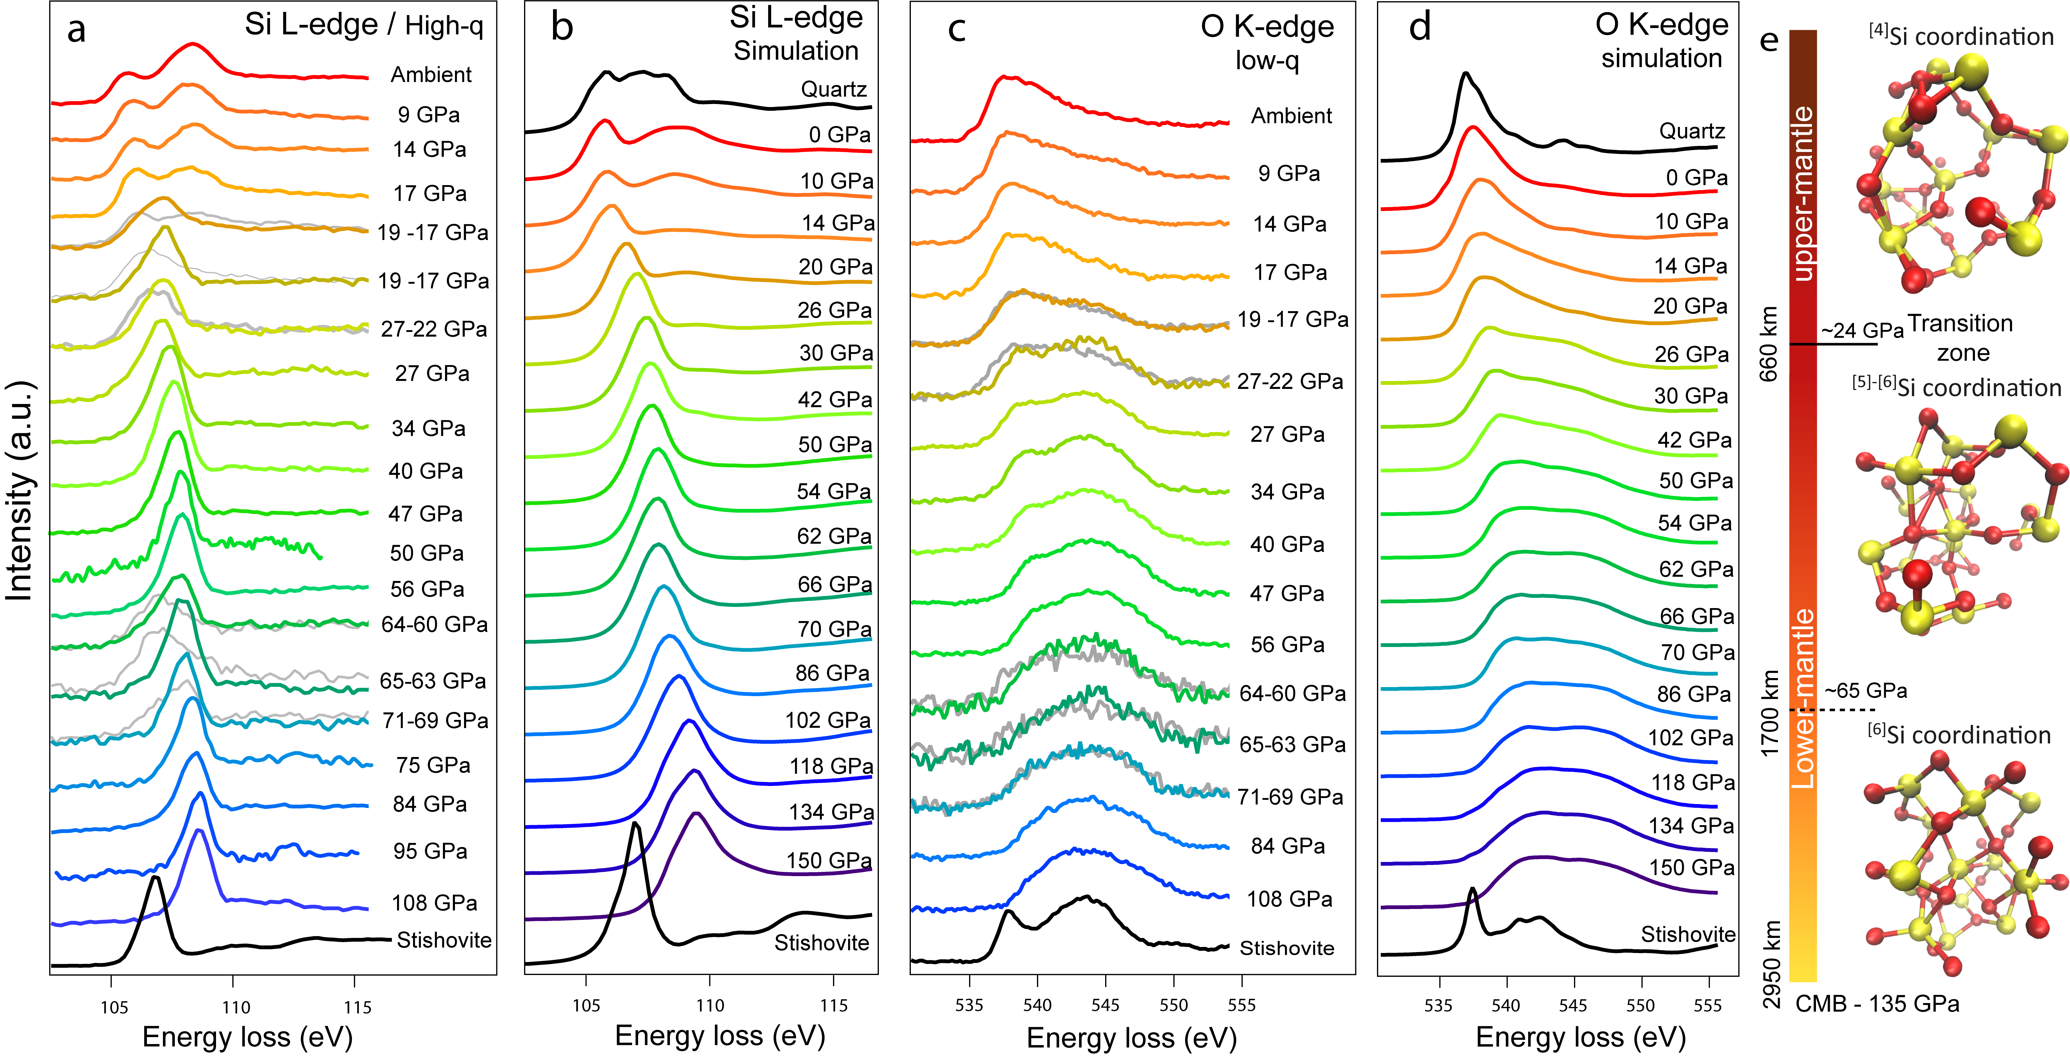
Petitgirard et al.
Magma properties at deep Earth’s conditions from electronic structure of silica
Figure 1 XRS spectra of Si L_{2,3} and O K-edge up to 110 GPa from experiment and calculations. (a,b) Si L_{2,3} spectra. (c,d) O K-edge spectra. Grey spectra in a and c show measurements at the starting pressure indicated on the right, the coloured spectra correspond to the final pressure. (e) Atomic structure of SiO₂ from MD.
© 2019 The Authors
Published by the European Association of Geochemistry
under Creative Commons License CC BY-NC-ND.
Petitgirard et al. (2019) Geochem. Persp. Let. 9, 32-37 | doi: 10.7185/geochemlet.1902
Notes:
Figure 1 XRS spectra of Si L_{2,3} and O K-edge up to 110 GPa from experiment and calculations. (a,b) Si L_{2,3} spectra. (c,d) O K-edge spectra. Grey spectra in a and c show measurements at the starting pressure indicated on the right, the coloured spectra correspond to the final pressure. (e) Atomic structure of SiO₂ from MD.

