Slide 1
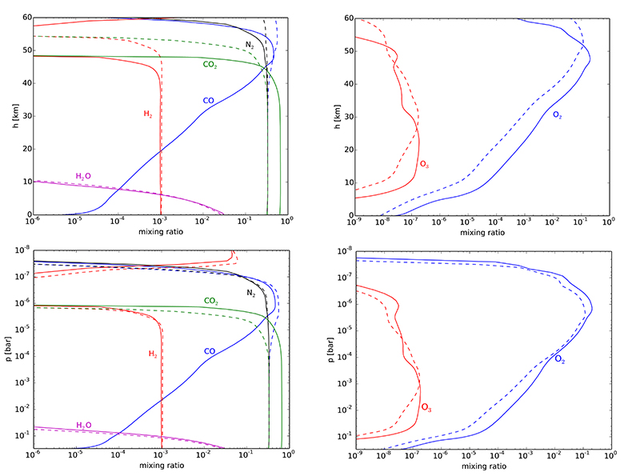
Rimmer et al.
Oxidised micrometeorites as evidence for low atmospheric pressure on the early Earth
Figure 2 Two low pressure model atmospheres of the 3.5 Ga − 2.7 Ga Earth. One model includes a surface mixing ratio of CO of 0.33 (dashed), and the other a surface mixing ratio of 10⁻⁶ (solid). The surface pressure is 0.3 bar for both models. Mixing ratios are shown as a function of atmospheric height, h (km; top two figures) and pressure (bar; bottom two figures).
© 2019 The Authors
Published by the European Association of Geochemistry
under Creative Commons License CC BY-NC-ND.
Rimmer et al. (2019) Geochem. Persp. Let. 9, 38-42 | doi: 10.7185/geochemlet.1903
Notes:
Figure 2 Two low pressure model atmospheres of the 3.5 Ga − 2.7 Ga Earth. One model includes a surface mixing ratio of CO of 0.33 (dashed), and the other a surface mixing ratio of 10⁻⁶ (solid). The surface pressure is 0.3 bar for both models. Mixing ratios are shown as a function of atmospheric height, h (km; top two figures) and pressure (bar; bottom two figures).

