Slide 1
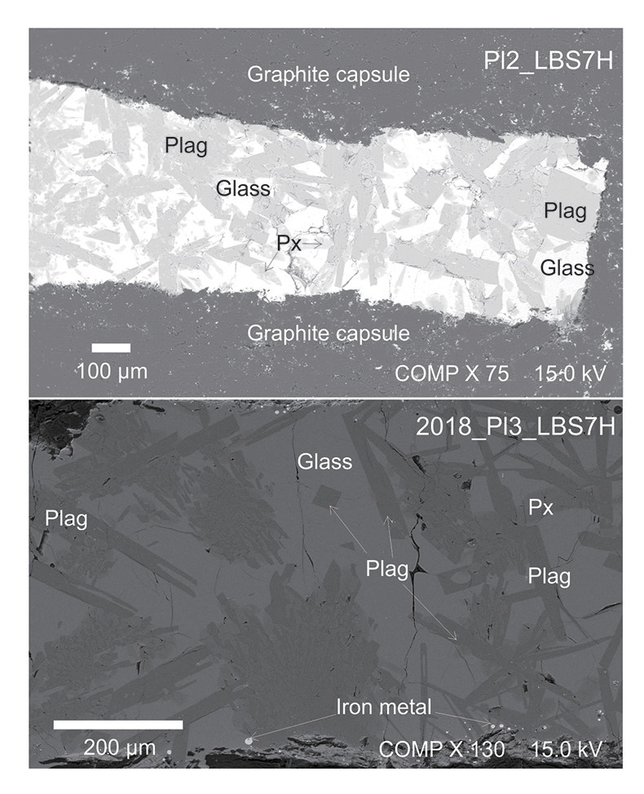
Lin et al.
A lunar hygrometer based on plagioclase-melt partitioning of water
Figure 1 Backscattered electron (BSE) images of representative experimental run products (Pl2_LBS7H, 0.4 GPa – 1200 °С; and 2018_Pl3_LBS7H, 0.3 GPa – 1160 °С). Px = pyroxene; Plag = plagioclase.
© 2019 The Authors
Published by the European Association of Geochemistry
under Creative Commons License CC BY 4.0.
Lin et al. (2019) Geochem. Persp. Let. 10, 14-19 | doi: 10.7185/geochemlet.1908
Notes:
Figure 1 Backscattered electron (BSE) images of representative experimental run products (Pl2_LBS7H, 0.4 GPa – 1200 °С; and 2018_Pl3_LBS7H, 0.3 GPa – 1160 °С). Px = pyroxene; Plag = plagioclase.

