Slide 1
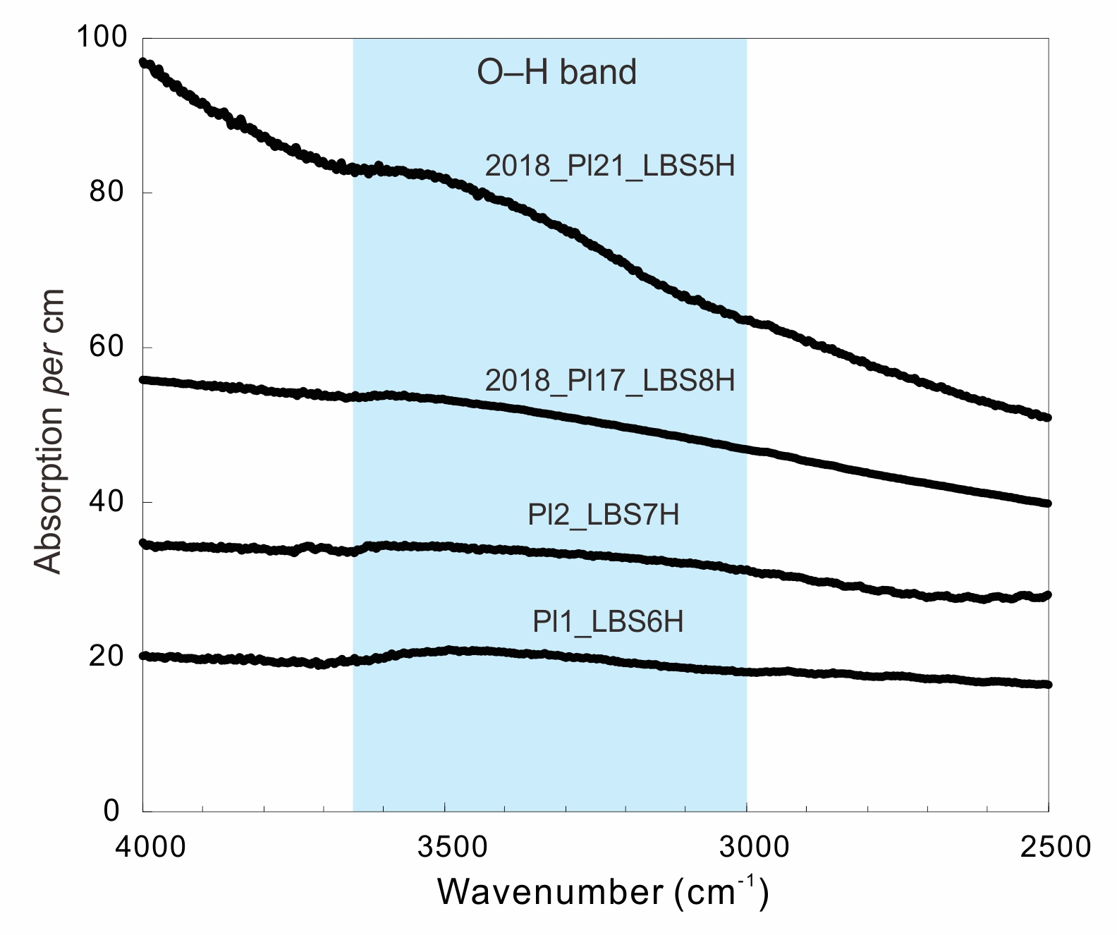
Lin et al.
A lunar hygrometer based on plagioclase-melt partitioning of water
Figure 2 Representative unpolarised infrared spectra of plagioclase, normalised to 1 cm thickness. Spectra are shifted vertically to facilitate comparison.
© 2019 The Authors
Published by the European Association of Geochemistry
under Creative Commons License CC BY 4.0.
Lin et al. (2019) Geochem. Persp. Let. 10, 14-19 | doi: 10.7185/geochemlet.1908
Notes:
Figure 2 Representative unpolarised infrared spectra of plagioclase, normalised to 1 cm thickness. Spectra are shifted vertically to facilitate comparison.

