Slide 1
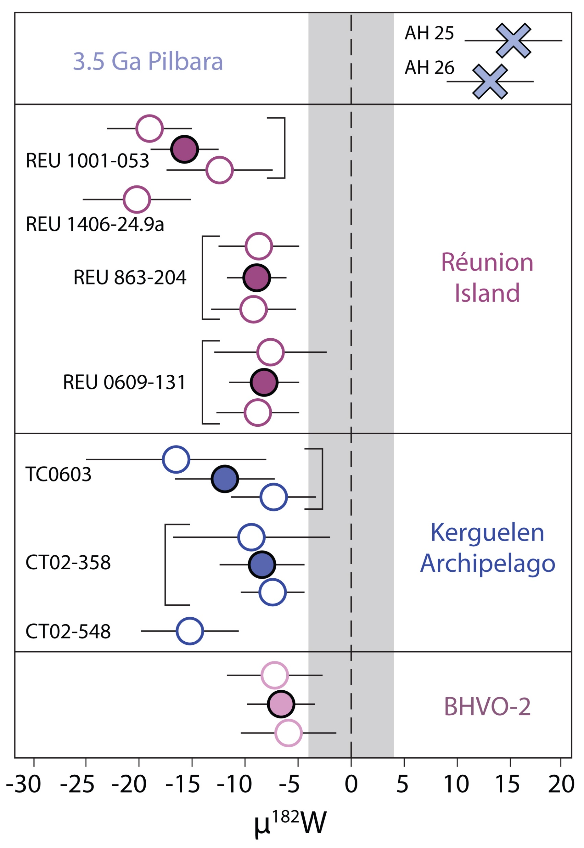
Rizo et al.
¹⁸²W evidence for core-mantle interaction in the source of mantle plumes
Figure 1 ¹⁸²W/¹⁸⁴W data obtained in this study shown as µ¹⁸²W values. Open symbols are individual analysis of samples and filled symbols show the average of the different duplicates. Errors on individual measurements shown are 2 standard error (2 s.e.) and propagated uncertainties are shown for averages. The shaded area represents the reproducibility obtained (2 s.d.) on repeated measurements of the Alfa Aesar W standard.
© 2019 The Authors
Published by the European Association of Geochemistry
under Creative Commons License CC BY-NC-ND.
Rizo et al. (2019) Geochem. Persp. Let. 11, 6-11 | doi: 10.7185/geochemlet.1917
Notes:
Figure 1 ¹⁸²W/¹⁸⁴W data obtained in this study shown as µ¹⁸²W values. Open symbols are individual analysis of samples and filled symbols show the average of the different duplicates. Errors on individual measurements shown are 2 standard error (2 s.e.) and propagated uncertainties are shown for averages. The shaded area represents the reproducibility obtained (2 s.d.) on repeated measurements of the Alfa Aesar W standard.

