Slide 1
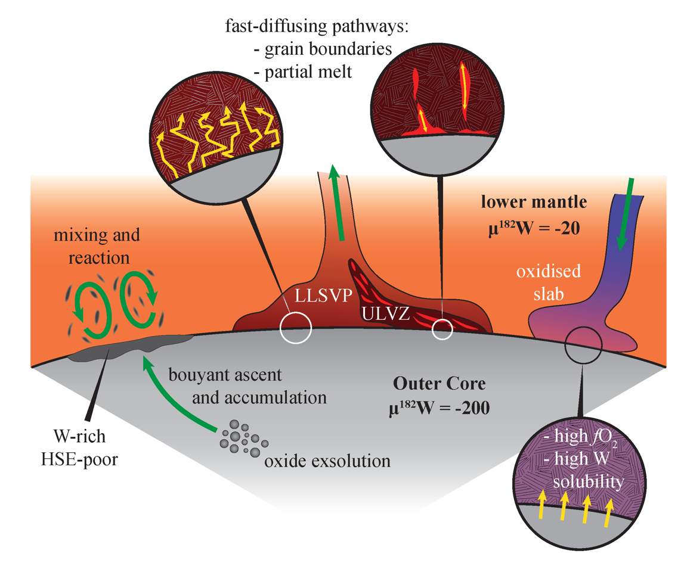
Rizo et al.
¹⁸²W evidence for core-mantle interaction in the source of mantle plumes
Figure 3 Schematic cartoon showing possible processes for core-mantle chemical interaction.
© 2019 The Authors
Published by the European Association of Geochemistry
under Creative Commons License CC BY-NC-ND.
Rizo et al. (2019) Geochem. Persp. Let. 11, 6-11 | doi: 10.7185/geochemlet.1917
Notes:
Figure 3 Schematic cartoon showing possible processes for core-mantle chemical interaction.

