Slide 1
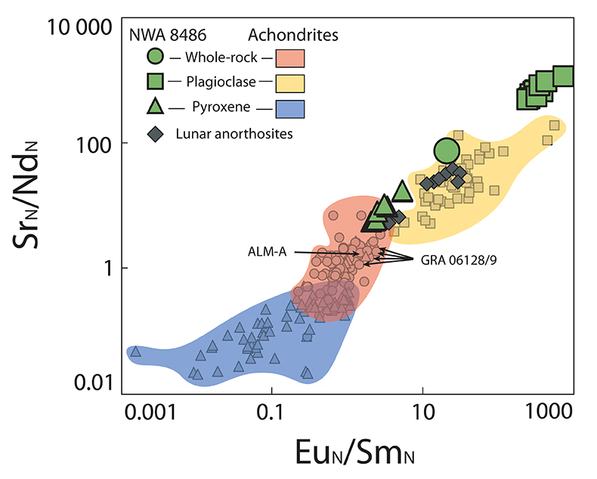
Frossard et al.
Evidence for anorthositic crust formed on an inner solar system planetesimal
Figure 2 Eu/Sm and Sr/Nd ratios of achondrites and NWA 8486 normalised to CI chondrites (Anders and Grevesse, 1989). Overlap between the different fields is due to whole rocks mainly composed of pyroxene or plagioclase (e.g., aubrites, ureilites, lunar anorthosites). For each field group, NWA 8486 exhibits higher Eu_{N}/Sm_{N} and Sr_{N}/Nd_{N}. Only lunar anorthosites are similar to NWA 8486 whole rock, but they contain much more plagioclase than NWA 8486. See Supplementary Information for data sources.
© 2019 The Authors
Published by the European Association of Geochemistry
under Creative Commons License CC BY-NC-ND.
Frossard et al. (2019) Geochem. Persp. Let. 11, 28-32 | doi: 10.7185/geochemlet.1921
Notes:
Figure 2 Eu/Sm and Sr/Nd ratios of achondrites and NWA 8486 normalised to CI chondrites (Anders and Grevesse, 1989). Overlap between the different fields is due to whole rocks mainly composed of pyroxene or plagioclase (e.g., aubrites, ureilites, lunar anorthosites). For each field group, NWA 8486 exhibits higher Eu_{N}/Sm_{N} and Sr_{N}/Nd_{N}. Only lunar anorthosites are similar to NWA 8486 whole rock, but they contain much more plagioclase than NWA 8486. See Supplementary Information for data sources.

