Slide 1
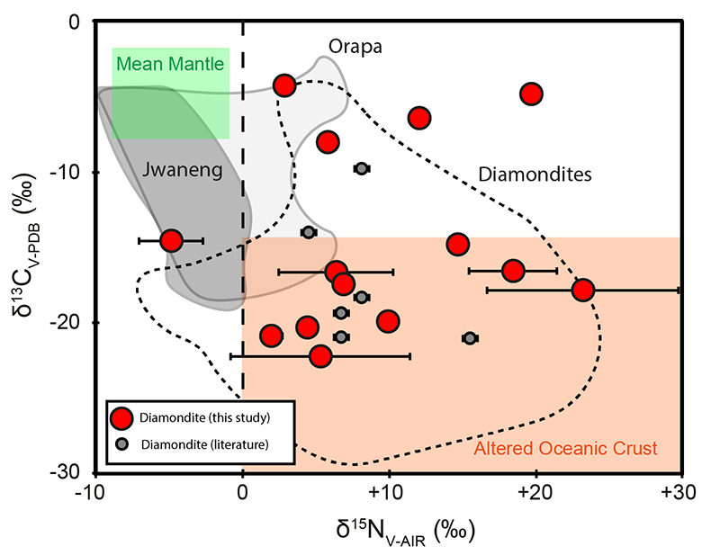
Mikhail et al.
A secretive mechanical exchange between mantle and crustal volatiles revealed by helium isotopes in ¹³C-depleted diamonds
Figure 1 New C and N isotope data for southern African diamondites (red circles) and literature data (grey circles: Gautheron et al., 2005; Burgess et al., 1998) Fields are shown for other diamondites (Mikhail et al., 2013), eclogitic monocrystalline diamonds from Jwaneng (Cartigny et al., 1998) and Orapa (Cartigny et al., 1999), the mean mantle and altered oceanic crustal material (Cartigny et al., 2014).
© 2019 The Authors
Published by the European Association of Geochemistry
under Creative Commons License CC BY-NC-ND.
Mikhail et al. (2019) Geochem. Persp. Let. 11, 39-43 | doi: 10.7185/geochemlet.1923
Notes:
Figure 1 New C and N isotope data for southern African diamondites (red circles) and literature data (grey circles: Gautheron et al., 2005; Burgess et al., 1998) Fields are shown for other diamondites (Mikhail et al., 2013), eclogitic monocrystalline diamonds from Jwaneng (Cartigny et al., 1998) and Orapa (Cartigny et al., 1999), the mean mantle and altered oceanic crustal material (Cartigny et al., 2014).

