Slide 1
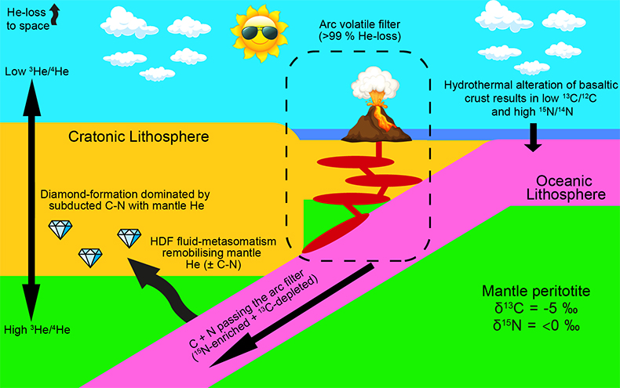
Mikhail et al.
A secretive mechanical exchange between mantle and crustal volatiles revealed by helium isotopes in ¹³C-depleted diamonds
Figure 3 Cartoon illustrating the model discussed in the text. Not to scale.
© 2019 The Authors
Published by the European Association of Geochemistry
under Creative Commons License CC BY-NC-ND.
Mikhail et al. (2019) Geochem. Persp. Let. 11, 39-43 | doi: 10.7185/geochemlet.1923
Notes:
Figure 3 Cartoon illustrating the model discussed in the text. Not to scale.

