Slide 1
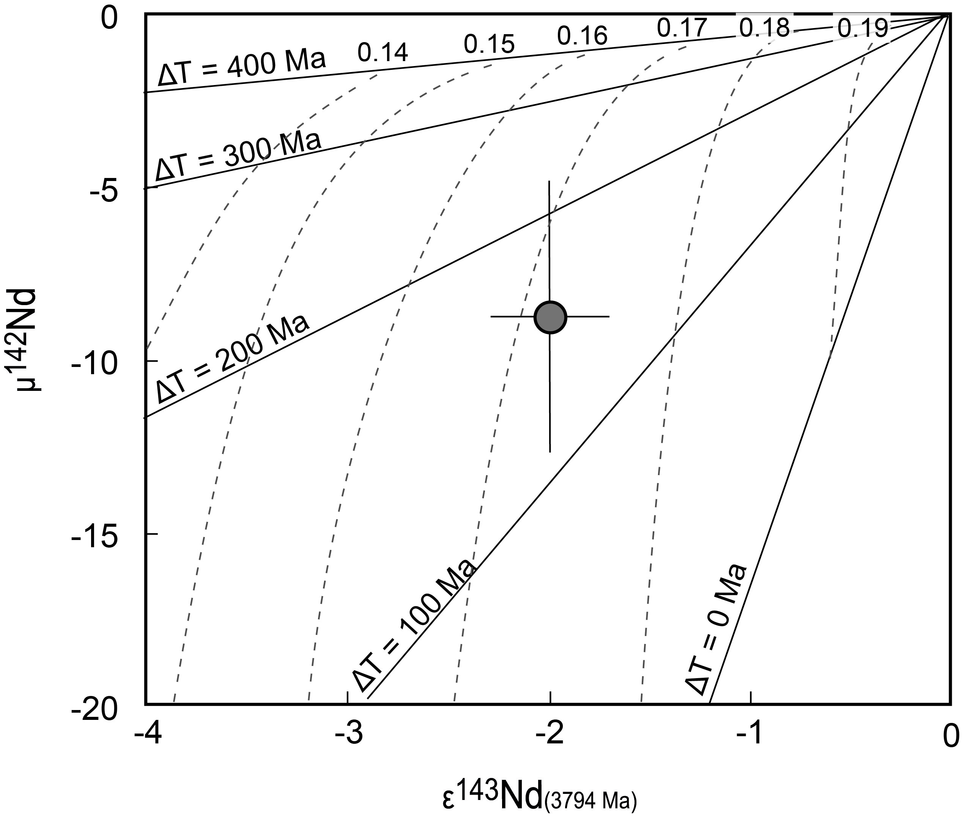
Guitreau et al.
Hadean protocrust reworking at the origin of the Archean Napier Complex (Antarctica)
Figure 3 Coupled ¹⁴⁶Sm-¹⁴²Nd and ¹⁴⁷Sm-¹⁴³Nd plot showing the data obtained for Mount Sones orthogneiss (78285007) as well as the coupled evolution of μ¹⁴²Nd and ɛ¹⁴³Nd signatures for lithologies with various Sm/Nd ratios. Solid lines represent isochrons with respective ages indicated by ∆T, which means time after 4568 Ma. Dashed curves correspond to the coupled evolution of μ¹⁴²Nd and ɛ¹⁴³Nd signatures according to specific ¹⁴⁷Sm/¹⁴⁴Nd values that are indicated next to the curves (i.e. 0.14-0.19). Mount Sones μ¹⁴²Nd and ɛ¹⁴³Nd isotope signatures are …
© 2019 The Authors
Published by the European Association of Geochemistry
under Creative Commons License CC BY-NC-ND.
Guitreau et al. (2019) Geochem. Persp. Let. 12, 7-11 | doi: 10.7185/geochemlet.1927
Notes:
Figure 3 Coupled ¹⁴⁶Sm-¹⁴²Nd and ¹⁴⁷Sm-¹⁴³Nd plot showing the data obtained for Mount Sones orthogneiss (78285007) as well as the coupled evolution of μ¹⁴²Nd and ɛ¹⁴³Nd signatures for lithologies with various Sm/Nd ratios. Solid lines represent isochrons with respective ages indicated by ∆T, which means time after 4568 Ma. Dashed curves correspond to the coupled evolution of μ¹⁴²Nd and ɛ¹⁴³Nd signatures according to specific ¹⁴⁷Sm/¹⁴⁴Nd values that are indicated next to the curves (i.e. 0.14-0.19). Mount Sones μ¹⁴²Nd and ɛ¹⁴³Nd isotope signatures are compatible with a mafic source (¹⁴⁷Sm/¹⁴⁴Nd = 0.17) that separated from a reservoir with a chondritic REE pattern ~150 Myr after Solar System formation (i.e. ~4400 Myr ago). Here we assume that the initial ¹⁴²Nd/¹⁴⁴Nd ratio of the Earth is similar to that measured in the modern terrestrial mantle (μ¹⁴²Nd = 0), which is equivalent to the signature measured in enstatite chondrites from the EL sub-group (Boyet et al., 2018).

