Slide 1
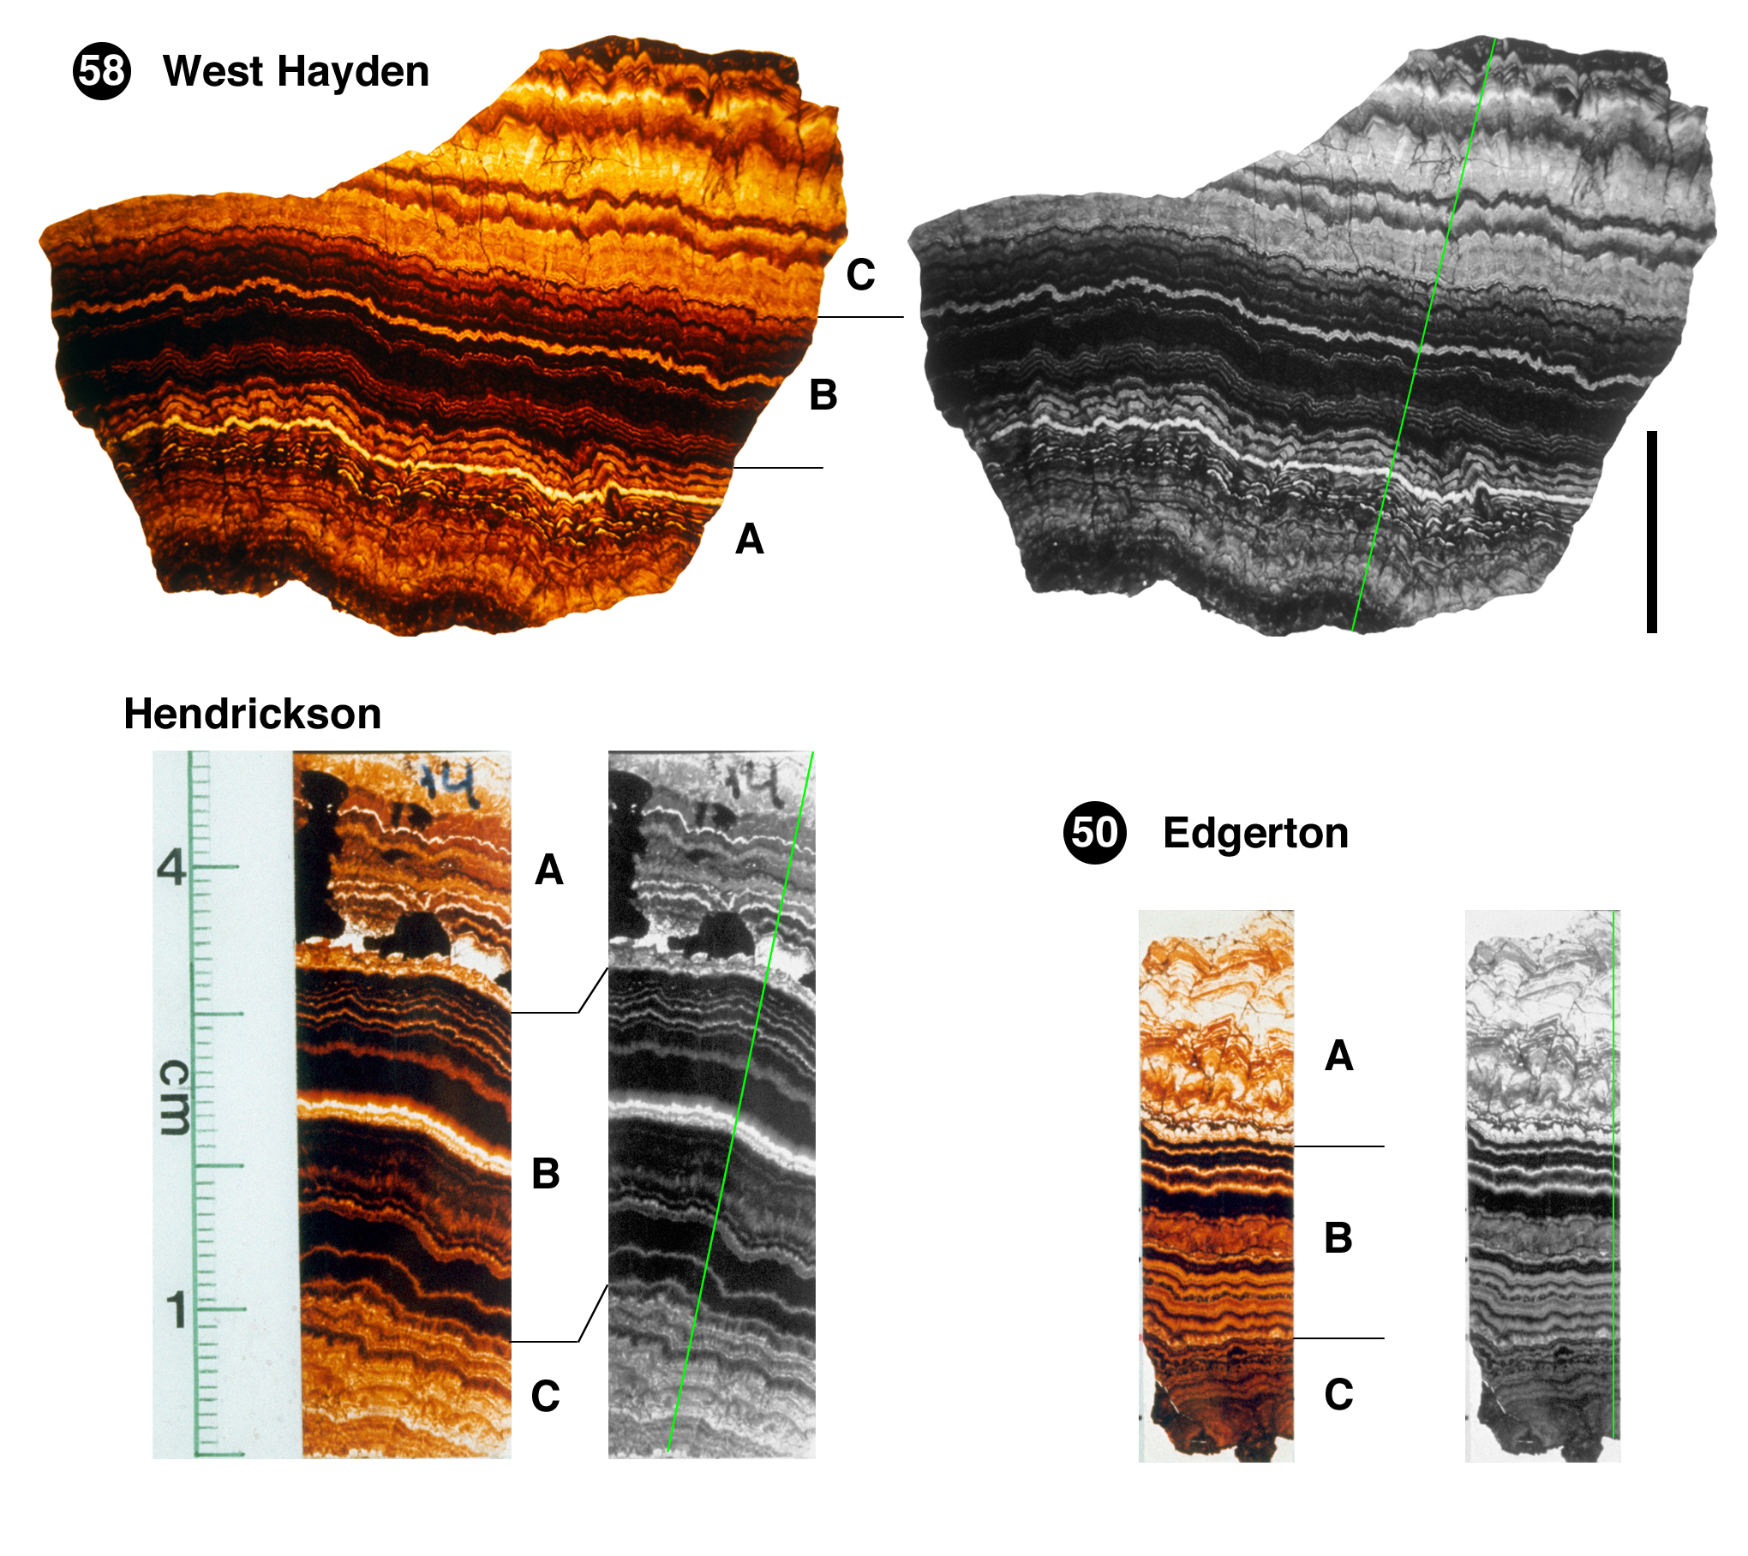
Li and Barnes
Orbitally forced sphalerite growth in the Upper Mississippi Valley District
Figure 1 Sphalerite samples from West Hayden, Hendrickson, and Edgerton orebodies. Coloured photographs are shown with three growth stages of A (early), B (middle), and C (late) following McLimans et al. (1980). The rock colour grayscale profile was measured along the traverse (green) in grayscale images. Length of the black bar is 2 cm. Samples from Hendrickson and Edgerton orebodies share the same scale.
© 2019 The Authors
Published by the European Association of Geochemistry
under Creative Commons License CC BY-NC-ND.
Li and Barnes (2019) Geochem. Persp. Let. 12, 18-22 | doi: 10.7185/geochemlet.1929
Notes:
Figure 1 Sphalerite samples from West Hayden, Hendrickson, and Edgerton orebodies. Coloured photographs are shown with three growth stages of A (early), B (middle), and C (late) following McLimans et al. (1980). The rock colour grayscale profile was measured along the traverse (green) in grayscale images. Length of the black bar is 2 cm. Samples from Hendrickson and Edgerton orebodies share the same scale.

