Slide 1
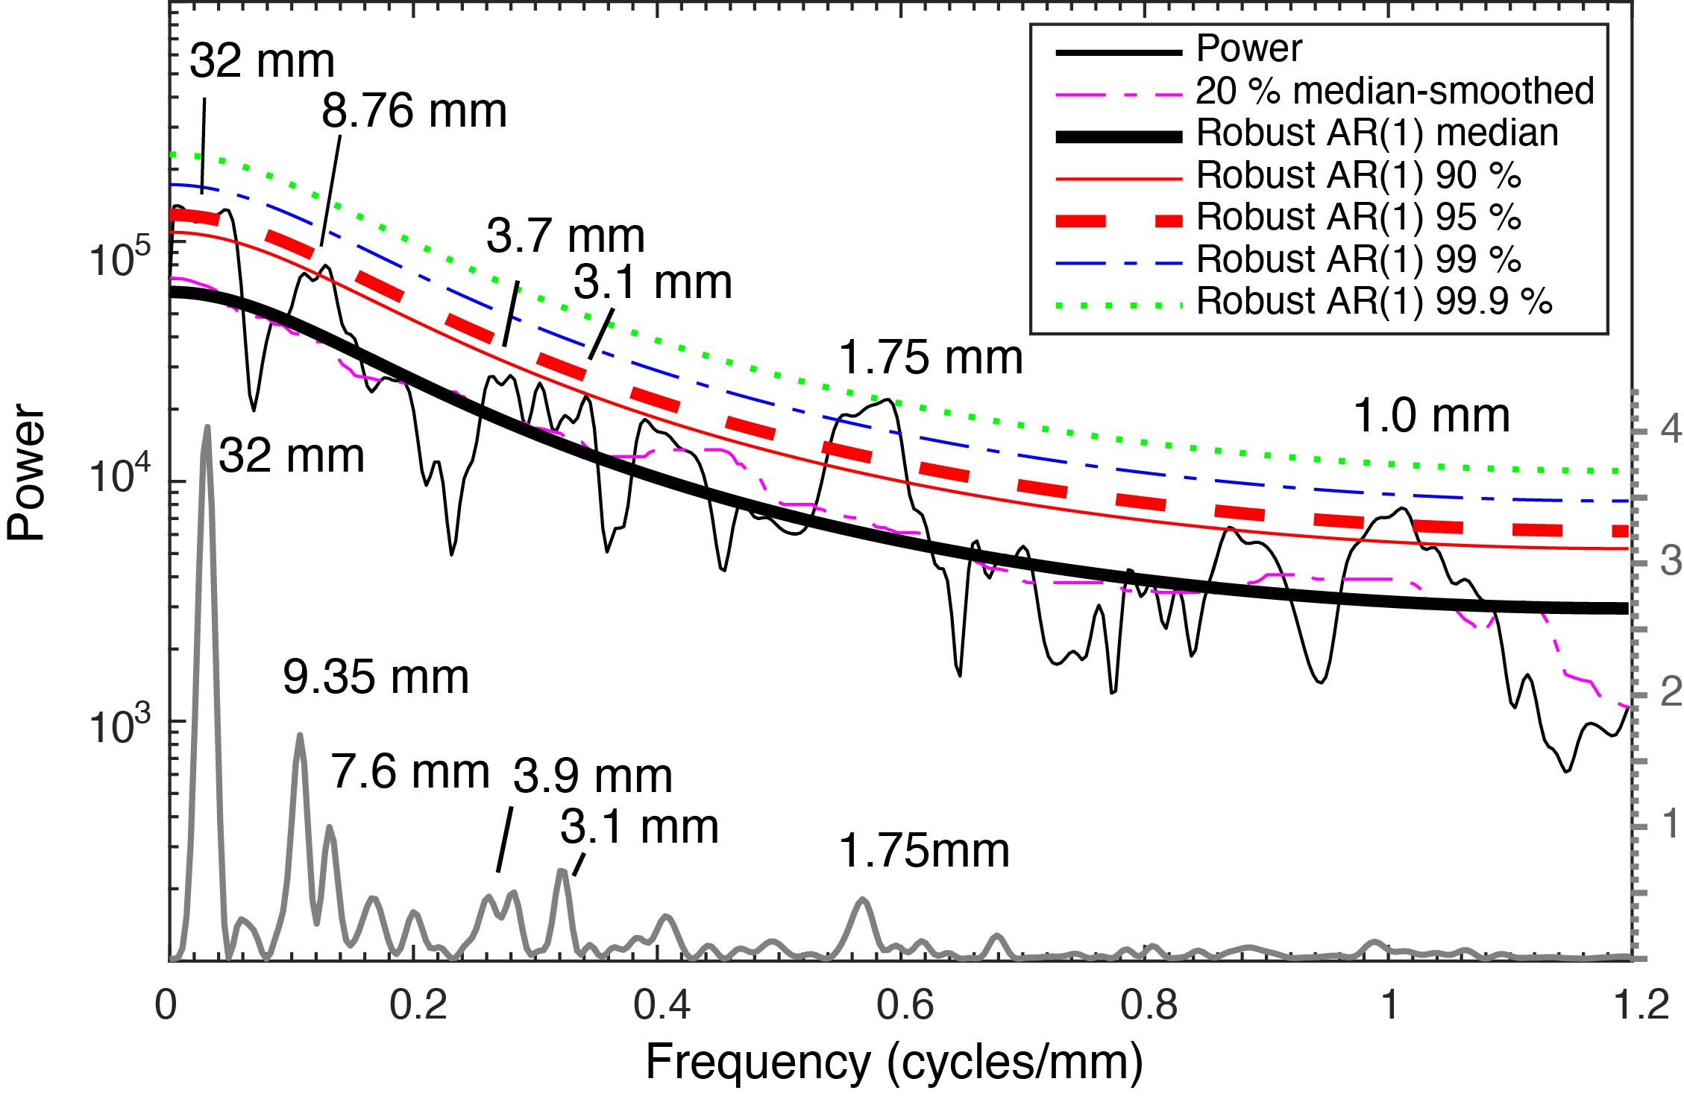
Li and Barnes
Orbitally forced sphalerite growth in the Upper Mississippi Valley District
Figure 3 2π MTM power spectrum (thin black) and periodogram (gray) of the grayscale series shown with robust red-noise models. The red-noise fit to the spectrum is based on the best fit to the log power of the 20 % median smoothed spectrum (dashed pink). The 90 % (solid red), 95 % (dashed red), 99 % (blue dashed line), and 99.9 % (dot green) confidence limits are shown. Cycle wavelengths are also marked.
© 2019 The Authors
Published by the European Association of Geochemistry
under Creative Commons License CC BY-NC-ND.
Li and Barnes (2019) Geochem. Persp. Let. 12, 18-22 | doi: 10.7185/geochemlet.1929
Notes:
Figure 3 2π MTM power spectrum (thin black) and periodogram (gray) of the grayscale series shown with robust red-noise models. The red-noise fit to the spectrum is based on the best fit to the log power of the 20 % median smoothed spectrum (dashed pink). The 90 % (solid red), 95 % (dashed red), 99 % (blue dashed line), and 99.9 % (dot green) confidence limits are shown. Cycle wavelengths are also marked.

