Slide 1
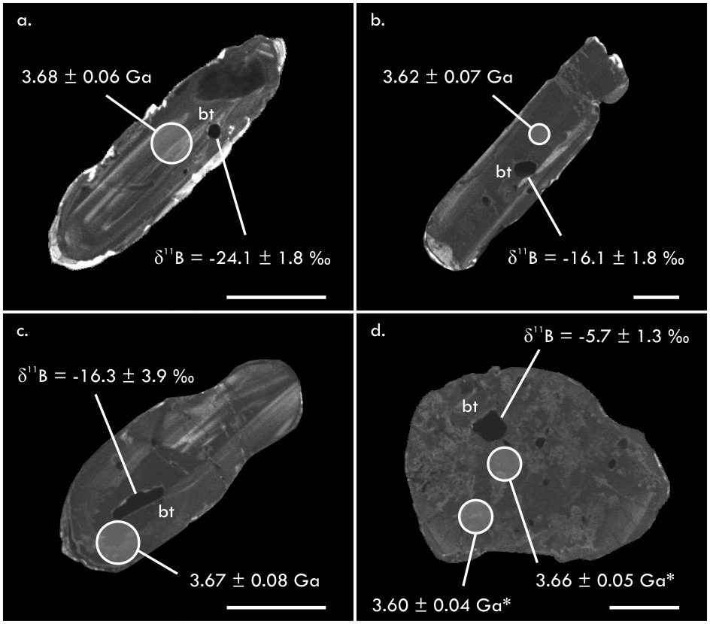
Smit et al.
Formation of Archean continental crust constrained by boron isotopes
Figure 4 Cathodoluminescence images of zircon from the Acasta Gneiss Complex samples showing analysed biotite inclusions. The δ¹¹B values of biotite (in ‰) and the ²⁰⁷Pb/²⁰⁶Pb age of the surrounding zircon (minimum inclusion age) are shown. Analytical spots are to scale; asterisk marks >10 % discordance; scale bars are 50 μm. Data are in Table S-9.
© 2019 The Authors
Published by the European Association of Geochemistry
under Creative Commons License CC BY-NC-ND.
Li and Barnes (2019) Geochem. Persp. Let. 12, 23-26 | doi: 10.7185/geochemlet.1930
Notes:
Figure 4 Cathodoluminescence images of zircon from the Acasta Gneiss Complex samples showing analysed biotite inclusions. The δ¹¹B values of biotite (in ‰) and the ²⁰⁷Pb/²⁰⁶Pb age of the surrounding zircon (minimum inclusion age) are shown. Analytical spots are to scale; asterisk marks >10 % discordance; scale bars are 50 μm. Data are in Table S-9.

